Slide 1
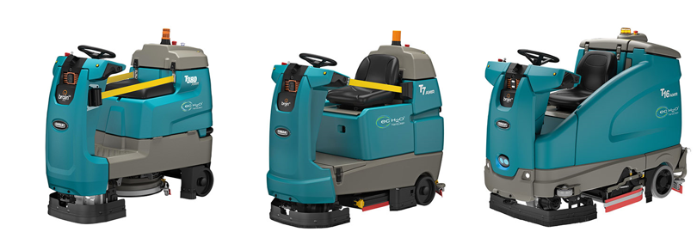
Product Application and Solution Guide
AMR Lithium-ion
POWER SOURCE

Slide 2
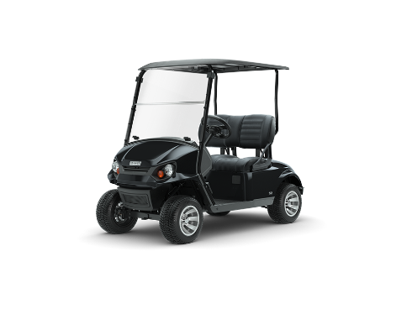
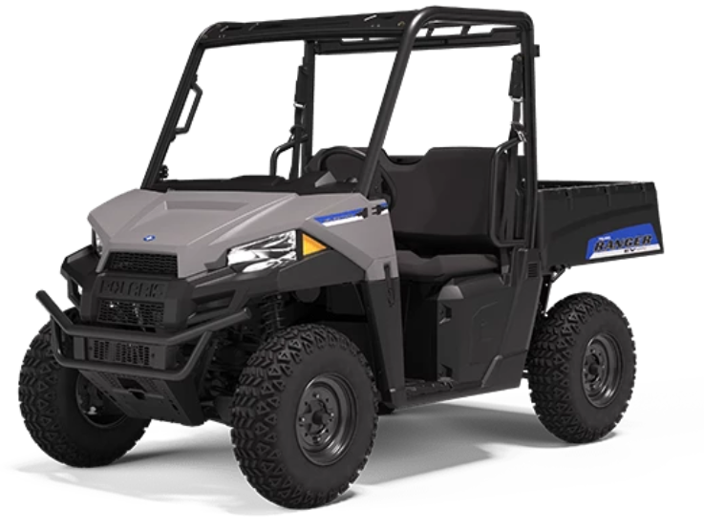
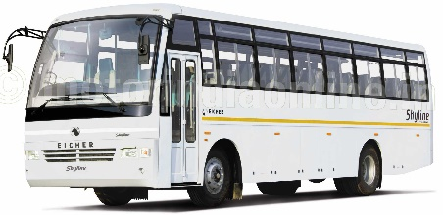
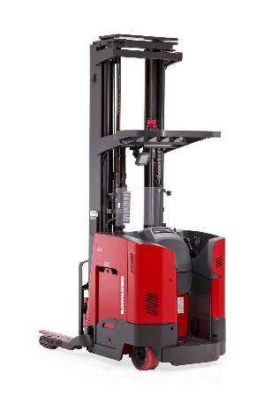
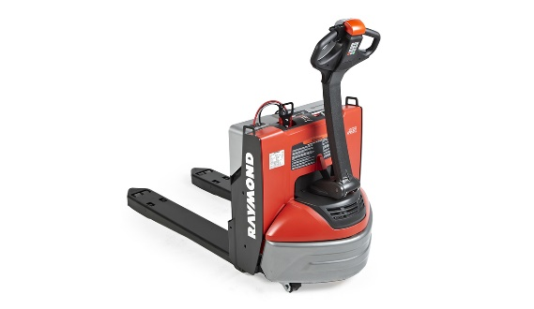
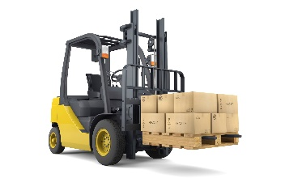
Why Are We Investing in Lithium-ion?
Growing customer acceptance
Growing adoption for material handling equipment
Notes:
So why are we launching lithium-ion at this time? First there is growing acceptance for the technology. Lithium-ion is growing in the automotive industry with hybrid's and Tesla leading the way. More and more golf carts are making the switch to lithium-ion to reduce its labor and maintenance costs and it allows longer runtime. Off-road vehicles are adopting the technology as well for some of the same reasons. To lower costs and improve environmental impact, public transportation is beginning to convert their busses to lithium. So lithium-ion is gaining a foothold in many parts of our society.
Getting a little closer to home, lithium-ion is expected to grow over 15% per year through to 2021 in material handling industry when 1 in 5 machines like forklifts and pallet jacks will have lithium-ion batteries. (Site source)
The bottom line is there is growing acceptance of the technology and Tennant is gearing up for it.

Slide 3
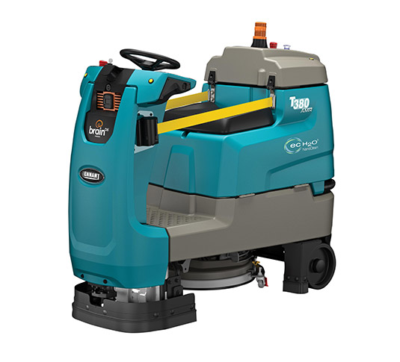
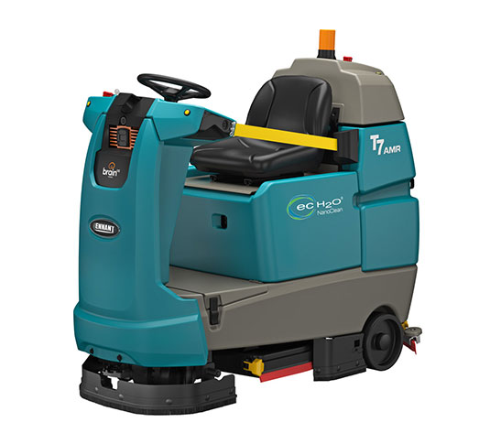
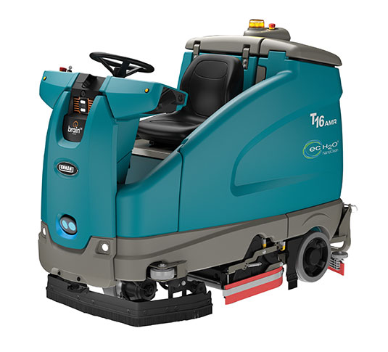
AMR Lithium-ion Battery Offering
T380AMR
24 volt 180AH (4.6 kWh)
T7AMR
24 volt
360AH (9.2 kWh)
T16 AMR
36 volt
320AH (11.5 kWh)
Long life, maintenance-free, longer runtimes, opportunity chargeable
Contact your Tennant sales representative for availability
Notes:
Tennant is happy to announce its new line up of lithium-ion batteries. The machines that will have Tennant’s lithium-ion battery are the T380AMR, T7AMR and T16AMR.

Slide 4
Lithium-ion Benefits
vs LPG/Diesel Fuel
vs Traditional Batteries
Provides a positive customer ROI
Delivers an excellent value
Eliminates Fuel
Costs
Reduced Safety Hazards
2,000+ Charge Cycles
Longer Runtime
Faster Charging
Opportunity Charging
Reduced Operational Costs
Improved Indoor Air Quality
Reduced Safety Hazards
Maintenance
Free
Lower Electricity Costs
Intelligence
Improved Uptime: Full-shift cleaning without fuel tank filling/changing
Enhanced Safety: Zero fuel emissions, no flammable fuels on-site & lower dBa sound levels
Lower Costs: Zero engine maintenance, fuel, fuel storage, shop supply costs & significantly reduced training costs
Sustainable Cleaning: Eliminates reliance on non-renewable natural resources
Improved Uptime: Long life, faster charging, longer runtimes, & opportunity charging to minimize idle time
Enhanced Safety: No risk of encountering battery acid & no harmful gases produced during charging
Low Operating Costs: No battery replacements, no battery watering, lower charging costs, and minimal training required
Intelligence: Constantly communicates data to machine to optimize safety, performance, productivity, & longevity
Notes:
There are many advantages with it comes to Tennant’s lithium-ion power source.
Advantages Over Fuel
Eliminates costly fuel usage
Eliminates fuels storage processes and related costs
Removes flammable fuels from the facility
Lithium-ion has no emissions
Lithium-ion machines operate at a much lower dBa
Advantages Over Traditional Batteries
Extremely longer life – 2000 charge cycles
Lithium-ion is more energy dense so more runtime is possible and can eliminate battery swaps
It is a maintenance-free system that does not need watering and it can be opportunity charged without reducing the battery’s life
It is more efficient to charge so charging costs are lower and it can be charged quickly
There is no acid to worry about

Slide 5
Lithium-ion Benefits
Zero Maintenance - No more battery watering, engine maintenance or worries.
Maximized Productivity - Optimize equipment uptime by spending more time cleaning and less time dealing with your power source.
Long Battery Life - 2,000+ charge cycles means fewer battery replacements.
Simplified Operations - No need to train or learn complicated charging processes because opportunity charging does not reduce battery life.
Safer Facilities - Improve indoor air quality and reduce the risk of accidents by eliminating exposure to flammable fuels and battery acid.

Slide 6
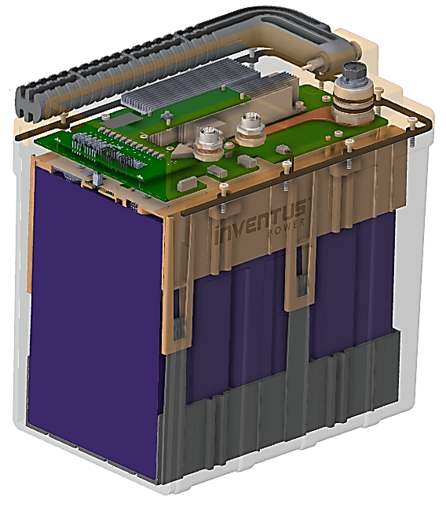
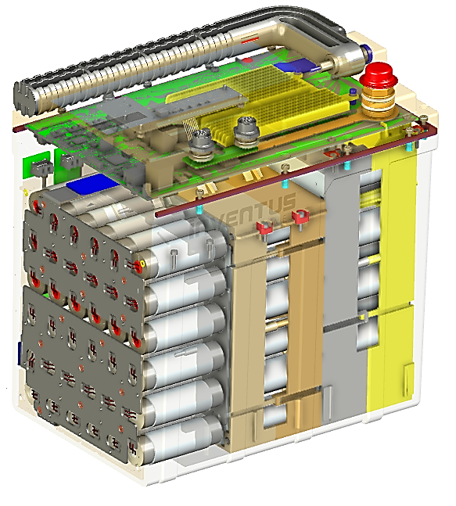
BATTERY ANATOMY
24V Battery
Battery SoC (State of Charge) Indicator State of charge / discharge and fault status
Signal Connector Intelligent communication between the battery packs and machine
Battery Management System (BMS) Intelligent communication, protection, and diagnostics to the machine for optimal performance and long life
O-ring Seal IP65 rating to protect the battery from dust and water exposure
Lithium-Ion Cells High performance, reliable & safe
24V - Iron Phosphate
36V - Nickel Cobalt Aluminum
More energy dense than iron phosphate
30% more energy & peak power to support performance needs of larger equipment
1
2
3
4
5
36V Battery
1
2
3
4
5

Slide 7
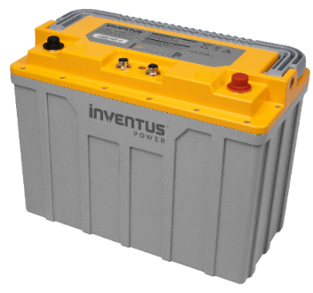
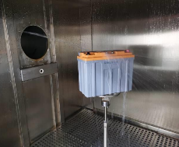
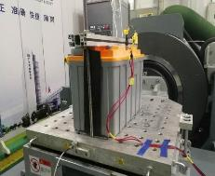
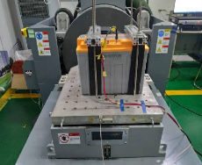
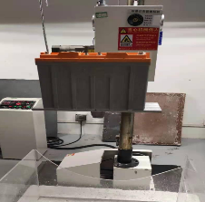
Lithium-ion Battery Safety
Rugged battery design to withstand harsh operating conditions
Cell modules certified to UL 2580 / IEC 60068-2-27 standards for drop and vibration means the battery is rugged and can withstand most cleaning environments
Meets IP65 standards providing assurance that the battery is protected against moisture, dust and dirt
Patented Battery Management Systems (BMS) monitors battery health of each battery block to ensure safe operation of the battery and machine
Shutdown mode functionality to extend battery shelf life
IEC 60529-2013
IEC 60068-2-27
UL2580 Shock/Vibration
UNDOT (UN38.3)
Worry-free Protection
Notes:
The components of a battery pack are the battery management system (BMS) the cell module and cabling.
Cell Module
The modules hold 240 lithium-ion cells. The number of cell modules determines the over all power of the battery pack
Battery Management System (BMS) And Cabling
The BMS is the “brains” of the system and the cabling allows constant communications in real-time between the battery and the machine. It delivers any alerts necessary to the operator and will shut down the machine when necessary to protect the battery, machine and the operator.

Slide 8
Why Inventus Power
Battery Engineering Expertise
Product Support
Proven
Safety
60+ years of expertise with 30+ years lithium-ion experience
300+ engineers worldwide, global applications engineering and On-Demand field support
1 billion+ products safely delivered
Proven
Reliability
Innovative Technology
Agency Approvals
Only top tier lithium cells providing, long-term, reliable performance combined with 100-point Quality Assurance inspection process
Patented technologies for a broad range of applications
In-house test lab certified by UL & TÜV
Quality & innovative solutions backed by expert technical support

Slide 9
Power Source Comparison
Category | Lithium-ion | Thin Plate Pure Lead (TPPL) | Sealed Lead Acid | Wet Lead Acid
Initial Cost | $$$$ | $$$ | $$ | $
Charge Cycles | >2,000 (95% DOD) | ~300 / ~600 (80% / 60% DOD) | <300 (80% DOD) | 400-700 1,200 (T17 & M17) (80% DOD)
Battery Watering | None | None | None | Weekly
Opportunity Charging | No Harm | No Harm | Shortens Life | Shortens Life
Runtime | Longest | Standard | Standard | Standard
Safety | BMS & No Acid | Sealed Acid | Sealed Acid | Acid exposure
Charging Costs | Low | High | High | High
Warranty | Best | Better | Good | Good - Better
Summary | Highest initial cost Longest life Easy charging Maintenance-free No acid No wet battery issues | Higher initial cost Longer life Easy charging Low maintenance | Low initial cost Short life Complex charging Low maintenance | Lowest initial cost Short life life Complex charging High maintenance Acid exposure
Notes:
As you know there are several power sources in the marketplace, and there is a place for all of them depending on the customer’s needs, budget and operator skill set. While the lithium-ion battery has the highest initial cost, it comes with a number of benefits that make lithium-ion a great choice at a great value.

Slide 10
Lithium-ion vs Lead-Acid Batteries – Performance
Lithium-ion batteries
Have a much longer life – 2,000+ charge cycles and still have 80% of its capacity
The lithium-ion battery could potentially be used in a second machine
Hold its peak capacity longer than traditional batteries
Hold its state of charge throughout the cleaning period
100
Sealed Lead Acid
Deep Cycle Wet Lead Acid
Steel Case Wet Batteries
Lithium-Ion
95
90
85
% of Rated Capacity
80
75
70
65
60
55
50
1
200
400
600
800
1000
1200
1400
1600
1800
2000
2200
2400
2600
2800
Estimated Cycles
Based on Tennant’s internal test data. For general comparisons purposes only.
Notes:
Another advantage of lithium-ion batteries is longevity of the battery and how well it holds its state of charge throughout its life and during the actual cleaning period. As you can see from this chart, lithium-ion compares favorably over traditional wet batteries on both counts.

Slide 11
Battery Pack and Charger Specifications
PROJECT TEAM REDDY K
Machine | Lithium-ion Battery | Battery Weight | Runtime¹ | Charger³ | Charge Time² | Runtime/ Hour of Charge
T380AMR | 4.6 kWh (180AH) | 47.2 kg | 5.0 (Hr.) | 24VDC 650W 100/240VAC | 6.8 (Hr.) | 44 Min
T7AMR | 9.2 kWh (360AH) | 87.5 kg | 6.5 (Hr.) | 24VDC 1000W 100/240VAC | 8.6 (Hr.) | 48 Min
T16AMR | 11.5 kWh (320AH) | 74.8 kg | 5.4 (Hr.) | 36VDC 1200W 100-240VAC | 9.5 (Hr.) | 36 Min
Runtime Improvements Compared to Traditional Flooded Lead Acid Batteries
Machine | Runtime¹
T380AMR | Up to 25%
T7AMR | Up to 60%
T16AMR | Up to 35%
Up to runtimes are calculations based Tennant testing for continuous scrubbing runtime using low down pressure and smooth surface
Up to charge times are calculated based on Tennant testing.
Chargers are specific to lithium-ion batteries. Chargers for other batteries will not properly charge lithium-ion batteries.
Actual results will vary based on machine configuration. Specifications are subject to change without notice.
Notes:
As you can see, Tennant offers a variety of lithium-ion batteries that have significantly more runtime options and can be charged more quickly. This allows you to choose the battery that best fits your operations
It should be noted that there is a specific charger for lithium-ion batteries. Please make sure you select the right charger.

Slide 12
Tennant Lithium-ion Battery Vs. 3rd Party Offering
Tennant lithium-ion batteries are:
Fully integrated with the machine
Designed and built by industry leaders
Category | Tennant | 3rd Party | Tennant Benefits
Design | Intelligent integrated BMS Modular design to maximize space in battery compartment | Non-integrated BMS leading to subpar performance Limited, off-the-shelf design | Maximizes the available space providing more runtime Optimized performance and efficiency
Battery discharge indicator (BDI) | Integrated with BDI | Not integrated with machine BDI located on the battery | Easy to know the charge level Warnings clearly visible
Scrub Head | Shuts off at 95% depth of discharge | Turns off at 100% depth of discharge | Provides time to get to charging area Minimizes the possibility of being stranded without power
Starting the battery | Battery turns on with the machine key switch | Press button on the battery prior to keying on machine | No extra steps or training required
Communications | Constant communication between battery and machine | No communication between machine and battery | Maintains machine performance
Product Backing | Backed by Tennant service Tennant service has access to battery data for diagnostics | Backed by battery provider | Worry-free support 3rd party battery could void machine warranty
Notes:
We have been asked, “can I put in someone else’s lithium battery in a Tennant machine.” The short answer is yes you can but there may be trade-offs. The main trade-off is the “other” battery is not integrated with the machine. This can mean:
The battery may be not hooked up to the battery discharge indicator (BDI). In many cases the BDI will be on the battery, In this case, the operator will not have the state of charge right in from of them. Instead the operator will need to stop working and check the battery to understand how much power they have left in the battery.
With our lithium-ion battery, the scrub head will shut off at 95% depth of discharge (DOD). This allows the operator enough power to get the machine back to a charging area with out shutting down the machine. The other battery will not be able to do that and could leave the machine stranded away from a charging area.
The Tennant battery is constantly communicating with the machine. This may not be the case with another lithium battery and could cause some performance problems.
The Tenant lithium-ion battery is backed by our service team. If something goes wrong with the 3rd party battery, the customer will need to work with them to resolve the issue. Additionally, if the customer or 3rd party battery provider modifies the machine in an attempt to integrate some of its features, the customers runs the risk of voiding the Tennant machine warranty.
Additionally, the Tennant lithium-ion battery is designed to maximize the available space in the battery compartment, which means more runtime.

Slide 13
Maintenance-Free | Hassle-Free | Worry-Free
Maintenance-Free
No battery watering
No special handling compared to fuel tanks
Hassle-Free
Opportunity charging permitted without reducing the life of the battery
No battery training required
Long battery life greatly minimizes the need to order replacement batteries
Eliminates fuel tank replacement, time and infrastructure
Worry-Free
Extensive testing by Tennant and Inventus to ensure robust design
Independent certifications for an extra layer of protection
Backed by TennantTrue® Service means maximum up time
Standard warranty for a worry-free experience
Buy it and forget it with Tennant’s lithium-ion batteries
Notes:
At the end of the day, Tennant’s lithium-ion batteries are maintenance-free, hassle-free and worry-free. They never need maintenance or watering. It is a battery that is long-lasting, can be opportunity charged without penalty, eliminates fuel tank swap outs, and does not require any extensive training. Additionally, extensive testing has been done by Tennant and our main supplier, Inventus Power, to ensure durability, reliability and safety. Tennant’s lithium-ion batteries are meeting CE, UL and UN38.3 requirements adding an additional level of safety. This is all backed by Tennant’s extensive service network and product backing.

Slide 14
Lithium-ion Technology Benefits
Zero Maintenance
No more battery watering. No engine maintenance. No worries.
Long Battery Life
2,000+ charge cycles means fewer battery replacements
No fuel cylinder replacements
Simplified Operations
Opportunity charging does not reduce the life of the battery
No complicated charging process
Safer Facilities
No emissions means improve indoor air quality
Eliminate flammable fuels on property
No exposure to battery acid or off-gassing during charging
Maximized Productivity
Spend more time cleaning and less time dealing with your power source
Notes:
To summarize. Tennant’s lithium-ion battery:
Requires no maintenance
Has an extremely long life
It simplifies your operations
Allows you a safer facility to work in
And can maximize your productivity

Slide 15
Thank You!
T380AMR
24 volt 180AH (4.6 kWh)
T7AMR
24 volt
360AH (4.6 kWh)
T16 AMR
36 volt
320AH (11.5 kWh)
Contact your Tennant sales representative for availability

