Slide 1
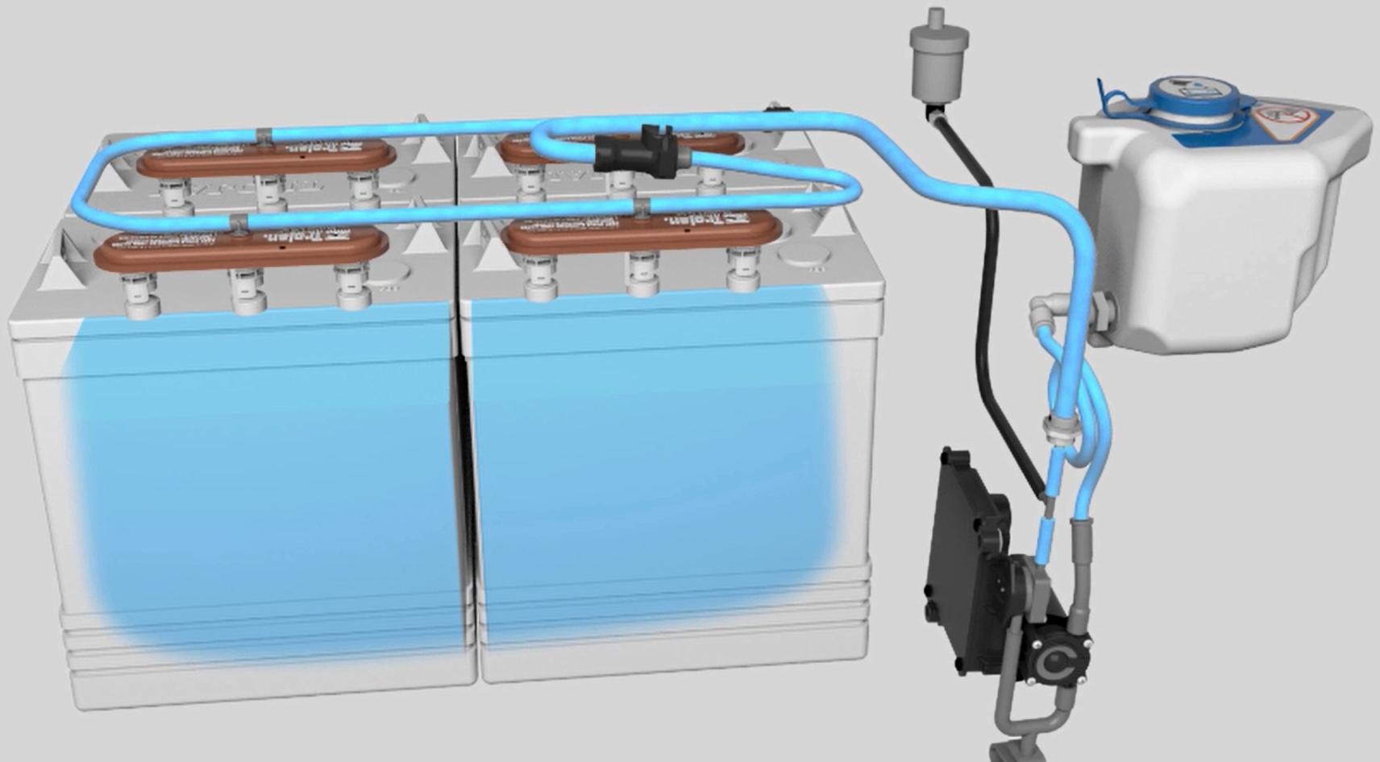
Automatic Battery Watering: SmartFill™

Slide 2
Learning Targets
Learning target on SmartFill™ - ABW (Automatic Battery Watering)
Understand:
Layout of the system
Description of all components and their function
Operation of the system
Faults and interlocks
System drain for freeze protection
Notes:
This online training program is dedicated to the new Automatic Battery Watering System called: Smartfill.
What do we want to achieve today with this training?
We want learn you to understand:
Layout of the system
Description of all components and their function
Operation of the system
Interlocks and Faults
Winterization of the system
In this training we will see many times the T500 as an example as this is the first machine where we apply this new technology. But it will be expended to other machines also. As this training is created for global usage, you will see images with US and European batteries. Although the battery types are different the operation of the system is equal.
The program will finish with a short quiz to test the knowledge that you have learned in this module.
Enjoy your study

Slide 3
First some Questions and Answers!
Q: What is the intended function of the Automatic Battery Watering?
A: Add automatically water to Flooded Lead-Acid batteries.
FLA batteries lose water during charging.
No maintenance means damage.
Q: Why do we offer this to our customers?
A: Hassle free system with big runtime
Lead-Acid traction batteries with little maintenance
No checking battery electrolyte level
Q: On which machines can this be installed?
A: T500/T500e machine
Future projects
Update existing machines (i.e. T16, T300)
Notes:
First some more explanation and clarification on Automatic Battery Watering:
See questions:
Q:What is the intended function of the Automatic Battery Watering?
A: The purpose of the ABW subsystem is to automatically add water to flooded lead-acid batteries. Flooded lead-acid batteries require periodic maintenance in order to replace water that is lost during the charging process. Without periodic maintenance, these batteries can be damaged.
Q: Why do we offer this to our customers?
A: We want to provide a hassle free system for our customers that demand a big runtime on their machine (and thus need Lead-Acid traction batteries) and do not want to have to perform maintenance on their batteries, in sense of checking electrolyte level and watering of batteries.
Q: On which machines can this be installed?
A: Smartfill will be launched on the T500/T500e machine and future projects. It will also become available as an update for existing machines (i.e. T16, T300)

Slide 4
Marketing message
Benefits – Patent-Pending On-Board System
  Simple – Worry-free battery maintenance
  Smart – Automatically fills batteries at the best time in the charging cycle
  Safe – Remove operator’s manual task of checking, opening, and filling batteries
Key Features
  Prevents operators from operating machine on dry batteries – shuts-down scrubbing functions after 10 hours of distilled water tank low level alert
  Control panel alert when 2,5 L on-board distilled water tank is low
      Operator will need to periodically fill distilled water tank - depends on usage
  Patent-pending system that monitors the best time to automatically fill batteries
Usage for Wet lead acid only: US: Trojan batteries; EU: TAB 210AH C/5 batteries
On-board charger is mandatory with this system!
Not available for customer install or field installation. Must be factory installed
Notes:
Some information on the marketing message on why we are offering this system in our machines.
The benefits: its simple, smart and safe
Some key features:
It Prevents operators from operating machine on dry batteries
For operator comfort it provides: Control panel alert
It’s Patent-pending system
It requires Wet Lead-Acid batteries
On board charger is mandatory
No field install kit available.

Slide 5
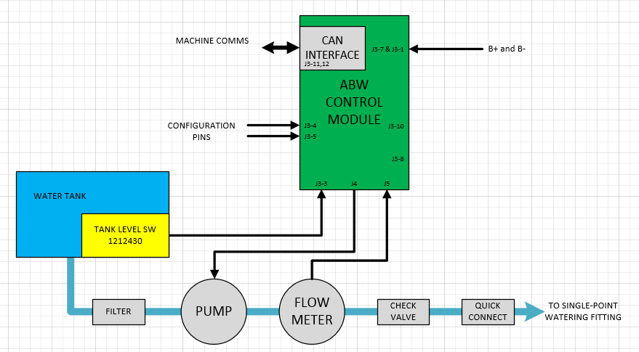
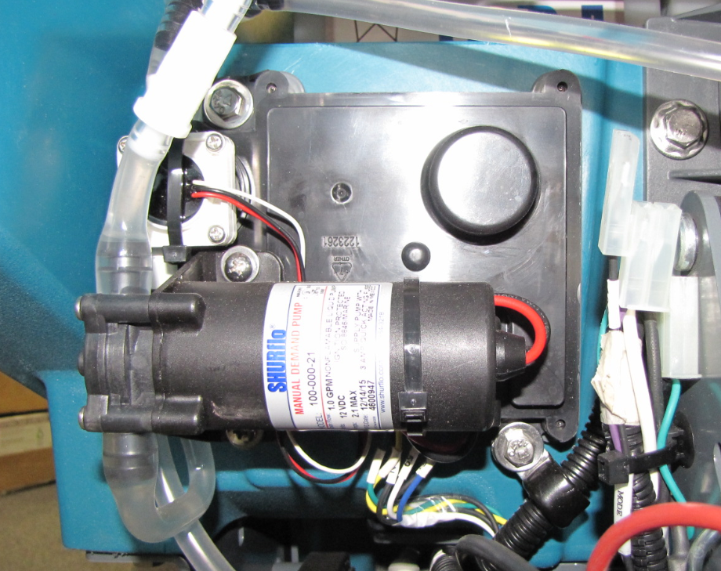
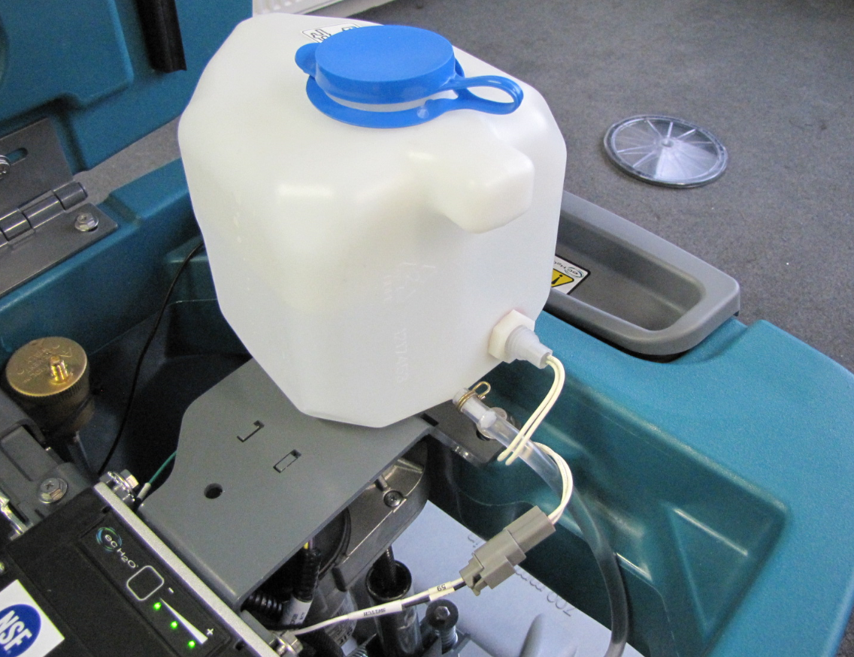
Layout of the system
Notes:
Lets start looking at the total system how it is layout.
The main components in the system are the water tank to contain the distilled water including the float switch to indicate when the tank is empty. The control module which controls operation of the pump, detects signals from the flow meter and tank level switch and communicates with the interface panel of the machine for operation. The pump is for the watering itself and it is PWM via the control module. The flow meter is a hall effect sensor. The sensor will monitor if there is actually flow to the batteries and communicates this information to the control module.

Slide 6
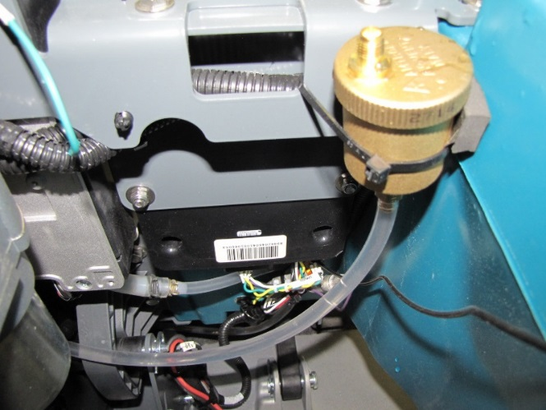
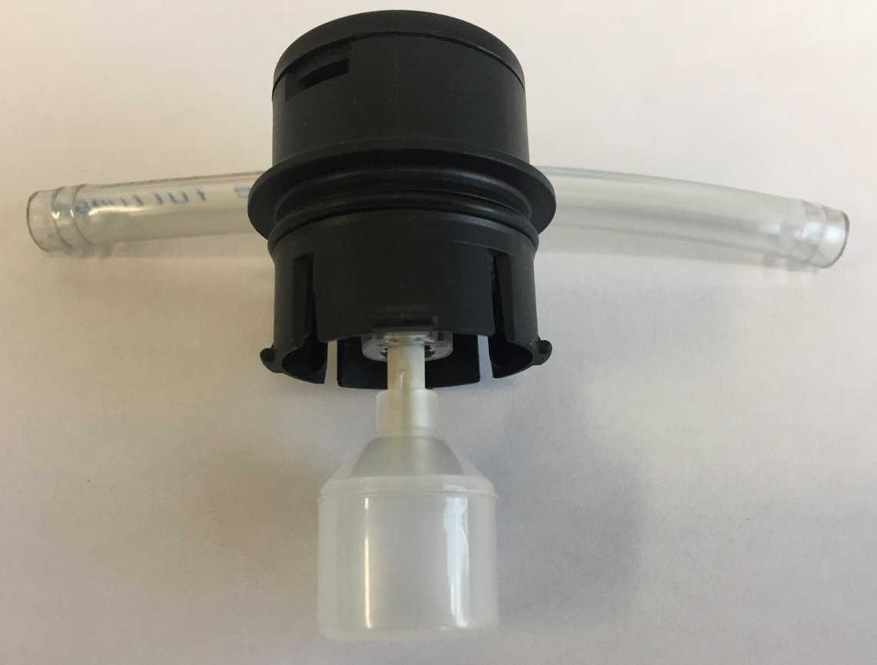
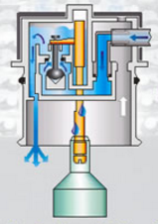
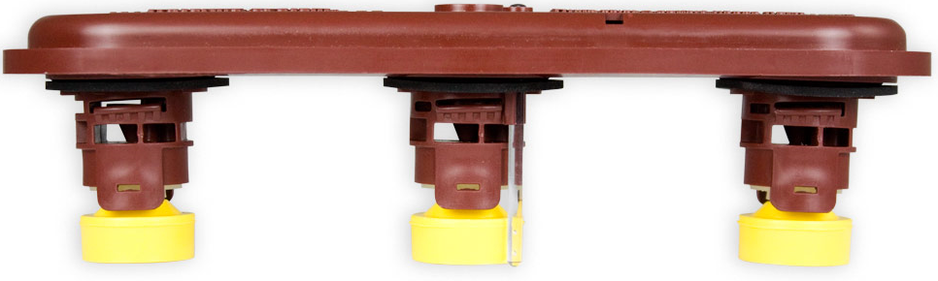
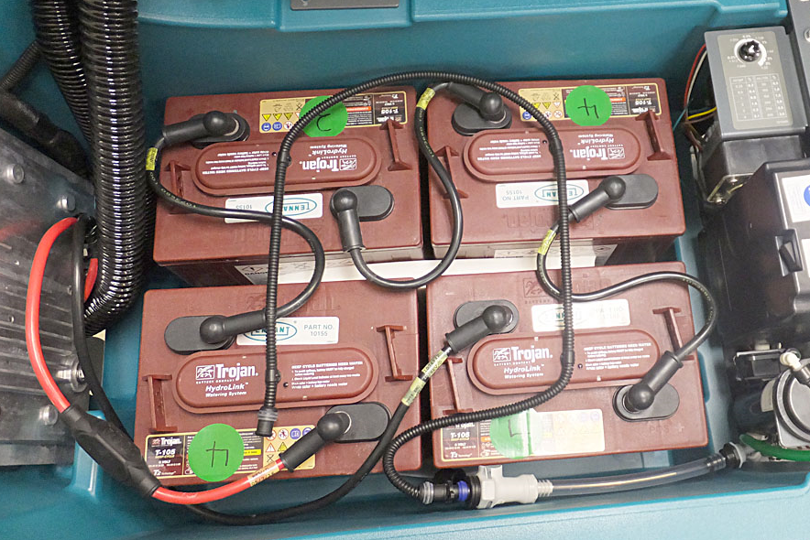
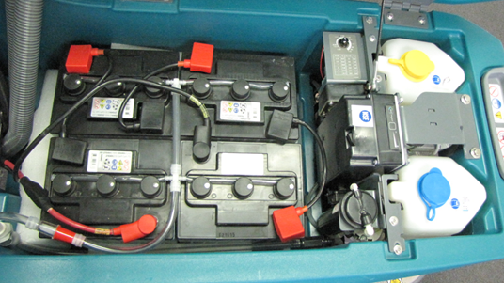
Layout of the system
Battery fill cap with float. (example shown, can differ between brands)
Air bleed valve mounted directly after flow sensor
Hoses, connections and routing differ per region, depending on battery brand
Notes:
Directly after the flow sensor is T-coupling and has an air bleed valve mounted. The purpose of the valve is to help priming the pump in case the distilled water tank is empty and there is air trapped in the hose.
One of the most important components in the whole Automatic Battery Watering system are the battery fill caps. At the moment the level of electrolyte in the battery is too low they must open and when it reaches the max level in the battery the float should close the fill cap so the flow stops. The fill caps can differ per battery brand.
These two pictures show the EU TAB batteries and the US Trojan batteries. The blue arrows indicate the routing of the watering hoses. Per brand the hoses, couplings and fill caps differ.

Slide 7
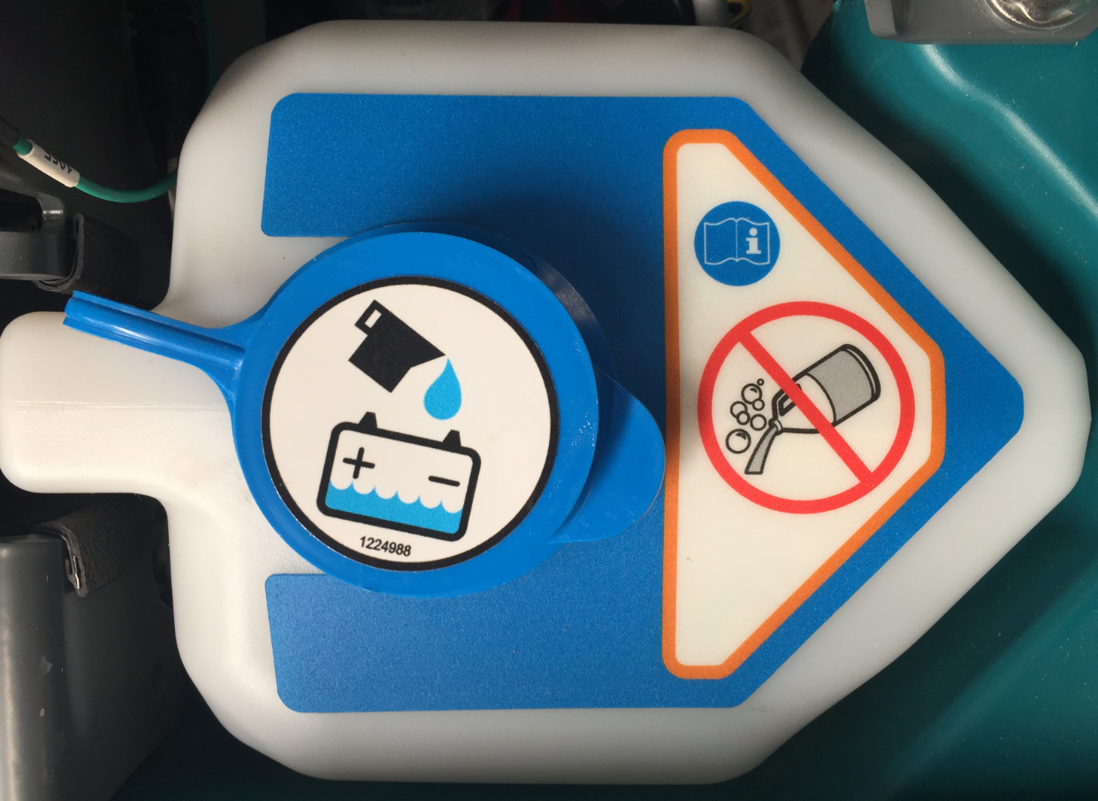
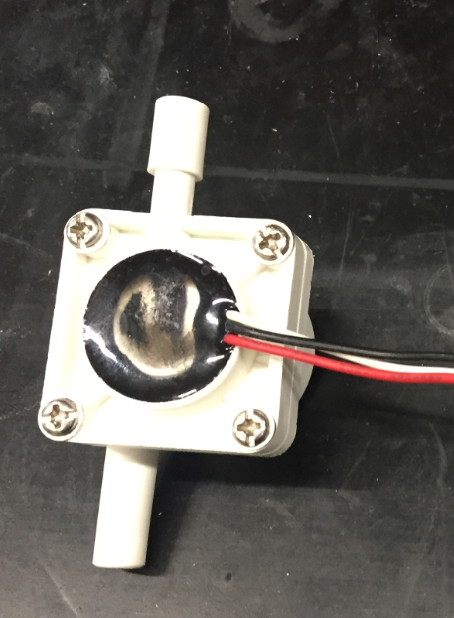
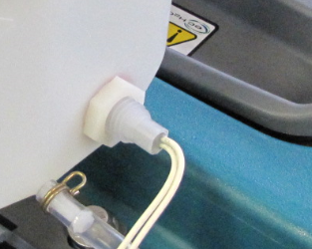
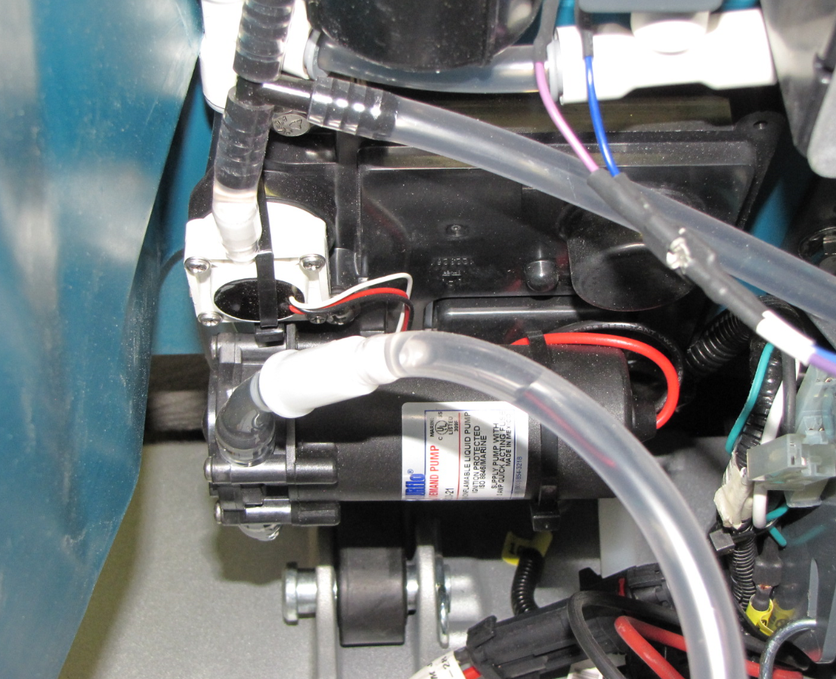
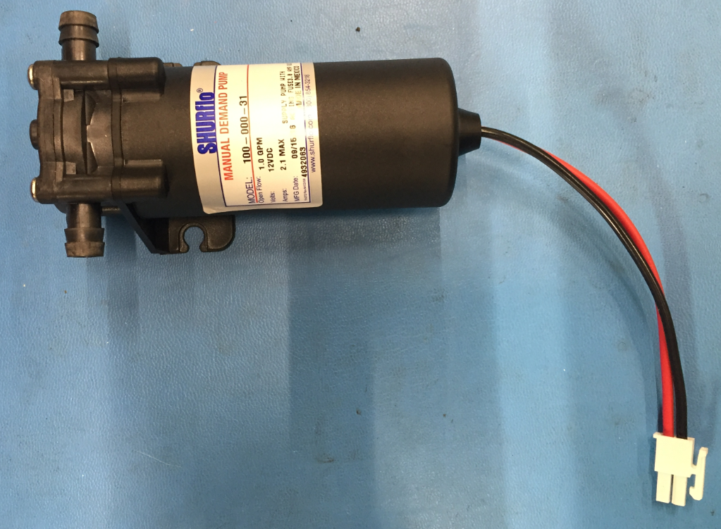
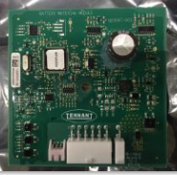
Components
Float switch water container
Flow sensor
Watering pump
ABW circuitboard
Notes:
The battery watering tank has a clear indication that it should be filled with distilled battery water. The float will indicate when the tank is empty. After 10 hours of operation with an empty battery water tank the scrubbing and solution delivery functions will be disabled by the system. This will be visualized by the high rate flashing battery watering icon on the operator panel.
The hall effect flow sensor is positioned above the pump and is attached with a tyrap to the ABW control module cover. The sensor will sense if there is water flow in the watering hose that runs to the batteries. If no flow is detected it will provide a signal to the control module to stop pump operation. More details will be shared in the chapter: operation of the system.
The battery watering pump is a 12V pump and is controlled via a PWM signal coming from the control module. The pump is also mounted on the control module cover.
Control module is situated behind the black cover where the pump and sensor is mounted on. It controls the whole system with exception of the determination what the batteries need watering. with other words the counting of the charges, this is done as previous told by the interface panel.

Slide 8
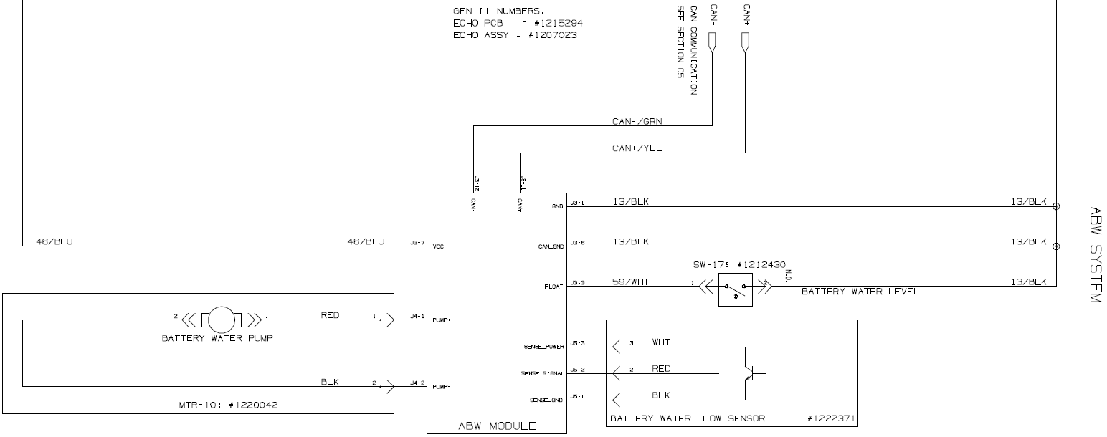
Layout of the system
Sub system in the electrical system
Notes:
This slide shows the basics on the electrical system of the ABW.
The battery + signal of 24V powers, via the Auxilary contactor, the ABW control module.
On the T500 this contactor is positioned behind the circuit breakers housing and is the same contactor that provides power to the ecH2O module. On the T500e it’s power via the main relay.
The battery ground comes directly from the battery and has a double connection.
The battery watering pump and the flow sensor are directly connected to the control module.
The float switch positioned in the battery water tank is directly connected to ground. When not engaged the switch is open, when there is battery water in the tank the switch is engaged and provides the ground signal to the control module.
The ABW control module is in contact with the machine via CAN connection.

Slide 9

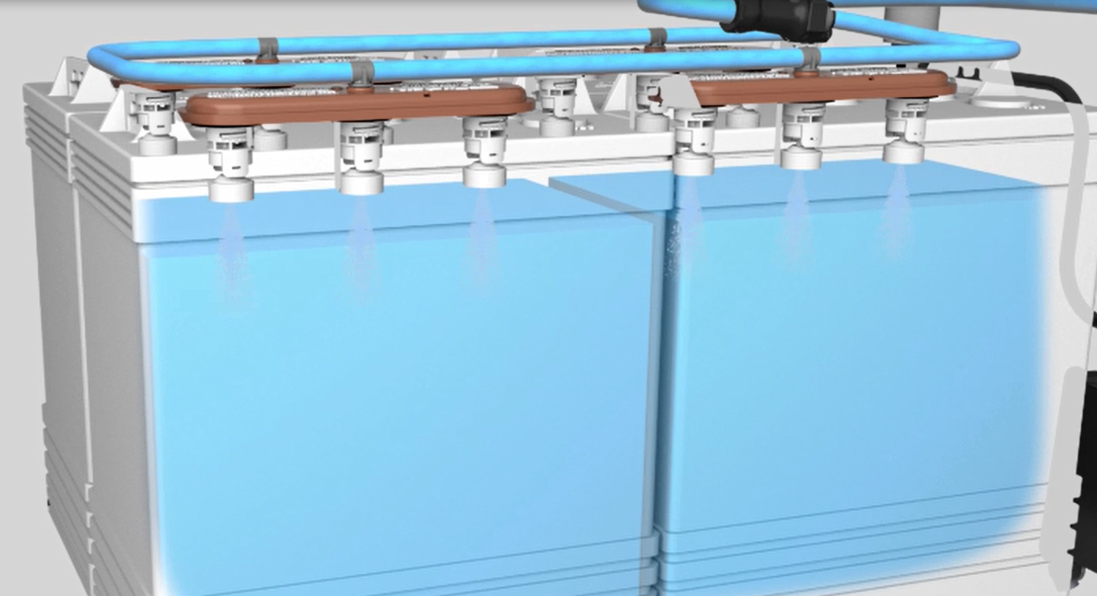
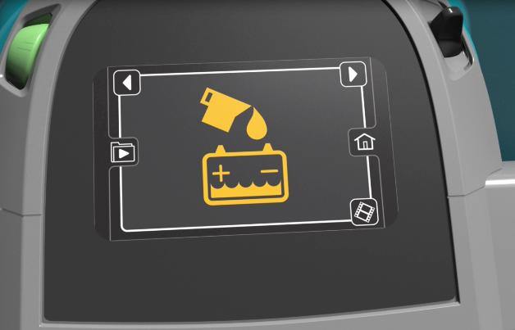
Operation of the system
The machine records # of battery charges:
15 completed charge cycles
20 partial charge cycles
10 completed charge cycles and 10 partial charge cycles
Notes:
The machine determines when the battery needs watering.
For this the User Interface module in the operator console keeps track of number of partial and full charge cycles.
The system shall be commanded to add water to batteries after it has accumulated OR [15 complete charge cycles] OR [20 partial charge cycles] OR [10 complete charge cycles AND 10 partial charge cycles].
The User Interface module also monitors the state of the tank level switch (this information is provide via a CAN message from ABW control module).
If the tank level switch indicates that the tank is empty, no battery watering shall take place and an icon on the user interface shall flash to let the user know.
If the tank level switch indicates that the tank is empty for longer than 10 hours, the User Interface shall disable the scrubbing and solution delivery functions (via CAN message to main scrub board), as well as flash the user interface icon at a higher rate.

Slide 10
Interlocks and Faults
Interlocks:
No feedback fault (no flow)
pump not priming
hose kinked
failed sensor
Or battery water full
Feedback provide by flow sensor
This will stop pump operation after 10 seconds.
After this it will try again watering after 3 complete charge cycles.
It will try watering for the next 9 key cycles. In order to give pump time to prime.
After this the ABW icon will flash at a higher rate.
Notes:
The user interface monitors how the watering sequence completes. If the watering sequence aborts due to a no feedback fault, (in case the pump is not priming, there’s a kinked hose, failed sensor, or battery water is full) then a no feedback fault will be counted. This happens after the pump has been running for 10 seconds.
After the first no feedback fault, the watering sequence will wait at least 3 complete charge cycles or 5 incomplete charge cycles to allow the batteries to lose more water. No it will try to water the batteries again.
This interlock is built in to eliminate no feedback faults due to the batteries being full, leaving only true faults.
The following 9 watering attempts will trigger on each key cycle to give the ABW pump more tries to prime. If 10 consecutive no feedback faults are counted, then the user interface shall disable the scrubbing and solution delivery, as well as flash the ABW user interface icon at a higher rate.
The error will reset when the watering attempt succeeds after a key cycle. This will clear the disability of the scrubbing and solution delivery.

Slide 11
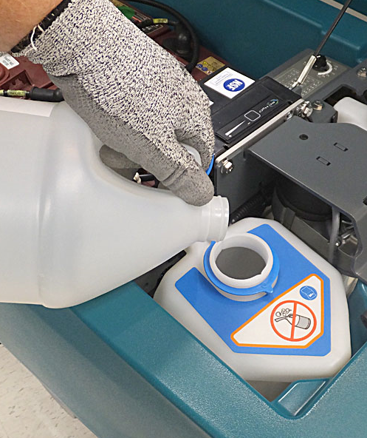
Interlocks and Faults
Notes:
If the machine is showing a ABW fault due to the battery water tank is empty, the tank should be filled again with distilled water and restart key to clear the flashing indicator.
If a ABW no feedback shutdown fault is shown it is the easiest way to disconnect the ABW water tubing downstream of the pump, then key cycle which should trigger another ABW cycle, let some water flow out, and reconnect the tubing while ABW is still running.

Slide 12
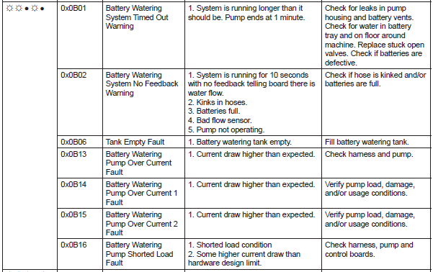
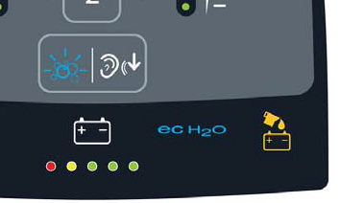
Interlocks and Faults
Notes:
All faults are reported via the Automatic Battery Watering icon. Together with the icon codes a failure codes which is shown on the interface panel when the machine is equipped with a Propanel. On machines with a membrane panel, the service diagnostics software must be used to read the actual failure code.
The list with failure codes and descriptions are shown in the service manual.

Slide 13
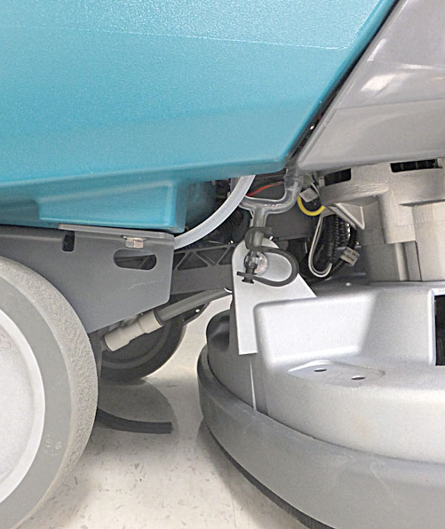
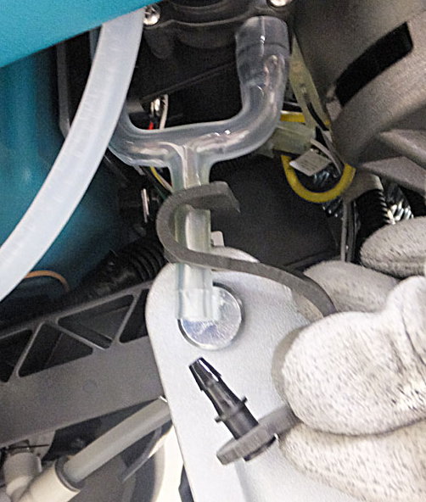
Drain of system for freeze protection
Notes:
When the machine is going to be stored or transported in a cold environment, pre-cautions must be made to prevent damage to the tubing and other components of the Automatic Battery Watering system due to the freezing conditions.
At the bottom of the battery water pump, there is situated a special molded tube with a plug. By removing the plug the whole system can be drowned.

