Slide 1
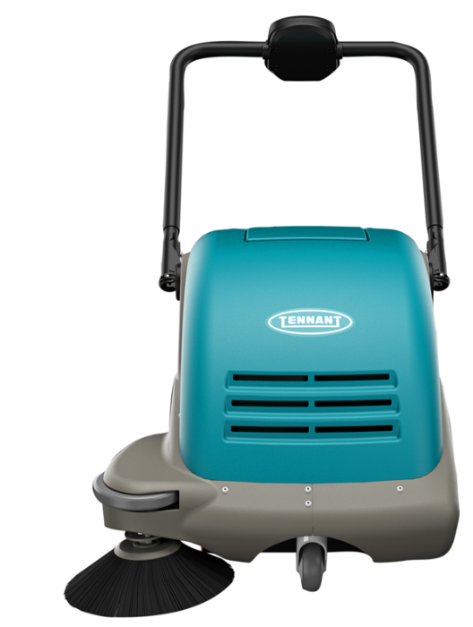
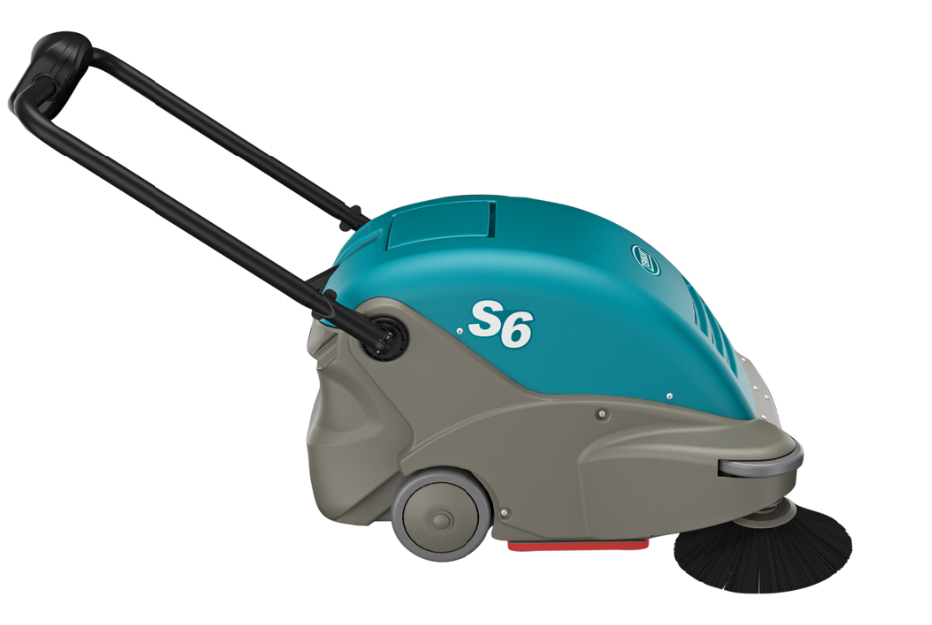
S6 Product Guide (PAS Guide)
Purpose of this internal product guide: Self-train and educate on S6 Sweeper
Other helpful sources for understanding these products:
Operator’s manual
Brochure
Public Website (videos available)
S6

Slide 2
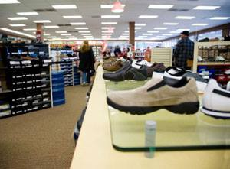
Markets and Applications
MARKET | APPLICATION | FLOOR TYPES
Retail | Aisle ways, check out counters, around displays, deli/cafeteria areas, ramps, side walks, parking lots | Carpet, VCT, polished stone, terrazzo, grouted ceramic and porcelain tile, concrete, asphalt
Schools and Universities | Hallways, entryways, kitchens, classrooms, cafeterias, ramps, sidewalks, parking lots | Carpet, VCT, polished stone, terrazzo, grouted ceramic and porcelain tile, concrete, asphalt
Healthcare | Hallways, entryways, patient rooms, cafeterias, handicapped ramps, sidewalks, parking lots | Carpet, VCT, polished stone, terrazzo, grouted ceramic and porcelain tile, concrete, asphalt
Hospitality | Lobbies, hallways, elevator areas, ramps sidewalks, parking lots | Carpet, VCT, polished stone, terrazzo, grouted ceramic and porcelain tile, concrete, asphalt
Logistics/ Light Manufacturing | Aisles, ramps, employee cafeterias, parking lots | Sealed concrete, polished concrete, coated floors, asphalt

Slide 3
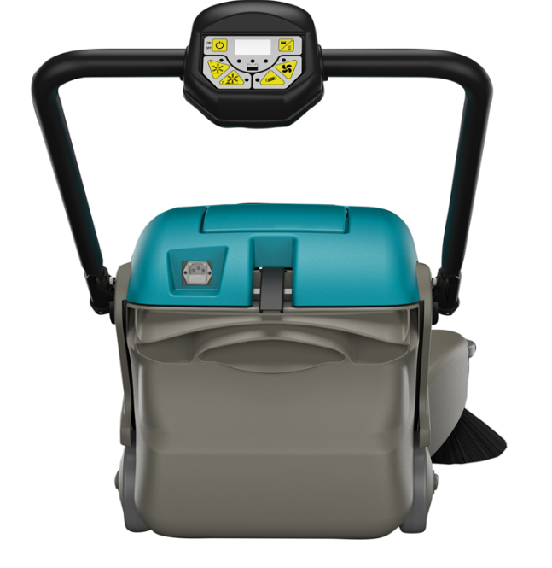
S6 Sweeper Product Specifications

Slide 4
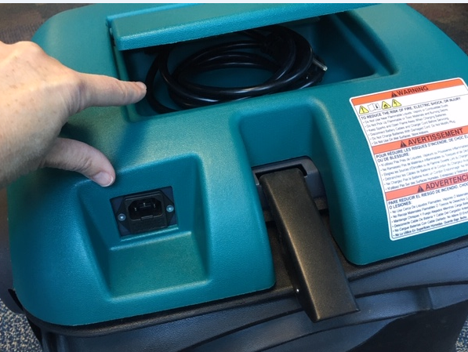
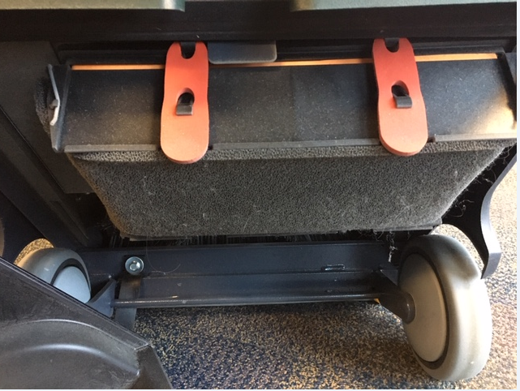
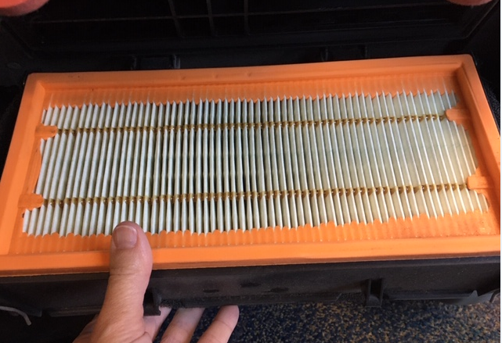
S6 Key Highlights Summary
25”/ 63.5 cm overall path width
Push unit
Sealed battery
12 v, 42 AH with built in on board charger
Up to 2 hrs. of run time
Hopper capacity
1.25 ft³ / 35 L
Filtration
Pre-filter and main filter
Main filter at 99.5% at 2 microns
Noise Level
Low 61 dBa
On-Board Charger with Cord Storage
Pre-Filter and Main Filter

Slide 5
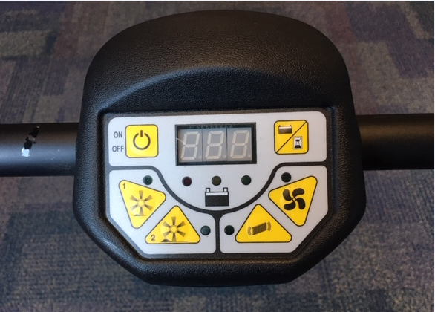
S6 Key Highlights Summary Cont’d
Simple controls with auto electronic filter shaker
Simple on/off button
Easily see battery status with battery discharge indicator lights
Two sweeping modes to adjust to flooring needs
Mode 1 – light debris, smooth surfaces
Mode 2 – for heavy debris, concrete, asphalt and carpeted surfaces
Vacuum fan switch – standard on
Cleaning the filter is easy with built-in pre-timed electronic filter shaker or can be manually engaged when desired
Sweeping mode 1 for light debris and mode 2 for heavy
Manual filter shaker switch. This is in addition to the auto filter shaking that cycles every 3 minutes
vac fan auto activates when sweeping mode is on. Switch is used to shut off the vac fan during sweeping mode
In addition to battery voltage, the display indicates the machine working hours (pressing once) and minutes (pressing twice)

Slide 6
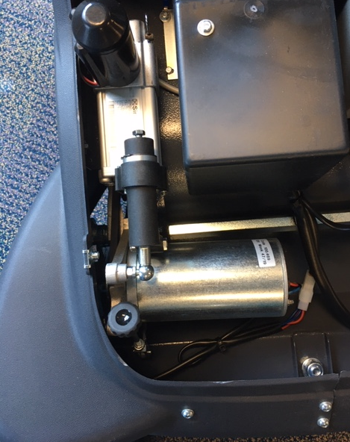
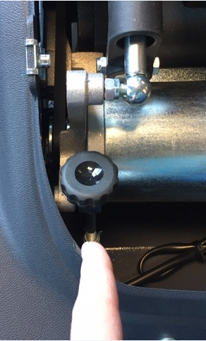
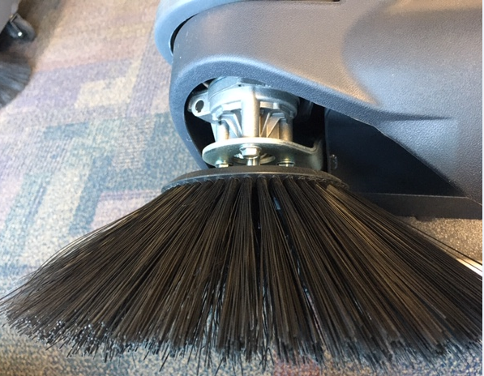
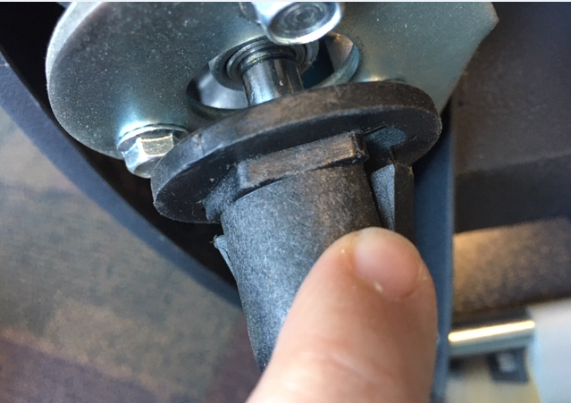
S6 Key Highlights Summary Cont’d
Automatically adjusting main
brush and adjustable side brush
Automatically go from soft/hard floor without adjusting main brush
Side brush manual adjustment; remove top cover (allen wrench required)
Main brush/side brush change
No tools required
Main brush
Manually turn brush to see black button (right side)
Press to disengage
Side brush
Simple pinch of two tabs
Side brush height adjustment knob under top cover
Side brush replacement – depress two pinch tabs

Slide 7
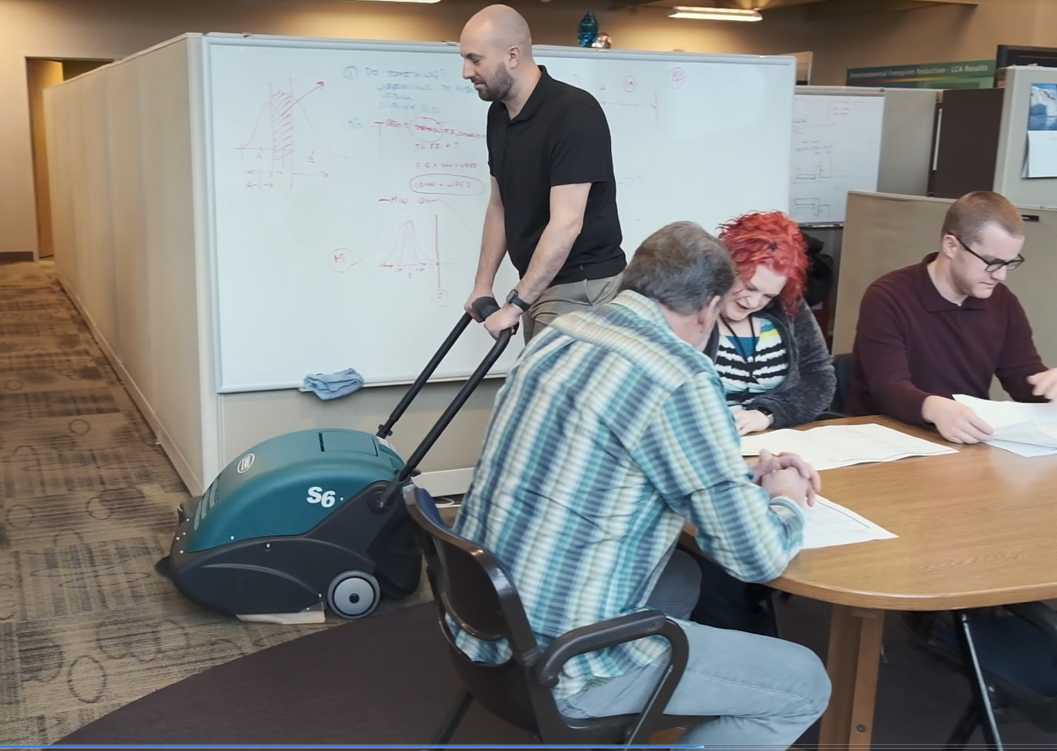
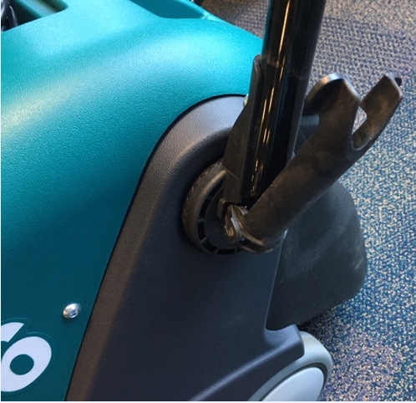
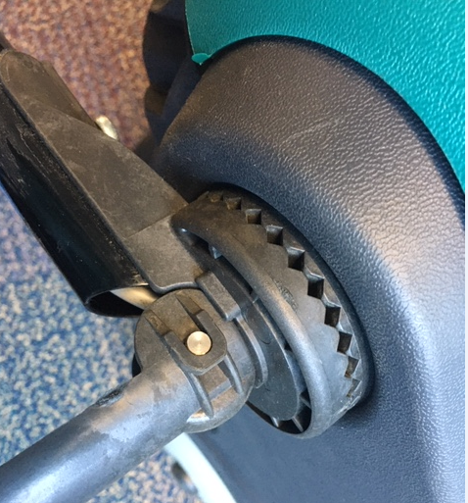
S6 Key Highlights Summary Cont’d
Safe for operators and others
Breathe easy at 99.5% filtration up to 2 microns
Work quietly when people are present at 61 dBa
Sealed batteries ensure no overspills/splashes to harm the working environment or employees
Ergonomic adjustable handle
Handle fully adjustable to operator’s comfort with locking cam design
Adjustable Handle

Slide 8
Warranty
S6 Warranty
1 year parts
1 year labor
30 days travel
battery pro-rated for 12 months

