Slide 1

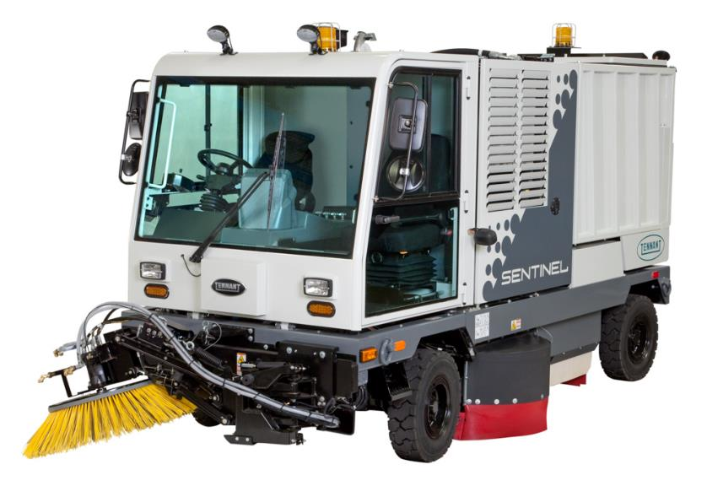
Sentinel®
Large Industrial Rider Sweeper
Product Applications & Solutions (PAS) Guide
January 2015
CONFIDENTIAL - For Internal Use Only

Slide 2
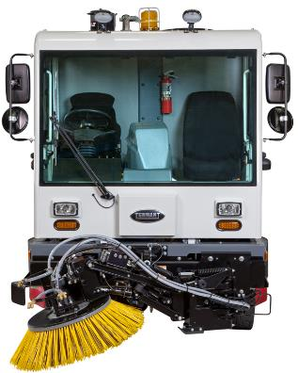
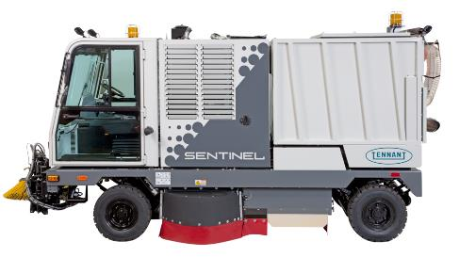
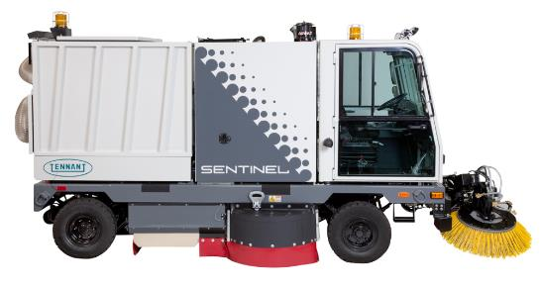
Sentinel PAS GUIDE VIEWING INSTRUCTIONS
Select slideshow mode
Press space bar to begin
Make a menu selection or scroll through each slide by pressing the space bar
If using the PDF, slideshow links will not work – must use in PowerPoint

Slide 3
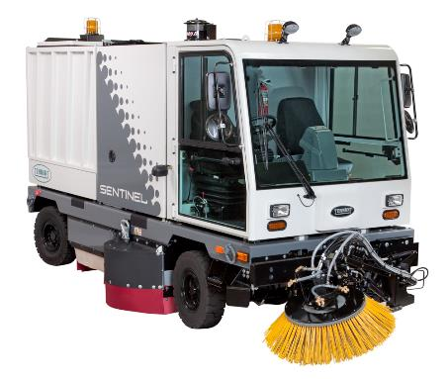
Sentinel PAS Demo Guide Menu (Click on a topic below. to return)
Menu
Target Verticals Key Applications
2. Dust Control
3. Power
4. Operator Compartment
5. Construction
Product Overview and Primary Messaging
Configurations and Options
1. Sweeping
Tennant and Competitive Comparisons
Demo Guide and
5-point Product Walk-Around
Unique Features and Key Enhancements

Slide 4
4
Sentinel Target Markets and Sweeping Applications
Target Markets
  Heavy Manufacturing
  Raw Materials
    Cement, Refractories, Gypsum, Brick, Limestone, Silica
  Municipalities, Schools, Campuses
    Gutters, curbs on top of sidewalks, parking lots
  Construction and Mining
  Warehouse & Distribution Facilities
Sweeping Applications
  Sand and Dust Sweeping
    Traditional sand, dust, road salt, etc.
  Gutters, Sidewalks and Curb Sweeping
    Bottles, papers, leaves, cups, etc. This includes light and heavy/large litter
  Military Spec Sweeping
    Pallet chips, pebbles/gravel, nuts, bolts, glass, etc.
  Large Area Patrol Sweeping
    Rapidly sweep large areas and remove unsightly litter
Menu
CONFIDENTIAL - For Internal Use Only

Slide 5
Market Characteristics and Sentinel Benefits 1 of 2
Heavy Industry / Manufacturing
Characteristics: Huge facilities, large outdoor space (yards and roadways), heavy soilage conditions, and community pressure to contain dust
  In cement or lime – water cannot be used to suppress dust when cleaning
Sentinel Benefit:
  Year-round heavy and fine dust sweeping without water with dry dust control
  Because of harsh conditions and daily use, planned maintenance may be needed – look at GOLD service or GOLD FlexClean offerings.
    Planned Maintenance & Breakdown coverage
  Ports and Shipping Terminals
Characteristics: Large outdoor space, dust control is key on water front, maneuverability, bulk container yard shifting daily creating different aisle sizes, many industries above may have their own port facilities to also maintain. Note, salt air is harsh on all equipment used in these areas.
Sentinel Benefit: Dust control and sweeping right up to obstacles with optional Vario Brush (like containers, other fixed structures), and maneuverability in changing footprint in shipping yard
Menu

Slide 6
Market Characteristics and Sentinel Benefits 2 of 2
  Airports and Other Transportation
Characteristics:
  Airport: Parking ramps, roadways, parking lots, areas in and around jet ways, maintenance sheds, tunnels – must manage foreign object debris (F.O.D.) on the airport side
  Other Transportation: Rail, bus, metro have large public spaces for passengers and equipment service. Facilities have high requirements for safety and need to maintain cleanliness
Sentinel Benefit: Size and maneuverability, poly-bristle brushes (can’t use wire mix on airport side, effective cleaning from mechanical broom), easy maintenance and serviceability, and dry dust control and wet dust control combined in one (for other transportation)
  Municipalities and Downtown Business Areas / Schools / Campuses
Characteristics: Congested areas with narrow streets, alley-ways, people, traffic. Need to capture dust and not create dusty situations with people around
Sentinel Benefit: Find applications where the Sentinel strengths are required: dust containment, maneuverability, or fine sweeping. Dry and wet dust control combination helps to clean year-around in any weather, even rainy days or freezing temperatures and maintain dust control
Menu

Slide 7





7
Product Overview – Exclusive Benefits
Reduce Cost to Clean
  Clean more productively
  Optimized for dry and wet dust control
Maintain Health and Safety
Enhance Facility Image
Deliver Easy Operation & Maintenance
Stands Apart from Competitors:
      Very maneuverable mechanical sweeper
      Excellent dry and/or wet dust control
      High quality and construction
      Simple 1-touch sweeping operation
      Highly customizable solutions
      Proven mechanical sweeping performance
REDUCE COST
TO CLEAN
MAINTAIN HEALTH
& SAFETY
ENHANCE FACILITY IMAGE
EASY OPERATION
& MAINTENANCE
Menu
CONFIDENTIAL - For Internal Use Only

Slide 8

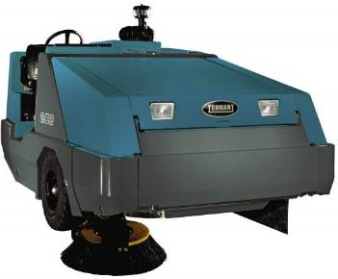
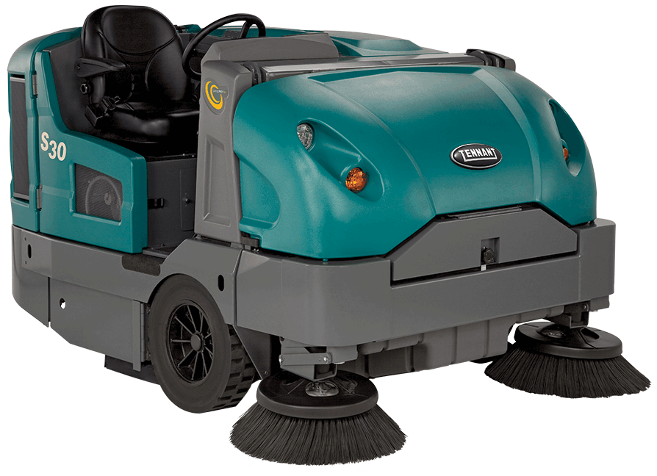
Tennant’s IC Large Rider Sweeper Product Line
S30
800
Sentinel
Mid-Sized | Large – 3-Wheel | Large – 4-Wheel
Menu

Slide 9
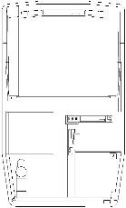
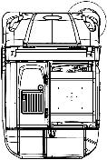
Large Size
Full Range Offering
Machine | S30 | 800 | Sentinel
Sweep Path Main Single Side Brush Dual Side Brush Vario Sweeping Brush™ | 45 inch | 1,145 mm 62.5 inch | 1,590 mm 80 inch | 2,030 mm N/A | 50 inch | 1,270mm 66 inch | 1,675 mm 82 inch | 2,080 mm N/A | 51 inch | 1,300 mm 69 inch | 1,750 mm 87 inch | 2,210 mm 106 inch | 2,690 mm
Length | 93 inch 2,360 mm | 120 inch 3,050 mm | 175 inch | 206 inch (Vario) 4,450 mm | 5,200 mm
Width (Hard) | 62.5 inch | 1,590 mm | 70 inch | 1,780 mm | 70 inch | 1,780 mm
Height w/o overhead guard with overhead guard | 58 inch | 1,475 mm 82.5 inch | 2,095 mm | 52.5 inch | 1,335 mm 82.5 inch | 2,095 mm | 100 inch | 2,540 mm (with safety light on top)
PGM

Slide 10



Sentinel Primary Messages
High performance, all-weather sweeper for demanding and congested sweeping challenges with optimum dry-dust control
There are 4 key benefits to communicate with customers to help set the Sentinel apart. Tennant’s Sentinel provides exceptional maneuverability and dry-dust control while delivering reduced costs to clean, improved facility image, health and safety benefits, all in an easy to use and maintain large four-wheel industrial rider sweeper.
KEY BENEFITS | Message
Reduce Cost to Clean | Delivers excellent heavy-duty sweeping performance in tough, congested sweeping environments in any season for maximized productivity at a low cost.
Maintains Health and Safety | Designed for maximum operator comfort and maintain air quality for decreased risk of injury and improved environment, employee, and customer safety.
Enhances Facility Image | Provides high performance cleaning for consistent results in even the toughest environments in any weather condition with no mud or water slurry.
Easy Operation & Maintenance | The Sentinel is easy-to-operate and maintain while running at peak performance year after year with its quality engineering.
Menu

Slide 11



Sentinel Unique Features
Reduce Cost to Clean:
  Solid shaft design for increased life of conveyor (compared to previous models) with built-in conveyor obstruction alert to optimize sweeping performance and help reduce cost of ownership.
  Unique hydraulic twin-vacuum dust control system meets the most stringent PM-10 environmental requirements – without requiring water tanks, trucks
  Optional Vario Sweeping Brush™ expands the sweeping path to 99 in / 2,515 mm and allows for reaching debris up to 36 in / 915 mm on either side of the machine
  Maintains Health and Safety:
Full-length TotalView™ glass doors and windshield give operators a clear view of the sweeping area to maximize safety. Optional rear view camera with in-cab monitor provides visibility behind the machine.
Improved cab ergonomics with more knee, leg and right elbow room for taller operators
Roomy, sealed pressurized cab interior keeps noise out and air quality is maintained with a MERV 15 filter
Enhances Facility Image:
4-Wheel power steering delivers high maneuverability for access to sweep tight spaces.
Sweeps virtually any debris, in any season – from sand, rocks, and large debris to broken glass and light litter.
Direct throw debris conveyor is a proven system that provides an efficient and effective sweeping performance for collecting most forms of debris for a clean and clear surface.
Deliver Ease of Operation and Maintenance:
  Optimum sweeping result on all surface types with main brush center-point suspension allowing main broom to follow the contours of uneven surfaces
  Simple worry-free operation starting all sweeping functions with one-touch activation
  Optional multi-level hopper-dumping enables discharging into large roll offs and dump trucks, preventing double handling of debris.
Menu

Slide 12
Sentinel Product Enhancements and Marketing Support
12
Product Improvements | Why?
Solid shaft conveyor design upgrades | Enhanced design for durability, increased life, reduced cost
Ergonomic cab updates and improvements | Increased operator comfort – especially taller operators
Side brush linkages bracket improvements | Increased durability for longer life, reduced costs
Elevator housing back-plate material upgrade | Increased durability for longer life, reduced costs
New thicker closed-cell filter gasket seal | Reduces opportunity for dust to escape, better filter seal
New Marketing Sales Tools | Why?
6 application-specific option packages on price sheet | Discounted, bundled packages for easier selling
New custom solution graphic wrap option | Advertise customer brands or municipalities
New customer-facing videos and demo video | Use for interest-generating demos – virtual demo
New Aftermarket – Gold Service and Gold FlexClean | More service coverage and flexibility for customers
Menu
CONFIDENTIAL - For Internal Use Only

Slide 13
Sentinel Standard Configurations
Standard Configurations – Diesel Only
  Wet Sidebrush Dust Control
  Dry Sidebrush Dust Control
  Wet and Dry Sidebrush Dust Control
Built-in Tennant Value Includes:
  99 hp (74 kW) Turbocharged Caterpillar Diesel Engine
    Sealed oil dipstick; Dual stage air cleaner
  Leaf-spring suspension system
  Oil bath power disc service brakes
  4-Wheel power steering
  Hydraulic towing bypass valve and hooks
  3.4 yd3 (2600 L) Stainless steel hopper
    Thermo-Sentry™
    Hopper movement warning alarm
  Easy-reach controls
  One-button sweeping
  Premium carbide inserted skids
  PM-10, AQMD Rule 1186 Certification
  Synthetic Filter with Shaker System
  Conveyor Hydraulic Self-Tensioning System
  Pressurized cabin
    Filtered air – MERV 15 rated filter
    TotalView™ glass cab doors and sliding windows
    Premium suspension seat with seat belt
    Heater/defroster
    Keyed door locks
  Slow moving vehicle sign
  Audio backup alarm
  Back-up rear lights
  Dual headlights/taillights
  Polypropylene main brush
  Polypropylene & wire side brush
Menu

Slide 14
6 Custom Option Application Packages – Pg 1 of 2
New custom options packages specifically chosen and bundled with that customer’s application/environment in mind.
Displayed within the price sheet
Customer receives 10% off when ordering the full package. Discount already built into the price sheet
Contact Custom Solutions group for the many available options, or any new requirements
Menu

Slide 15
6 Custom Option Application Packages – Pg 2 of 2
New custom options packages specifically chosen and bundled with that customer’s application/environment in mind.
Displayed within the price sheet
Customer receives 10% off when ordering the full package. Discount already built into the price sheet
Contact Custom Solutions group for the many available options, or any new requirements
Menu

Slide 16
Aftermarket – Sentinel Service Programs and FlexClean Option (North America Only)
NEW in 2015, Sentinel will be eligible for Gold Service contracts
Gold Service is Tennant’s full service offering in North America
  Planned Maintenance & Breakdown coverage
Unique to Sentinel, Gold pricing will not be listed in the Quote tool
  Instructions on how to obtain Gold service pricing for your customer is located in the machine quote tool
  Standard pricing will be adjusted based on customer attributes
FlexClean for Sentinel
Bundle your service contract with a new machine lease
  Gold Service + Lease = FlexClean Gold
  Silver Service + Lease = FlexClean Silver
Sales Tools Information and Location
Visit the Sales Tool Hub for more information about Service and FlexClean offerings
  C:\Sales Tool Hub - Aftermarket\
Menu

Slide 17
Product Demonstration Guidance
Easy-To-Follow Structure for Demonstrating the Sentinel Rider Sweeper
  Follow the 5-point walk-around to effectively demonstrate the Sentinel to prospective customers, in a simple yet memorable way – follow the path of the dirt!
    1) Sweeping, 2) Dust Control, 3) Power, 4) Operator Compartment, 5) Construction
  Highlight these 4 benefits areas, discussing the Sentinel strengths for each benefit:
    1) Reduce Costs to Clean – Increased conveyor life, durable 4-bar H-frame side brush design
    2) Enhance Facility Image – Dry dust control, wet dust control, and combined dry and wet on one machine
    3) Health & Safety Benefits – Cab-forward design, 180 degree TotalView™ with full glass doors
    4) Easy Operation & Maintenance – One-touch button for starting sweeping functions, easy-access side panels
Helpful Tips on Demonstrating
  Understand the application following a thorough customer site survey and recommend the right offering
  Perform pre-demo checklists – customer considerations for buying, machine prep, general prep, etc.
    Clean and fuel demo unit – includes dumping hopper, cleaning conveyor paddles
  Know the competition: download literature, and review walk-around comparison videos and sheets, found on Sales Tools Hub or MyTennant
  Be ready for crowd control – having 3 Tennant people on site is not too many in most cases
MOST IMPORTANT – Reference Full Sentinel Demonstration Guide Found in Your Sales Tool Hub Folder on Your Desktop
Menu

Slide 18
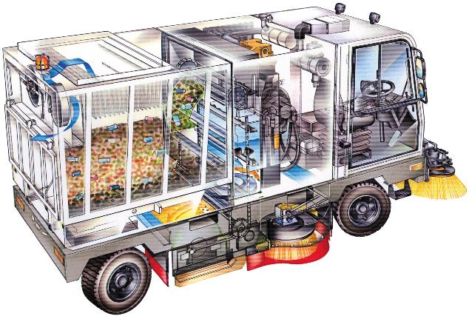
Sentinel 5-point Product Demo Walk-Around
5) Construction
3) Power
2) Dust Control
1) Sweeping
4) Operator Compartment
Menu
CONFIDENTIAL - For Internal Use Only

Slide 19
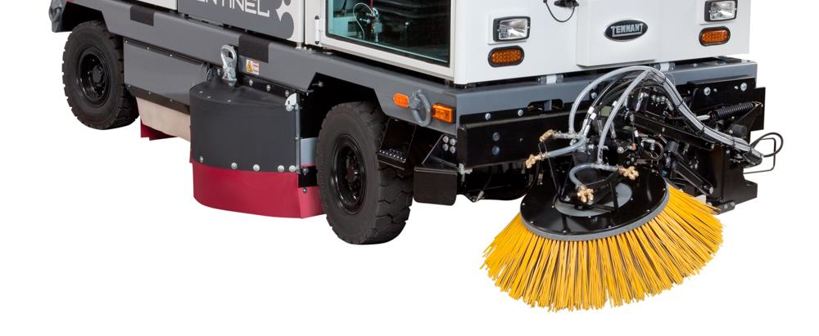
1. Sweeping - Following the Path of the Debris:
- Vario Brush™
- Side Brush
- Main Brush
- Conveyor
- Hopper
Menu
CONFIDENTIAL - For Internal Use Only

Slide 20
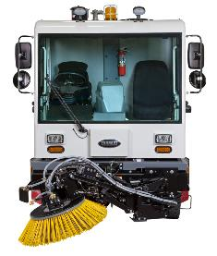
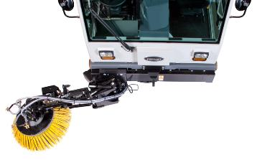
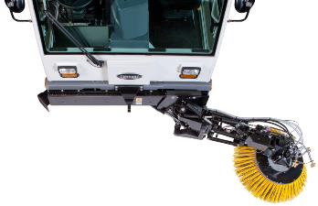
1. Sweeping
Vario™ Brush, Side Brush, Main Brush, Conveyor and Hopper
Optional Vario Sweeping Brush Benefits
Increases total sweeping path width 45% to 126 in / 3,200 mm (w/ dual brushes)
Also has up to a 56 in / 1,420 mm reach from the machine to the outside tips of the brush. This extended reach helps sweep debris in corners, on top of curbs or around obstructions. Has a 38 in / 970 mm diameter
Distances Sentinel from outside corners to collect all debris and keeps sweeper from riding up on curbs
Gives the operator the ability to sweep on top of curbs, around fixed obstacles and in narrow or congested areas
Sweeps both sides of a street, one ways and medians sidewalks, by swinging the Vario arm out to the left side of the machine
Moves left and right, up and down, and the head can tilt. All from inside the cab
Wet dust control for using on both left and right side included
Menu

Slide 21
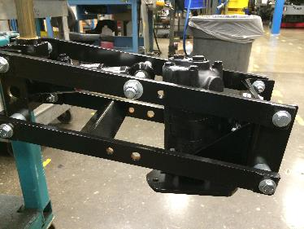
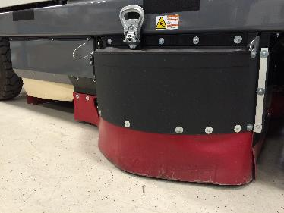
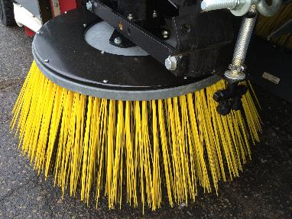
1. Sweeping
Vario Brush™, Side Brush, Main Brush, Conveyor and Hopper
Side Brush
Provide increased productivity with standard right-side sweeping brush, optional left-hand sweeping side brush (dual) and optional Vario Brush sweeping brush
  Single Side Brush = 69 in / 1,750 mm
  Dual Side Brushes = 87 in / 2,210 mm
  Dual plus Vario Brush Path = 126 in / 3,200 mm
On side brushes, new 4-bar linkage with H-frame construction on lower arms helps increase durability and longer link life, improving brush performance
Reduce maintenance costs and increase reliability with side brush assembly that retracts on impact
Both wet and dry dust control on side brushes available individually, or combined
Menu

Slide 22
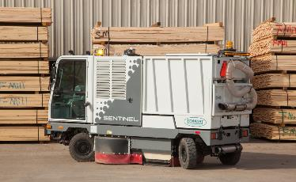
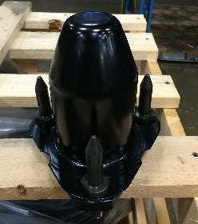
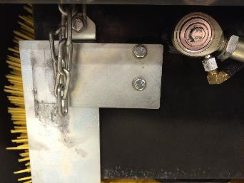
1. Sweeping
Vario Brush™, Side Brush, Main Brush, Conveyor and Hopper
Main Brush – 1 of 2
4-Wheel power steering delivers high maneuverability to access and sweep tight spaces
Reduce maintenance costs and provide efficient, consistent sweeping results with a 6 in / (150 mm) 3 pin drive and idler hub with cone-shape design that transfers power deep in to the brush core
Easier brush change maintenance with cone-shaped drive and idler hub to help guide the brush onto the drive
  Optional hinged main brush door makes it easier to remove door
Easy maintenance and reduced labor time with identical fasteners, M8 diameter size – only one size tool required to remove main brush idler hub plate
Menu

Slide 23
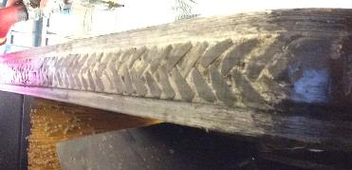
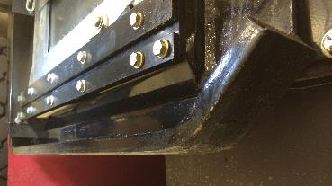
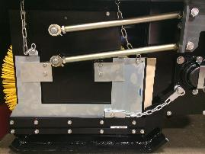
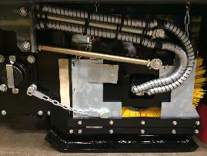
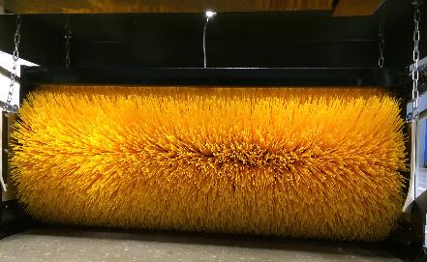
Direction of travel
1. Sweeping
Vario Brush™, Side Brush, Main Brush,
Conveyor and Hopper
Main Brush – 2 of 2
Standard long-life carbide inserted skids help hold debris in brush area, and are more effective than skirts because of consistent contact with road surface
Main brush is center-hung and free floating, with a durable 4-bar linkage, allowing the main brush to conform to the road contour for consistent contact
  This means operator does not have to set brush pressure. Although, brush pressure can be changed manually in the rear of the machine
Slinger seal on drive motor acts a debris guard and protects the drive motor for longer life (not pictured)
Only polypropylene brush is offered for main brush
Carbide
Menu

Slide 24
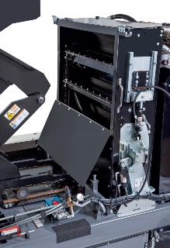
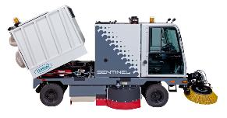
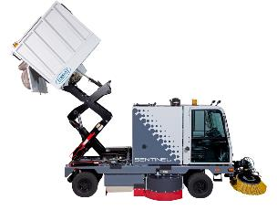
1. Sweeping
Vario Brush™, Side Brush, Main Brush, Conveyor and Hopper
Conveyor
New solid shaft design increases conveyor life (more info in Construction section)
13 paddles/troughs rotate vertically on a single solid-shaft design, for longer life and reduced cost, depositing debris at the top of the hopper
Hydraulically lowers when sweeping, raised when not (transport)
Standard hydraulic self-tensioning conveyor chain system eliminates the need to manually adjust the chain, keeping it at optimum tension, reducing maintenance time, and increasing conveyor chain life
Hopper
Maximum productivity from high capacity 3.4 yd³ (2.6m³) stainless steel hopper
Standard low dump and optional high dump (allows you to dump in a dump truck or roll-off)
  Low dump = 40 in (1,020 mm) disposal height
  High dump = 114 in (2,900 mm) disposal height (9’ 6” height)
Able to sweep in wet conditions and recover water effectively, and contain in hopper (better sealing when vac fans are on)
  Also effective Glycol recovery (running with vacuum fans on may impact filter life)
Shown with optional hinged conveyor door
Menu

Slide 25
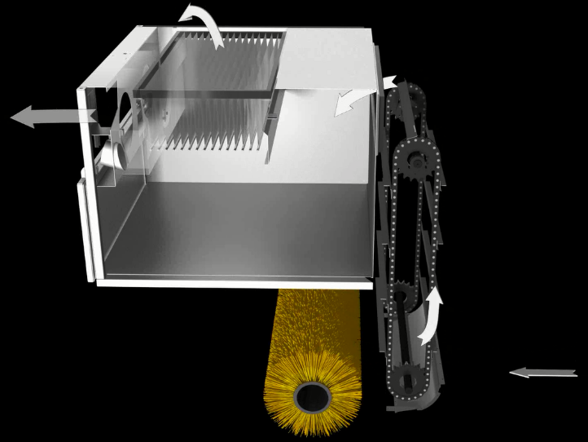
2. Dust Control
Menu
CONFIDENTIAL - For Internal Use Only

Slide 26
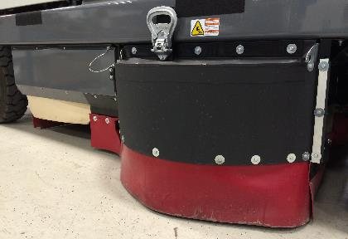
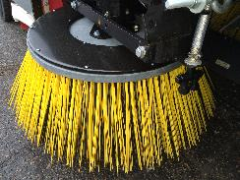
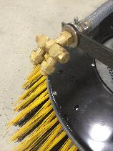
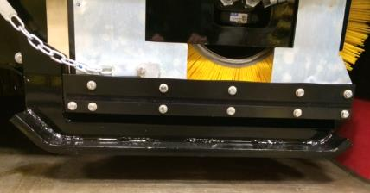
2. Dust Control
Mechanical Sweeping with Conveyor
Enhanced Facility Image with Excellent Sweeping Performance
Dry Side Brush Dust Control
  Full skirting around side brushes and main brush, using durable high-density polyethylene skirts and rubber coated nylon covers
Wet Side Brush Dust Control
  Adjustable spray nozzles help knock down dust with fine water mist fed from a 94 gal / 355 liters water tank. Two brass nozzles on optional Vario Sweeping Brush
Main Brush Skirting and Heavy-Duty Carbide Skids
  Floating suspension allows skids to keep contact with the surface, maintaining vacuum pressure and dust control
  Optional rubber skids for certain applications with protruding objects from the surface, providing more forgiveness when impacting surface obstructions – you may see debris trailing with this option
Menu

Slide 27
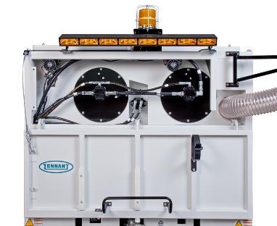
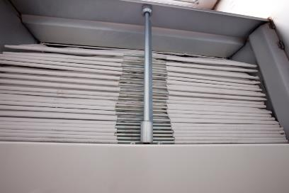
2. Dust Control
Standard Dry or Wet Dust Control (or combination)
High-Powered Twin Vacuum Fans and Long Lasting Filter
15 HP Twin vacuum fans pull dust from the main brush up through the conveyor to maintain dust control.
211 ft2 / 20 m2 of long lasting flame retardant filter media made of singed polyester, resisting water and mildew
Robust and effective beater-bar style shaker removes dust from the filter and drops directly into the hopper
Menu

Slide 28
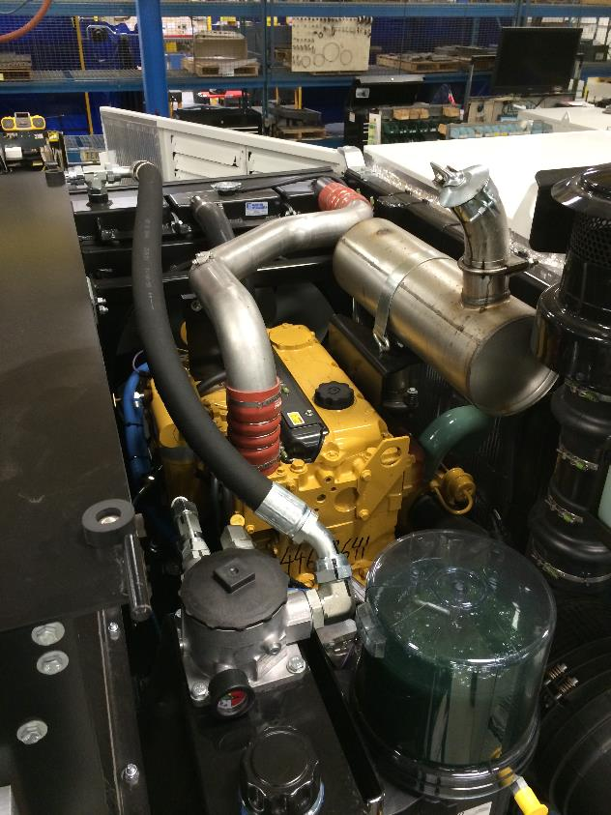
3. Power
Menu
CONFIDENTIAL - For Internal Use Only

Slide 29
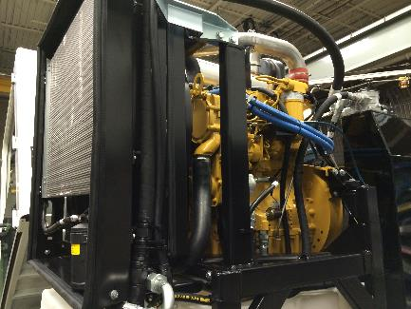
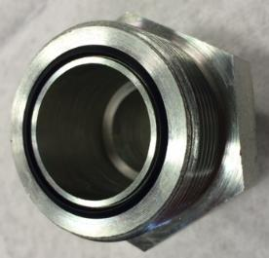
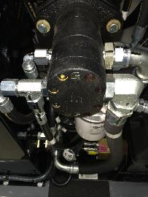
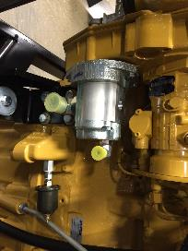
3. Power
Engine Specifications
Turbo Diesel = CAT 4.4L, 99 hp (74 kW) @ 2200 RPM, 120 amp 12 volt alternator, EPA Tier III, EU Stage 3
CAT Engine supported by significant global dealer network and parts support. B10 life at 8,000 hours (measurement of average life of engine). Turbo feature helps manage high altitudes with minimal reduction in horsepower up to 10,000 ft / 3,045 m elevation
Reduce maintenance costs and increase protection against messy hydraulic leaks with high quality “O-ring” face seal on hydraulic fittings and connections for better sealing and less susceptibility to leakage, utilizing steel tubing in critical areas, premium quality hoses, and abrasion-resistant hose covers
Longer component life and lower maintenance costs with a minimum of 4 accessory pumps (5 pumps when adding vario brush) that provide consistent hydraulic flow and pressure
“O-ring” Face Seal
Menu

Slide 30
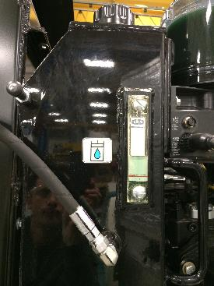
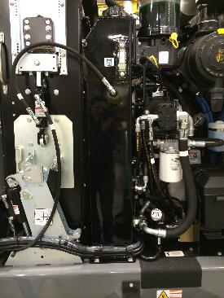
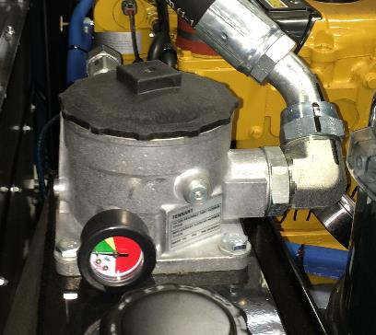
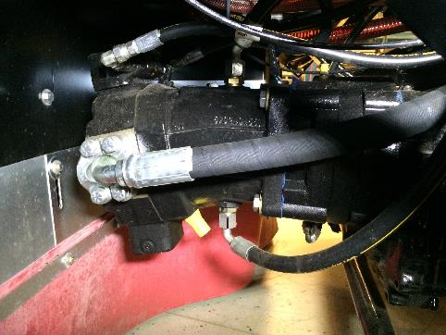
3. Power
Engine Specifications
A large capacity hydraulic oil tank and a convenient sight gauge allow for quick and easy hydraulic oil level checks
Reduce maintenance costs and protect the hydraulic system from outside contaminants with a high-quality, 5 micron fiberglass filter, for longer component life and reduction in valve sticking
Top-of-the-line Rexroth Propel System, is a well respected system with high reliability and high overall power efficiencies resulting in long life; front wheel driven
Menu

Slide 31
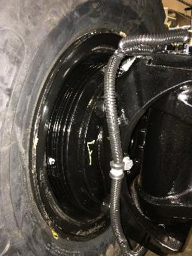
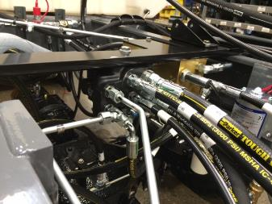

3. Power
Lower maintenance costs and easy service
Fully-sealed oil bath multi-disk braking system, to prevent any dirt from entering. Brake system that was developed for mining equipment increases brake life and decreases maintenance costs
Easy to use touch panel display (with self diagnostics) controls the electronic solenoid hydraulics for the sweeping system, which reduces the amount of hydraulic plumbing and connections required, reducing potential leak points. Also, easy access to hydraulic system for greater serviceability.
Pressurized hydraulic cooler bypass maintains hydraulic fluid temperature at the correct temperature no matter ambient conditions and increases life of the machine and lowers maintenance costs
Menu

Slide 32
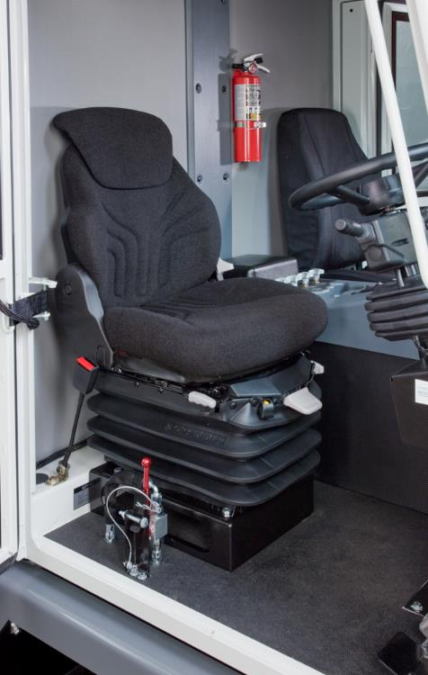
4. Operator
Compartment
Optional Air-Ride Suspension Seat
Menu
CONFIDENTIAL - For Internal Use Only

Slide 33

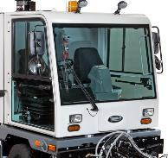
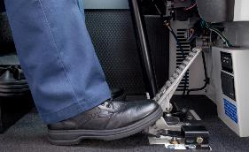
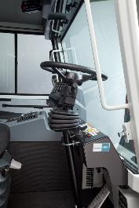

4. Operator Compartment
Improved Cab Ergonomics and Simple to Use
Increased safety and comfort with beneficial cab forward design, placing the operator in front of the machine for excellent visibility
Full-length TotalView™ glass doors and windshield give operators a clear 180 degree view of the sweeping area to maximize safety. Optional rear view color camera provides 360 degree view, seeing completely around the machine
Provide comfort to a wide range of operators with a spacious compartment that incorporates adjustable suspension seat, and tilt steering wheel, so fit can be customized. Plus added room for knees with redesigned dash, steering column rake, and propel pedal placement (moved toward front for more room)
Easy to use touch panel display (with self diagnostics) controls the electronic solenoid hydraulics for the sweeping system.
Menu

Slide 34


4. Operator Compartment
Improved Ergonomics and Simple to Use
Decrease operator training time with simple 1-Step button push, which begins all sweeping operations, and remembers the previous setting when shut-off:
  Lowering the conveyor, main brush, and side brush(es)
  Activating conveyor, brushes & dust control vacuum fan
  Note: Does not activate the Vario Brush
Greatly reduce training time and operator judgment with line-of-sight controls and a backlit LCD screen that display diagnostic codes
Increase safety and productivity with excellent forward sightlines and Vario Sweeping Brush and side brush visibility, so operators see their sweeping path out in front and on the side with side-view mirrors
Menu

Slide 35



4. Operator Compartment
Health and Safety with Easy Operation and Maintenance
Fully pressurized cab with MERV 15 rated in-cabin fresh air filter for, cleaner operator cab air during operation (commonly used in hospitals, bacteria, and smoke removal)
Standard operator seat features black cloth cushions, fore/aft adjustment, adjustable mechanical suspensions, operator presence control (seat switch)
Air ride seat custom option, same as standard, plus: seat and back cushions with active carbon moisture absorption, 12 v adjustable air suspension, fore/aft isolation control, adjustable seat back angle, adjustable lumbar support
Cab has the following: Filtered fresh air, heater/defroster, sliding windows, tinted safety glass, single windshield wiper, passenger jump seat (optional), seat belts, quad mirrors, power steering, and the cab will tilt to allow service access
Menu

Slide 36

5. Construction
Solid Shaft Conveyor Design
Menu
CONFIDENTIAL - For Internal Use Only

Slide 37




5. Construction
NEW Design
Bolted solid shaft
Reduced costs from durability – Increased Conveyor Life
Redesigned conveyor system now with longer life from a bolted, solid shaft construction, eliminating flex couplings, and going from double ball bearings to sealed roller bearings, rated at 20,000 lbs / 9,070 kg, which is 2 times the load rating compared to the previous design.
  Redesigned conveyor in production since summer 2013 and starts with 9607 serial numbers
  We have seen improved conveyor system life, reducing cost of ownership
Advantages over the previous flex shaft design:
  Removed two flex couplings, reducing chance for coupling discs to become packed with dirt and reduce load capability and potentially break-down
  Reduced maintenance with sealed roller bearings compared to two ball bearings that required being greasing often
OLD Design
Removed flex couplings and double ball bearings
Menu

Slide 38



5. Construction
Reduced costs from robust design
Four wheel leaf spring suspension for added durability, and reduced operator fatigue for increased comfort while operating
Maintain “industrial” durability over the life of the machine with a 5/16 in / 8 mm and 3/8 in / 10 mm heavy-gauge steel machine frame that is designed using box section steel structures for greater strength and rigidity
Provide excellent machine protection and appearance with state-of-the-art, baked-on powder coated paint finish
Reduce costs with durable, stainless steel hopper and steel service panels that are easy to access with lockable door handle and optional engine step feature
Menu

Slide 39




5. Construction
Health and Safety Features
Ensure operator safety and comfort with roomy, fully enclosed cab which is pressurized with heat (standard) and has optional air conditioning
Provide safety with increased operator visibility and machine awareness, with the use of standard headlights and LED taillights
Increase employee and facility protection with standard audio visual warning kit which includes a safety warning light and audio back-up alarm (not pictured)
Standard hopper lifting alarm along with hopper raise-and-tilt sensor to maintain proper stability when lifting
Menu

Slide 40


5. Construction
Ease of Maintenance
Reduced maintenance costs with quality electrical connections that are environmentally-sealed, automotive grade and water resistant and are the same used for on and off-road vehicle equipment
Ease of maintenance and serviceability with electrical wires that are numbered for easy tracing, and an electrical system that uses color-coded wires for easy troubleshooting
Longer life with electrical and hydraulic design layout that is engineered to avoid hot or moving components
Optional hydraulic cab jack (hand pumped) makes for easier service
Menu

Slide 41
5. Construction
Available Tire Options
Industrial Pneumatic Bias Ply – Standard Tire
  Description/Benefits = Acceptable in most light to medium duty applications, but not as durable and comfortable as a steel belted pneumatic radial. Not meant to be a long-distant high speed transport tire.
Steel Belted Pneumatic Radial
  Description/Benefits = Works well in a majority of applications. Less prone to flats, has a longer life, and improved ride. Go with this pneumatic tire for ride comfort characteristics and reduced potential for flats. Recommended for long distance high speed transport (municipalities).
Foam-Filled Bias Ply
  Description/Benefits = Not a pneumatic – air replaced with foam. Puncture resistant as main benefit. Reduced comfort with ride than standard Industrial Pneumatic Bias Ply, reduced wear life. Not recommended for applications/customers where high-speed transport is needed.
Foam-Filled Radial
  Description/Benefits = Not a pneumatic – air replaced with foam. Puncture resistant as main benefit. More comfortable ride than Foam-Filled Bias Ply. Less durable than Steel Belted Pneumatic Radial. If a customer (some municipalities) insists on having ability for higher speeds and puncture resistance, this is the recommended tire.
Menu

Slide 42
Comparisons to Tennant Offering
Menu
CONFIDENTIAL - For Internal Use Only

Slide 43


Key Differentiators in the Sweeper Line
43
Machine | S30 | 800 | Sentinel®
Sweep Path Main Single Side Brush Dual Side Brush Vario Sweeping Brush™ | 45 inch | 1,145 mm 62.5 inch | 1,590 mm 80 inch | 2,030 mm N/A | 50 inch | 1,270mm 66 inch | 1,675 mm 82 inch | 2,080 mm N/A | 51 inch | 1,300 mm 69 inch | 1,750 mm 87 inch | 2,210 mm 126 inch | 3,200 mm
Length | 93 inch 2,360 mm | 120 inch 3,050 mm | 175 inch | 206 inch (Vario) 4,450 mm | 5,200 mm
Width (Hard) | 62.5 inch | 1,590 mm | 70 inch | 1,780 mm | 70 inch | 1,780 mm
Height w/o overhead guard with overhead guard | 58 inch | 1,475 mm 82.5 inch | 2,095 mm | 52.5 inch | 1,335 mm 82.5 inch | 2,095 mm | 100 inch | 2,540 mm (with safety light on top)
Debris Hopper Volume Capacity Weight Capacity | 14 ft³ | 395 L 1,080 lb | 490 kg (plas.) 1,200 lb | 545 kg (steel) | 30 ft³ | 850 L 2,000 lb | 907 kg (steel) | 3.4 yds³ | 2,600 L 7,000 lb | 3,175 kg (low dump) 4,000 lb | 1,8115 kg (high dump)
Dust Control System | SweepMax® Plus 8 cyclones | Dual Canister Filters Wrap-around pre-screen | Twin Vac Fans with dry and optional wet dust control
Menu
CONFIDENTIAL - For Internal Use Only

Slide 44


Recommendation: 800 vs Sentinel®
44
800 when…
Price point is extremely critical and customer is willing to trade-off capacity
Tighter areas or aisles of sweeping
Disposal location is easily accessible for hopper capacity
LPG or Gasoline option is required
Sentinel when…
Cleaning performance requirement, such as campus or business improvement districts
Larger areas that need to be swept and transport between dumping is longer distances
Dry and/or wet dust control need, wider sweeping path and larger hopper capacity
Need to reach curbs, or sweep in corners or around obstacles (Vario brush option)
Passenger transport or ride-along required (also standard with cab)
Understand the application following a thorough customer site survey and recommend the right offering
Menu
CONFIDENTIAL - For Internal Use Only

Slide 45
Competitive Comparisons
Also Utilize Detailed 5-Point Walk-Around Comparison Sheets
  Tymco® DST 4
  Dulevo® Quattro 200
  Elgin® Pelican®
Menu
CONFIDENTIAL - For Internal Use Only

Slide 46




Competitive Landscape
46
Brand | Tennant | Tymco | Dulevo | Elgin
Model | Sentinel® | DST 4 | Quattro 200 | Pelican
Reach | Global (Not Europe) | N.A. | Global (less in N.A.) | Global
Type | Mechanical | Regenerative Air | Mechanical | Mechanical
Main Path | 51 in / 1,300 mm | 82 in / 2,080 mm | 51 in / 1,300 mm | 66 in / 1,675 mm
Single SB Dual SB Vario Brush | 69 inch / 1,750 mm 87 inch / 2,210 mm 126 inch / 3,200 mm | 104 in / 2,640 mm 130 in / 3,300 mm N/A | in / mm in / mm 102 in / 2,590 mm | 96 in / 2,435 mm 120 in / 3,045mm N/A
Hopper Vol. | 3.4 yds³ / 2,600 L | 4.0 yds³ / 3,050 L | 3.3 yds³ / 2,500 L | 3.5 yds³ / 2,675 L
Side Brush Dust Control | Dry Dust Skirting Wet Spray Dry and Wet | Wet Spray | Wet Spray | Dry Dust Skirting Wet Spray Unknown for combo?
AQMD PM10 | YES | YES | YES (Europe Only) | YES
Gradeability | Full Hopper: 8⁰ / 14% Empty Hopper: 22⁰ / 21% | Not determined | Not determined | Full Hopper: 17⁰ / 30% Empty Hopper: Unknown
Travel Speed | 25 mph / 40 kmh | Unknown, but truck mounted | 18.5 mph / 30 kmh | 20 mph / 32 kmh
Menu
CONFIDENTIAL - For Internal Use Only

Slide 47





Competitor Scorecard
47
4-wheel steering/maneuverability
Single engine for sweeping and propel
Vario brush for extended path and reach
Cab-forward, with full glass doors
Side brooms dry dust control
One touch button sweeping controls
High transport speed (on-road)
Configuration of Wet and Dry Combined
Multi-Level Dump |  |  | Unknown
Full dust control system contained in hopper
Conveyor motor not in the debris path |  | N/A
Engine not located under hopper
Score | 11 | 2 | 7 | 6
Tymco DST 4
Dulevo Quattro 200
Elgin® Pelican®
Menu
CONFIDENTIAL - For Internal Use Only

