Slide 1




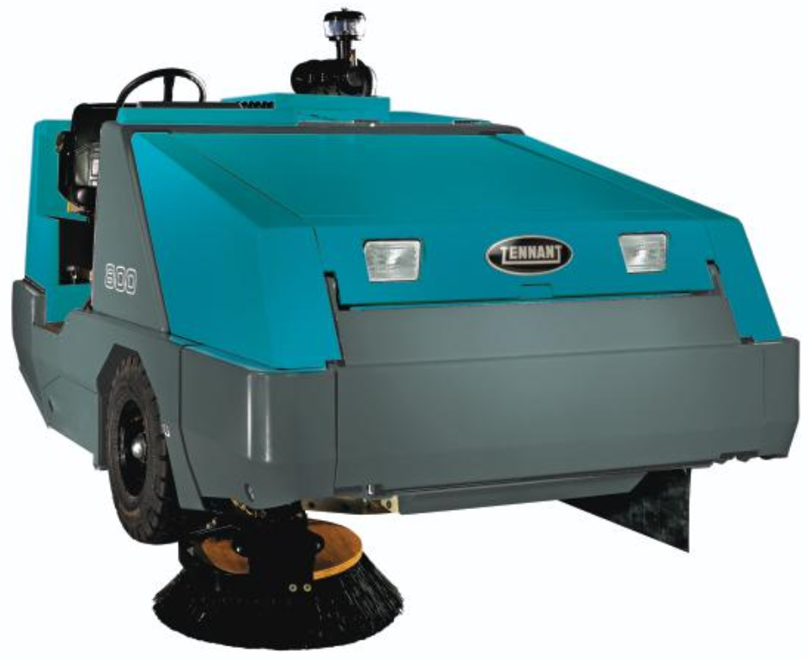
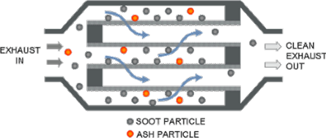
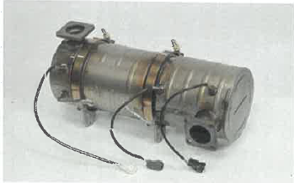
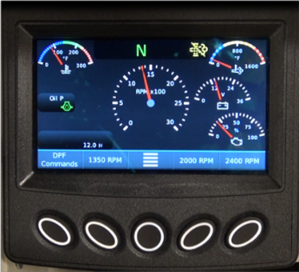
Diesel Particulate Filter on 800D with Kubota Tier 4F

Slide 2
Objective of this training
After this session you will be able to answer the following questions:
Why do we have a Diesel Particulate Filter on the 800D?
What is a Diesel Particulate Filter?
How does a DPF work?
What fuel and engine oil should be used?
What is the EDM – Engine controller?
What is regeneration?
  Yellow alert
  Orange alert
  Red alert
Sweeping Regeneration
Parked Regeneration

Slide 3
800D – Kubota tier 4F engine
The 800D is equipped with a DPF (Diesel Particulate Filter) to meet the latest emissions requirements.
This filter automatically burns all soot* collecting in the DPF when the machine is operating at full power / capacity.
When the machine has not been operated at full power to eliminate the soot from the DPF, the machine will need to run through a Regeneration process.
System on the machine since 2014, starting serialnr: 800-8015
14x 800D sold with this system in Europe only at Master Distributors
NOTE: Operate the machine at full power / capacity to avoid having to initiate a regeneration.
Soot = Particulate matter, blackened diesel emission
Notes:
The 800D machine is equipped with a DPF (Diesel Particulate Filter) to meet the latest emissions requirements.
This filter automatically burns all soot collecting in the DPF when the machine is operating at full power / capacity.
When the machine has not been operated at full power to eliminate the soot from the DPF, the machine will need to run through a Regeneration process. The EDM (engine display module) alerts the operator when a regeneration process is required.
NOTE: Operate the machine at full power / capacity to avoid having to initiate a regeneration.
See DPF REGENERATION in the MAINTENANCE section of this manual.

Slide 4
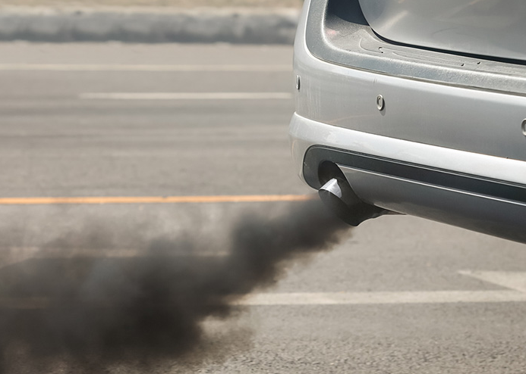
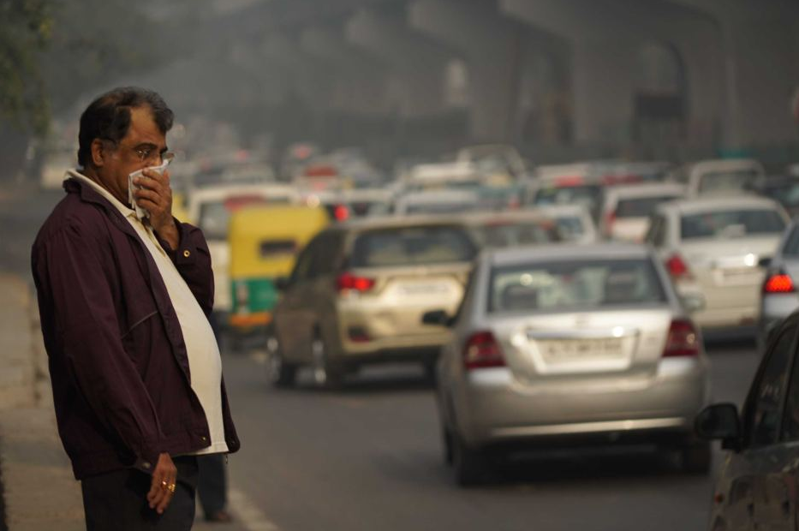
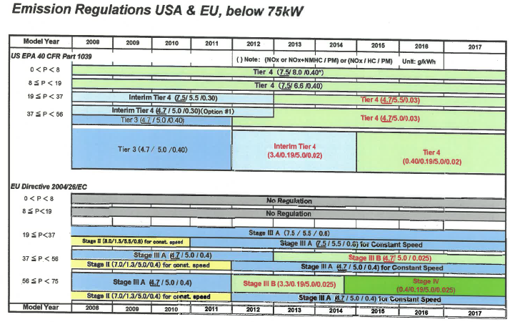
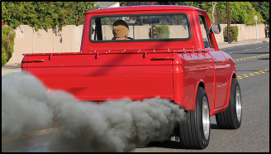
Why Diesel Particulate Filter (DPF)
Health and Environment -> tighter emission regulations
Reduce amount of Diesel Particulate Matter (also known as Soot)
Soot = incomplete burned diesel fuel
Notes:
For environmental and health aspects regulation around diesel engine emission has become tighter over the last decades.
The DPF traps the soot from the exhaust system preventing it from being released into the atmosphere.
This is needed to meet the latest emission requirements.
The emission of the diesel particulate matter known as Soot will (and must) be reduced dramatically.
Soot = incomplete burned diesel fuel
Note: Diesel engine is 43,2kW (57,6Hp)

Slide 5
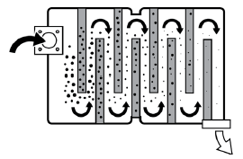
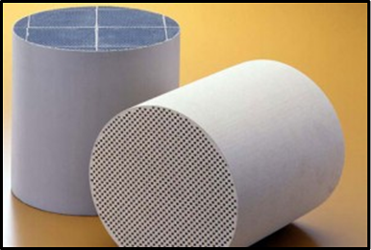
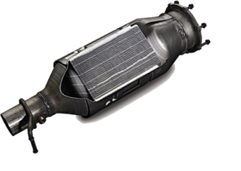
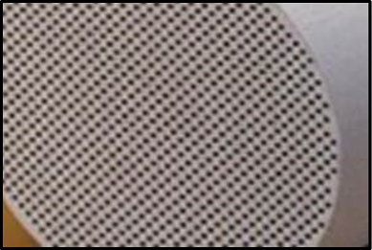
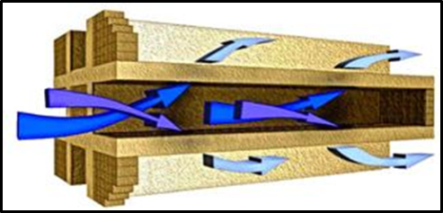
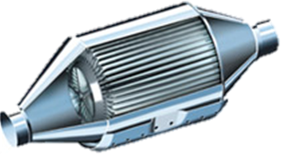
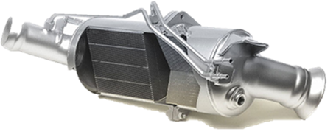
What is a DPF?
Notes:
DPF's are an emission reduction device which is designed to trap and remove diesel particulate matter or soot. As the DPF filters the exhaust stream, soot particles will remain trapped in the DPF and will need to be removed through a process called Regen or Regeneration.
They resemble catalytic converters, with half the channels blocked at the inlet, and half blocked at the outlet.
The DPF's come in a great variety of shapes and sizes that are matched to the engine displacement and available space in the equipment.
Similar to a muffler or a catalytic converter.

Slide 6


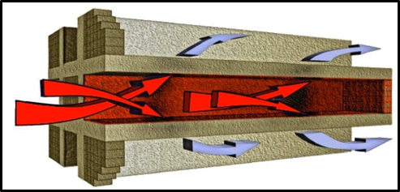
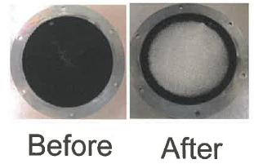
How does it work a DPF?
High temperature (600°C) during regeneration
Porous walls where PM (soot) can’t flow through
Due to high temperature soot will be burned to restore air flow through DPF
Notes:
The walls are porous so the exhaust gasses are able to flow through the "walls" however; the particulate matter (soot) is unable to flow through the walls and remains trapped in the channels.
The machine automatically burns the soot collecting in the DPF when the machine is operating at the optimal power level (full power / capacity). The DPF gets clogged much more quickly when the machine is not run at the power optimal level.
To avoid having to initiate active regenerations, always try to operate the machine at the optimum level.
A DPF regeneration is necessary when the DPF is significantly clogged. An alert appears on the EDM (engine display module) when a regeneration is necessary.
The alert will be generated due to back pressure in the DPF caused by the trapped soot.
If regeneration process is not executed, back pressure will build up and eventually affect engine performance and/or damage the engine if the soot is not eliminated. The soot trapped inside the DPF is must be burned during the regeneration process.
How is the soot and other "particular mater" burned? This is achieved by elevating the exhaust temperature in the DPF to around 600⁰C or (1200⁰F).
The hot exhaust gasses heat the DPF substrate igniting the soot that has collected and built up in the cells. When regeneration is complete, all that remains is a tiny amount of ash. This process effectively restores air flow through the cell walls, or regenerates its ability to filter soot.
When the sweeper is in the regeneration process the operator "Must be aware of and avoid any flammable or combustible materials near or under the sweeper."

Slide 7

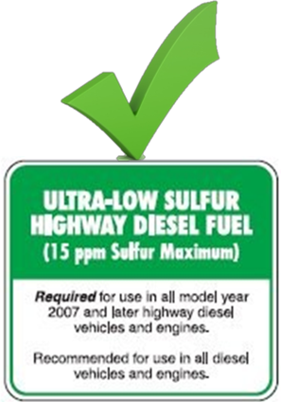
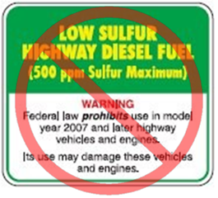
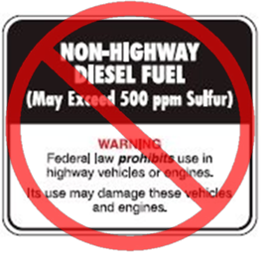
Important notice
IMPORTANT: Use Ultra Low Sulfur Diesel Fuel Only.
NO, Low sulfur or Non-highway diesel, Bio−Diesel or aftermarket additives to the fuel.
Engine oil: SAE 10W−30 Engine oil
API diesel classification CJ−4 or better, CF / SH.
Notes:
In order for the DPF to operate correctly, it will be critical to properly maintain the DPF and use the correct diesel fuel and engine oil.
IMPORTANT: Use Low Sulfur Diesel Fuel Only. DO NOT use other fuels such as Bio−Diesel or add aftermarket additives to the fuel in this machine. Other fuels and aftermarket additives will damage emission components, requiring more frequent and costlier maintenance. Engine damage due to use of other fuels and aftermarket additives may not be covered under the machine warranty.
Engine oil: SAE 10W−30 Engine oil, API diesel classification CJ−4 or better, CF / SH.

Slide 8
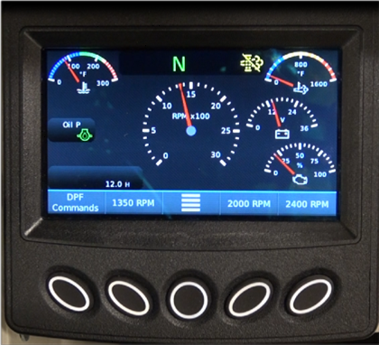
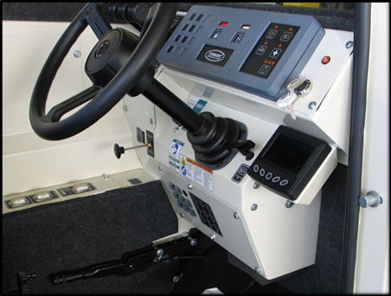
Engine Controller
EDM = Engine Display Module (Kubota PV480)
Display engine parameters
Inhibit (prevent) and un-inhibit (allow) regeneration process
Notes:
The EDM is used to display engine operating parameters.
It is also used to inhibit (prevent) and un-inhibit (allow) the regeneration process.

Slide 9
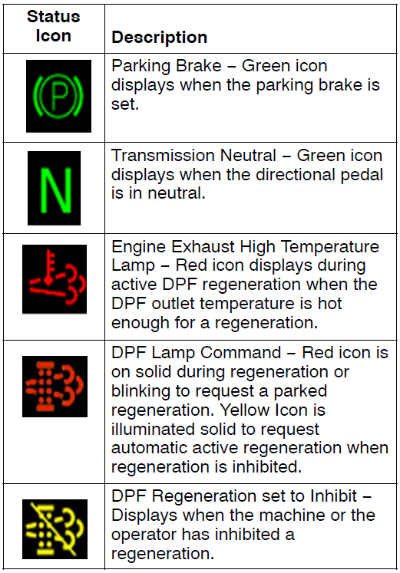
Engine Controller
Notes:
DPF (DIESEL PARTICULATE FILTER) STATUS ICONS Monitor the color coded DPF Status Icons for DPF status.
DPF (DIESEL PARTICULATE FILTER) ALERTS The EDM will display colored DPF alerts starting with a yellow, proceed to orange and finally to red symbolizing the increase of the alert urgency.
Yellow alert: The DPF contains enough soot for an automatic active regeneration. The machine can still be used for cleaning and there is no change in engine performance. Regeneration can be done while sweeping at this level. It is recommended that a regeneration be performed at this level. CALLED A SWEEPING REGENERATION.

Slide 10
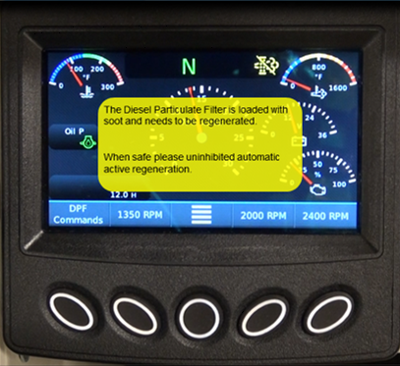


Regeneration process – Yellow alert
Sweeping regeneration
Notes:
It is strongly recommended that the regeneration be done when the first yellow alert appears.
A regeneration may take between 20−40 minutes to complete depending on engine and ambient temperatures. Once a regeneration is started it should be allowed to complete.
The regeneration can be run at a later time, but each time the request is declined, soot will continue building up further diminishing engine performance and requiring a longer time to perform the next regeneration process.
If it is not possible to complete a Regeneration (due to work situation / conditions), press the soft button below the X (Deselect) to close the regeneration alert and return to the gauge view.
If the request for regeneration is declined several times the next alert will be Orange.

Slide 11
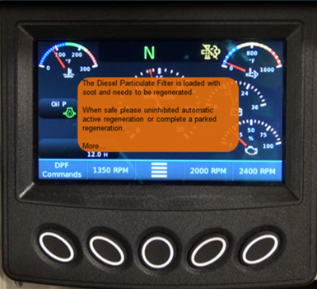
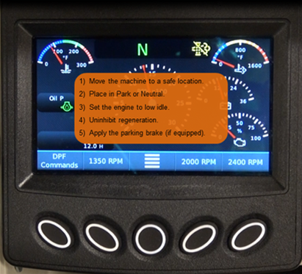
Regeneration process – Orange alert
Active and/or Parked regeneration
Notes:
Orange alert: The DPF contains enough soot for an automatic active regeneration. The machine can still be used for cleaning but there is some decrease in engine performance. A Sweeping or a Parked Regeneration can be done while at this level. It is strongly recommended that a regeneration be performed at this level since only a parked regeneration can be done if the machine is allowed to go beyond this alert.
If the operator fails to "Un-inhibit" for the "sweeping“ or “parked” regeneration request several times in row, the EDM will then request what is known as a parked regeneration. As the name implies, a Parked Regeneration is performed while the sweeper is parked. This regen will require more time and fuel.
The second screen shows the instructions what to do for the parked regeneration process.
NOTE: Use soft button located under the Down arrow to see the full screen. Use soft button located under the Up arrow to go back to previous screen.

Slide 12
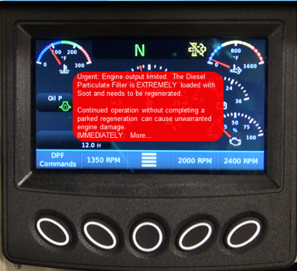
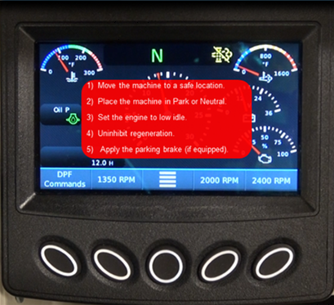
Regeneration process – Red alert
Parked regeneration
NOTE: If orange alerts are ignored, a shutdown warning will display and the engine will shut down every 5 minutes until a regeneration is completed. If a red alert appears and the display shows Excessive PM4 (P3007) or Excessive PM5 (P3008), then the operator can no longer initiate the regeneration process.
Notes:
Red (URGENT) alert: The DPF is extremely loaded with soot and needs a PARKED regeneration. The machine should NO LONGER be used for cleaning as there is significant decrease in engine performance. It is imperative that an active parked regeneration be performed immediately after receiving this alert since this is the last alert that allows an operator initiated parked regeneration.
If the operator fails to "Un-inhibit" the parked regeneration request several times in row, the EDM will then request what is known as an Urgent Request for regeneration. Continued operation will cause unwarranted damage to the engine and DPF.
This is the second screen for the Urgent Request regeneration request. On the screen are the instructions for the regeneration process.
At this level, the sweeper may be operating under reduced power levels, and sweeping performance will be reduced.

Slide 13
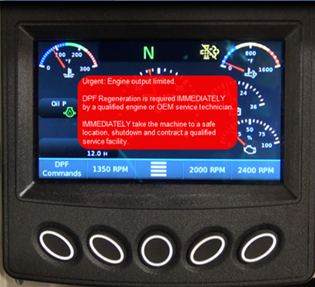

Regeneration process – 2nd and 3rd Red alert
Sweeping regeneration
NOTE: If orange alerts are ignored, a shutdown warning will display and the engine will shut down every 5 minutes until a regeneration is completed. If a red alert appears and the display shows Excessive PM4 (P3007) or Excessive PM5 (P3008), then the operator can no longer initiate the regeneration process.
Notes:
2nd Red (URGENT) alert: If the first Red alert is ignored, the operator can no longer initiate the regeneration process. A qualified service person will need to initiate the regeneration. Park the machine immediately and call a qualified service person. NOTE: All DPF related repairs due to the ignored
regeneration alerts are not covered under the machine warranty.
3rd Red (URGENT) alert: If the 2nd Red alert is ignored and the machine is not immediately turned off, the DPF will need to be either replaced or removed from the machine and sent to a qualified cleaning facility to be cleaned. This is a very costly repair and is not covered under the machine warranty.

Slide 14
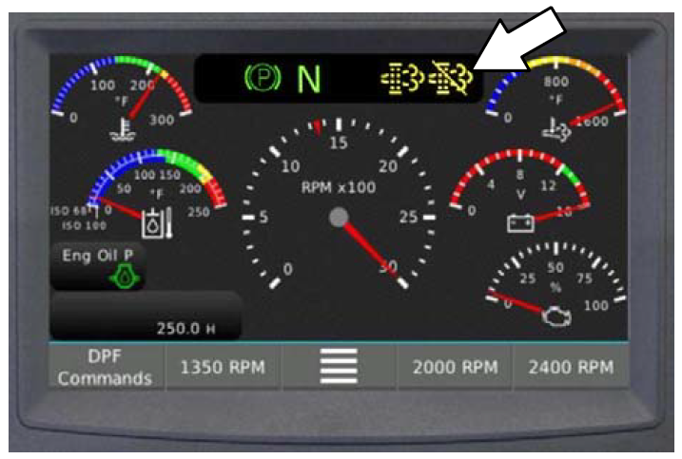
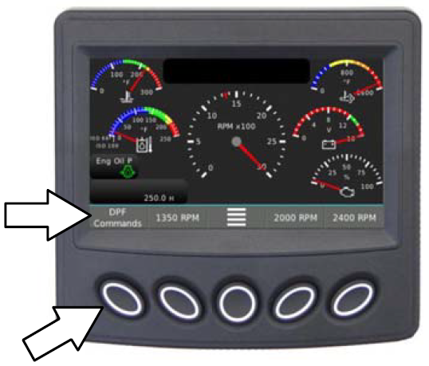
Initiate Sweeping regeneration
The EDM defaults to the Inhibited setting. The DPF inhibited icon illuminates when a regeneration is inhibited.
Un−Inhibit the system to initiate an active regeneration.
Select Un−Inhibit Regen from the menu and follow the on screen directions.
The EDM returns to the Inhibit default after the Un−Inhibited regeneration is complete.
Press the soft button under DPF Commands to access the Un−Inhibit Regen command.

Slide 15
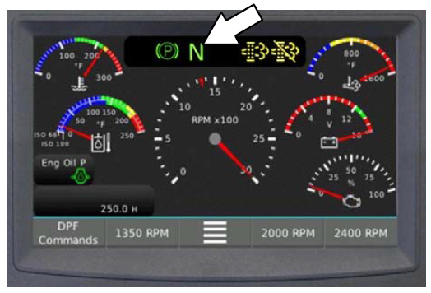
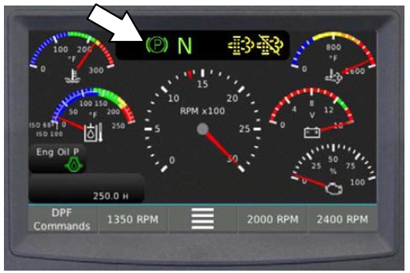
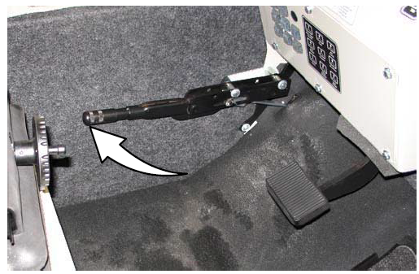

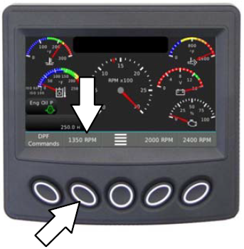
Initiate Parked regeneration
NOTE: All EDM (engine display module) error codes must be cleared before placing the machine into regeneration. The EDM will not allow the engine to regenerate if there are error codes on the display.
Set parking brake
Directional pedal in Neutral during Regeneration
Follow instructions on EDM:
Press DPF Commands
Select Un-inhibit
Lower idle to 1350rpm
Continue next slide ->
Notes:
FOR SAFETY: Before initiating an active parked regeneration, stop on a level surface in a well ventilated open area. Park in low traffic areas away from pedestrians and other equipment. Do not park near combustible materials, dusts, gases, or liquids. Do not park indoors or in enclosed areas. Set parking brake. Do not leave machine unattended.

Slide 16
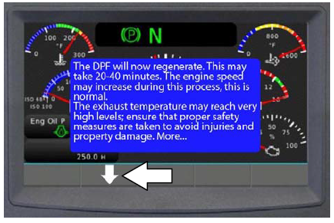
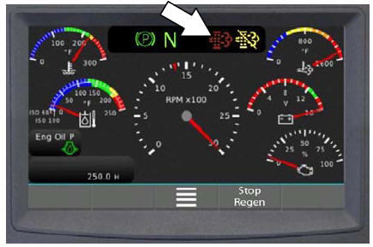
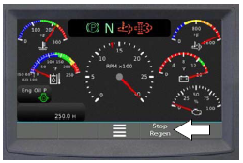
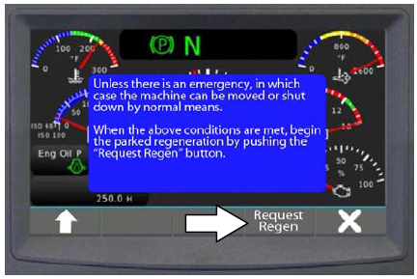
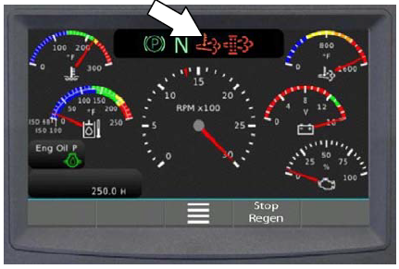
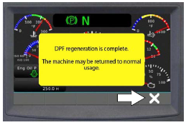
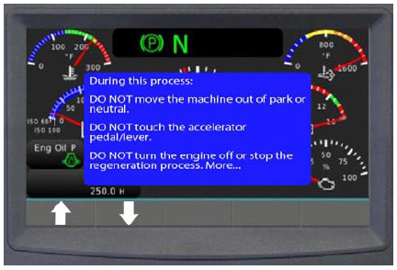
Initiate Parked regeneration
Navigate through the alert with the down button
DPF icon iluminated red in parked regen
Press Request Regen
Engine exhaust high temp icon
Only stop regen premature in case of an unsafe situation
No not touch directional pedal or release parking brake
After the regeneration press the X to return to normal operation
NOTE: If engine shuts down every 5 minutes it will need to be restard each time and regen command set to un-inhibit until the engin reaches operation temp for regen.
Notes:
NOTE: If the engine shuts down every 5 minutes, it will need to be restarted each time and regen command set to un−inhibit until the engine reaches operating temperature so a regeneration can occur.
NOTE: Do not touch the directional pedal, release the parking brake, or turn off the engine after placing the machine into parked regeneration.
Wait for the machine to complete the Parked Regeneration (may take 20−40 minutes to complete).
The DPF icon and engine exhaust high temperature icon illuminate solid red while the machine is in parked regeneration.
NOTE: Do not stop the parked regeneration unless there are extenuating circumstances (safety issues) that require the parked regeneration to be prematurely stopped. Only if necessary, press the soft button located below Stop Regen to stop the regeneration.
NOTE: After a prematurely stopped parked regeneration the EDM may again display an alert that a regeneration is necessary the next time the machine is started and allowed to warm up to a temperature hot enough for a regeneration to be initiated, When circumstances allow, initiate another regeneration.
“DPF regeneration is complete” appears on the EDM display when the parked regeneration is complete. Press the soft button under X (Deselect) to close the message and return to the gauge display. The machine is ready for use.

Slide 17
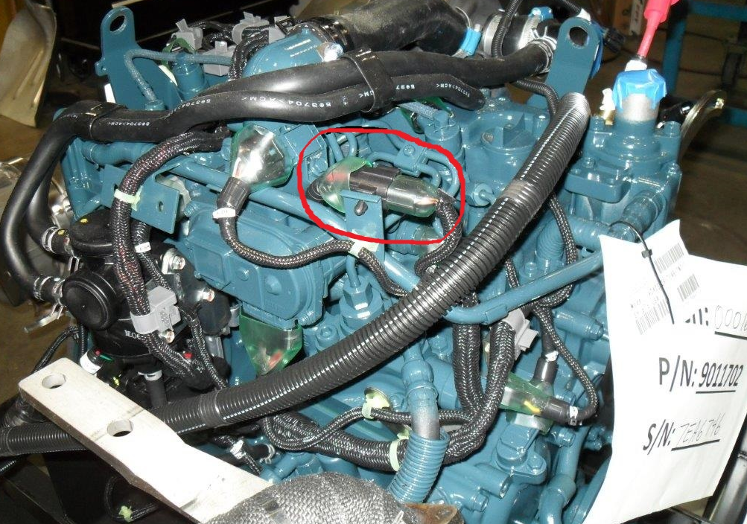
Important: PM4 and PM5 alert
Display shows a red alert: Excessive PM4 (P3007) or Excessive PM5 (P3008)
PM4 red alert, operator cannot initiate the regeneration process, involvement from authorized service is needed, with Diagmaster software.
PM5 red alert, the DPF will have to be taken of the machine and send to a facility to get the filter cleaned, after re-installing regen is needed which can only be done by authorize service with Diagmaster.
Currently we do not have Diagmaster in Europe
In case of PM4 or PM5 Kubota must be contacted
Always at the expense of the customer!
Good instructions must be given to Operators to never neglect alerts!!
Connector interface cable
Notes:
Steps to follow for level PM5 (clogged DPF) recovery. If the level is PM4, the DPF does not need to be removed and cleaned skip to step 5 below
Mark the 3 sensors for location, remove sensors and DPF muffler assembly, the part is fragile so package well.
Identify a DPF cleaning facility. You can use the following link to locate one: http://www.fsxinc.com/site1/Services/LocMap.html
Make arrangements with the facility to get the filter cleaned
Reinstall the DPF muffler and sensors in their marked locations
Contact a Kubota Service Provider who has access to the Kubota Diagmaster software and interface cable. (The Tennant P/N for the cable is 9012823)
The ECU will require a forced regen with the Diagmaster system cable plugged into the engine harness (see attached picture for connection point, the existing connector will need to be unplugged.
Hook the cable up to the connector on the engine (see attached picture)
Complete a manual regeneration process through Diagmaster.
Kubota only grants access to Diagmaster to authorized Kubota Service Providers and OEM’S. Independent service providers cannot access Diagmaster.

Slide 18
Summary DPF system
Use Ultra Low Sulfur Diesel and CJ-4 classification engine oil
Operate machine as much as possible at optimal power level
When the first Yellow alert screen is coming up, try to regenerate the DPF in active operation or parked regeneration, asap
When a regeneration is active try to prevent to interupt the process
When regeneration is active beware of high temperatures on the exhaust side, do not park near combustible materials , dusts, gases or liquids.
When in parked regeneration never, touch direction pedal or release parking break
If the Orange alert are neglected, the engine will start to shut down every 5 minutes.
When a regen has to be started at a red alert, (and engine shuts down every 5 minutes) it must repeat the sequence every 5 minutes until the engine has reached operating temperature.
PM4 and PM5 level, need involvement Kubota or Service with Diagmaster software

Slide 19
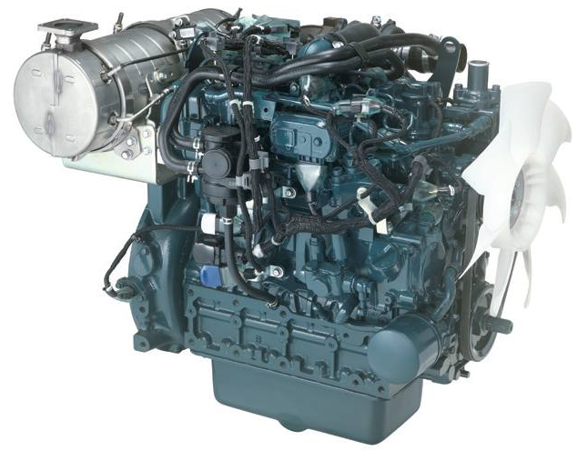
More Information?
Available on Tennant University:
Kubota V2403 Service Introduction
  Introduction course on the complete V2403 engine in the 800D sweeper
Kubota 800F and DPF Technology
  Detailed course explaining all about the DPF technology
Supporting materials - Tech Docs:
Engine Workshop manual – Kubota 2403-T-4f (9012443)
Kubota EDM operator manual (9012997)
Diagnosis Manual Kubota 03-CR-E4B series (only on ASK)

Slide 20
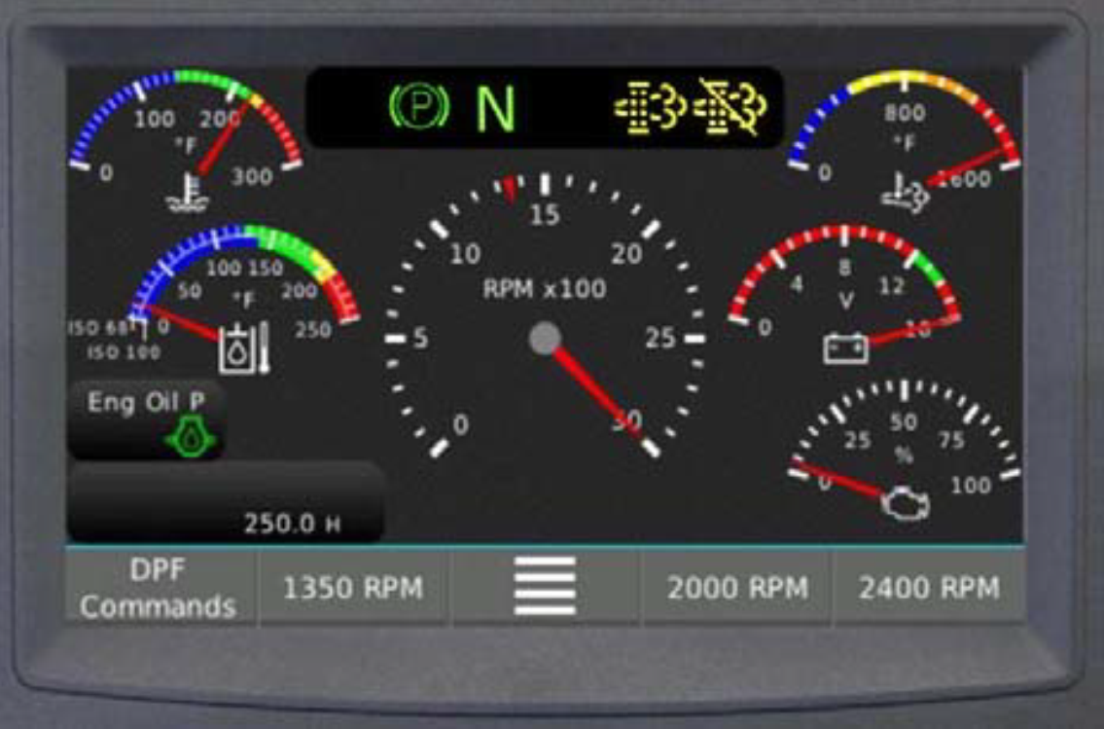
Update Diesel Particulate Filter on 800D with Kubota Tier 4F

