Slide 1
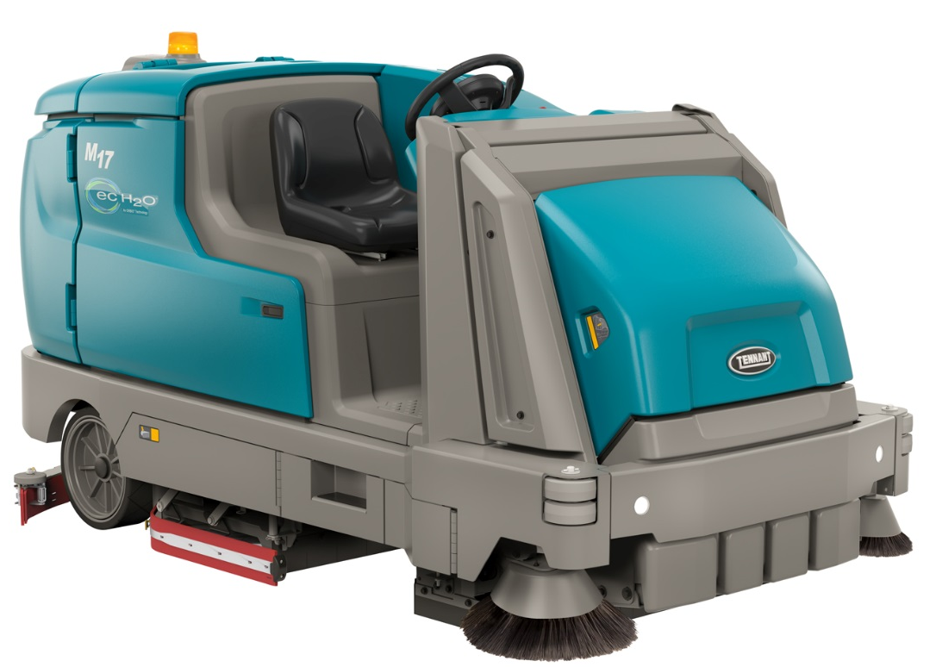
Product Application and Solution Guide
M17BATTERY SWEEPER-SCRUBBER

Slide 2




M17 Benefits
Reduced Cost to Clean
  Efficient cleaning through simultaneously sweeping and scrubbing
  Full-shift cleaning
  Eliminate need for costly fossil fuels
  Remove secondary cleaning & water pickup equipment
Enhance Facility Image
  Cleaning solutions to match the soil load of the facility
  Excellent water recovery
  Capture large and small debris in one pass
Ease of Use
  Intuitive controls
  Tool-free access to main parts
Maintain Health and Safety
  Minimize contact with harmful materials
  Improve indoor air quality
  Exceptional dust control
  Forward operator position, eyes-forward controls & engineered sightlines

Slide 3


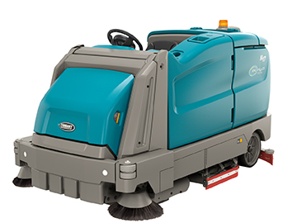


M17 Key Markets
Warehousing & Logistics
Manufacturing
Retail Distribution Centers
Food and Beverage

Slide 4
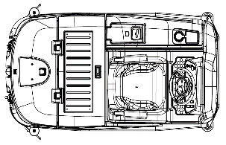
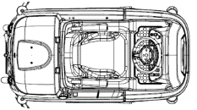
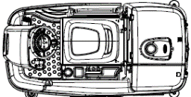
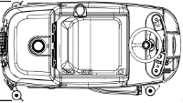
Full Range Offering
 | T7 | T12 | T16 | T17 | M17
Length | 1520 mm | 1710 mm | 1880 mm | 2245 mm | 2850 mm
Width | 740 mm | 950 mm | 1040 mm | 1168 mm | 1370 mm Standard dual sweeping side brush
Height | 1270 mm | 1425 mm | 1475 mm | 1480 mm | 1480 mm

Slide 5
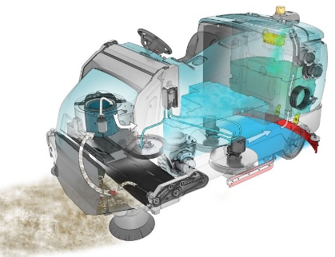
Reduced Cost to Clean
Sweeper/scrubber machine - One pass sweeping and scrubbing
Disk and cylindrical scrubbing – Cleaning tools for unique application
Large 285 L solution tank – maximizes uptime & minimizes dump and fills
Large 364 L recovery tank – easy access to tank and easy cleaning
ec-H2O™ technology – detergent-free cleaning; scrub up to 3-times longer on single tank of water
Optional scrubbing side brush - Extends scrubbing path by 20%
Multiple battery solutions - Match power source to cleaning needs
High pressure washer – remove tough soils; reduces need for separate equipment
Live wand - operators remain on the machine while picking up debris
Powered high dump - reduces need to manually handle debris

Slide 6
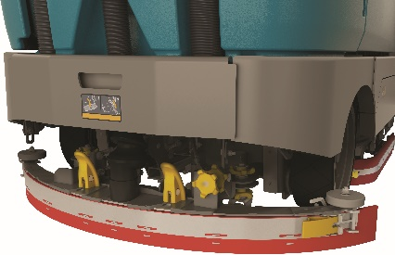
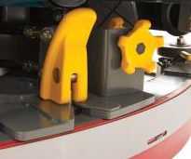
Reduced Cost to Clean
Yellow touch points – Provides easy, tool-less access to machine components
Optional spray hose – easily cleans recovery tank
Economy Mode - Save money and optimize performance levels when cleaning lightly soiled areas, saving brush/pad life and extending runtime
SmartRelease™ - Prevents damage to the machine from severe impacts
SmartRelease
Release Point

Slide 7

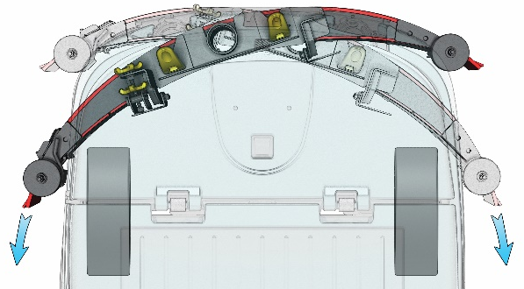
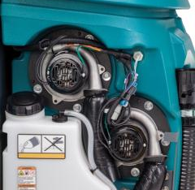
Enhance Facility Image
Standard dual sweeping side brushes - Ensures the entire scrub path is swept
Dual Force or Direct Throw sweeping - Effectively captures large and fine debris
Large scrub brush motors - Significant power to the floor to clean and maintain shine
QA® Controls - Consistent results, reduce operator error by locking machine settings
Dual Vacuum fans - Advanced water evacuation design lets water siphon out of the fan chamber before damage is caused to the motor*
Unique rear swinging squeegee - Leaves a clean path and reduces streaking
High pressure washer - Effectively cleans tougher soils and non-floor surfaces
Live wand - Easily removes debris like shrink wrap
* Based on information from the manufacturer

Slide 8
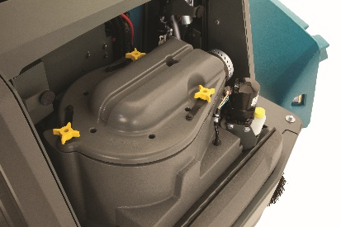
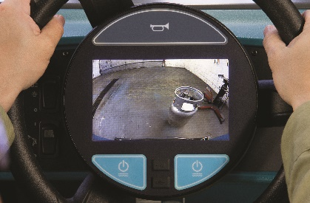
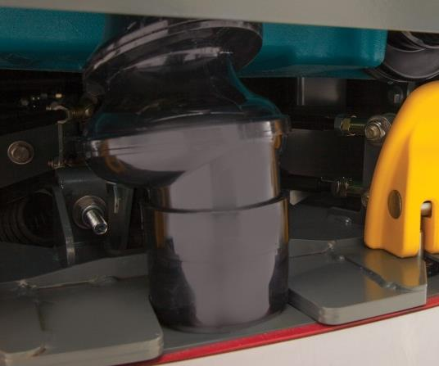
Maintain Health and Safety
Forward operator position - Improves sightlines
Eyes-forward controls - Keeps operator focus forward
2-stage dust control and ShakeMax™ filter shaker - Maintains indoor air quality
Excellent water recovery - Reduce the risk of slips and falls
Fume-free battery options - Improves indoor air quality
Front-wheel steering and propelling - Pull machine away from walls and racking
Pro-Panel PerformanceView™ - Provide operators a rear view of the machine
Patent Pending Water Trap – Captures moisture in the recovery hose

Slide 9
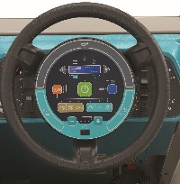
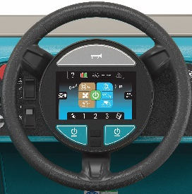
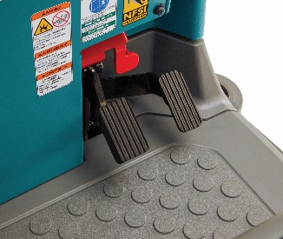
Ease of Use
Touch-n-Go™ Control Module – Makes machine operation easy
Pro-Panel™ Technology – Provides intuitive machine controls
  Zone Settings™ – Preconfigure machine setting for the needs of a particular building area
  On-Board/On-demand Maintenance Videos – Makes maintenance and training easy
Yellow Touch Points – Easily identifies parts that need routine preventative maintenance
Car-like brake and propel pedals - Increase ease of operation
Tool-less access to squeegees, brushes & filters - Reduces time spent on maintenance
Optional spray nozzle - Quickly and easily cleans the recovery tank

Slide 10

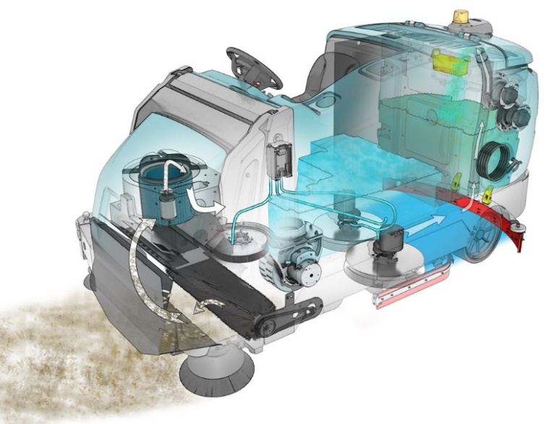
M17 Sweeping Systems
Dual Force Sweeping (DFS™)
  Twin counter rotating main sweep brushes tosses debris into hopper
  Total hopper capacity is 85 L – Usable capacity is 70,8 L
  Picks up debris like:
    Soda cans
    Larger pieces of paper
    Pallet chips smaller than 15cm
  Must lift sweeping hopper on ramp transitions greater than 7,5 degrees
Direct Throw Sweeping
Single main sweeping brush sweeps into hopper
Total hopper capacity is 85 L – Usable capacity is 30,3 L
Picks up debris like:
  Sand and dust
  Sheets of paper
  Small metal objects like nuts, bolts and paper clips
  Pallet chips up to 55 cm long
Must lift sweeping hopper on ramp transitions greater than 3 degrees
Dual Force™ Sweeping
Direct Throw Sweeping

Slide 11
Multi-Level Dump Hopper
Ergonomic Debris Disposal
  Powered dump lifts debris and disposes of it into trash bin.
  No Manually lifting or handling of debris eliminates the possibility of potential back strain injury.
Proprietary Features:
  Hopper Load can be inspected to determine if hopper is full
  Large debris can be easily placed in hopper. No need to place it in the operator compartment.

Slide 12
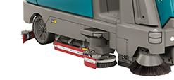
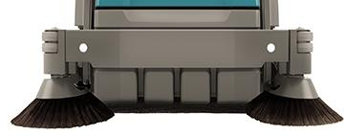
Edge Cleaning
Standard Dual Sweeping Side Brushes
  Large 170 cm sweeping path
  Protected from impact with robust frame structure and suspension
  Swept path covers entire scrub path, helps keep squeegee clear of debris minimizing streaking
Scrubbing Side Brush
Increased reach allowing edge-to-edge cleaning and a 122 cm cleaning path
Improve productivity by up to 20% over the M17 without side brush
With a down pressure equivalent to level 2 this is a powerful scrubbing side brush
Sweeping and scrubbing next to the edge while allowing operators to focus on cleaning, not the distance between the wall and the machine.

Slide 13
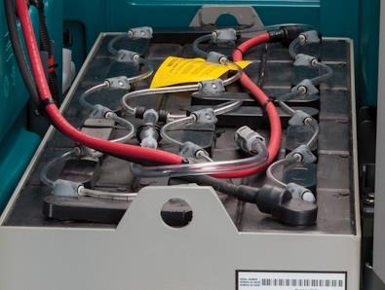
Power Source Options
Battery
  Wet Tubular 625AH C/5 (with battery watering)
  Wet Tubular 775AH C/5 (with battery watering)
  Wet Tubular 775AH C/5 w/OC (prepared for but not including opportunity charger)
  Wet Tubular 860AH C/5 (with battery watering)
  Battery Connection Assist
  Battery Fill Tank (30 L)
Battery Exchange System
  Battery Slide Out System
Charger
  80A 200-240VAC 50/60Hz 1Ph (off-board)
  120A 380-415V AC 50/60Hz 3Ph (off-board)
  195A 400V AC 50/60Hz 3Ph (off-board)

Slide 14
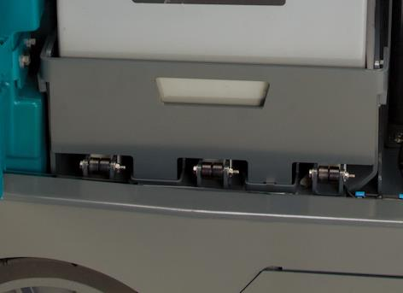
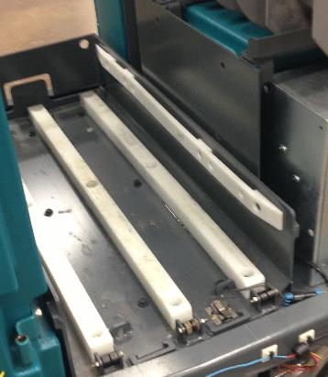
14
Battery Exchange: Slide Out
Recommended for applications that demand continuous multiple shift operations
Guide rollers and heavy duty glides which run the full length of the battery compartment
Batteries can also be lifted 50-75 mm by overhead crane and removed out the side of the unit.

Slide 15
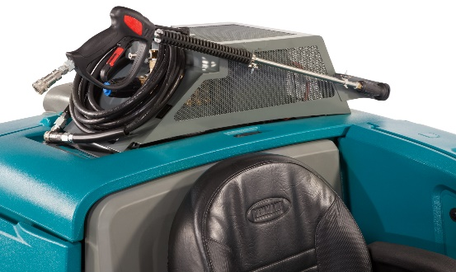
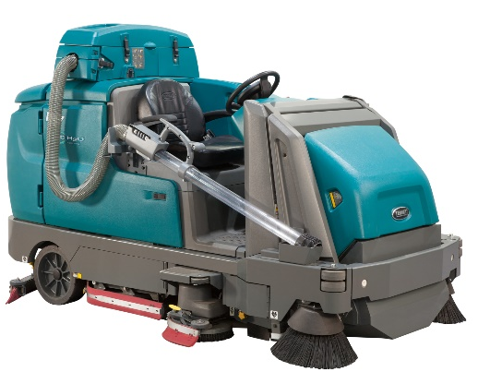
High Pressure Washer and Shrink Wrap Wand
Electric High Power Pressure Washer
  First on-machine electric powered pressure wand in the industry
  2500 psi with flow rates up to 7,6 L / minute
  delivers a powerful spray to clean tough soils on the floor
  Long spray allows for cleaning of tall vertical surfaces
  Eliminates the need to have a separate pressure washer
  The machine’s water pick-up system makes water removal quick and easy
Live Wand
  Improved productivity by quickly picking up random light weight
  debris like shrink wrap
Pressure Washer
Live Wand
Specialized on-board tools leading to efficiency and an enhanced cleaning

Slide 16
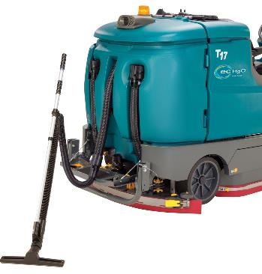
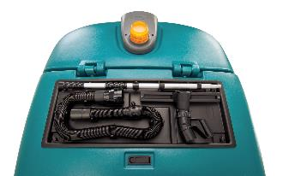
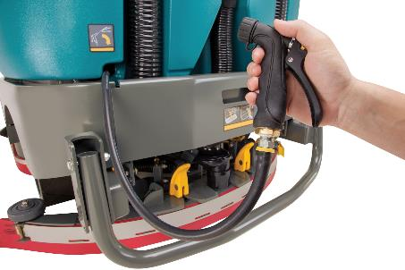
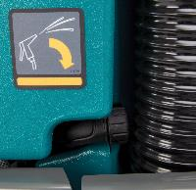
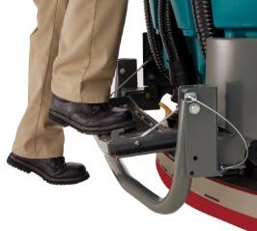
Vacuum Wand and Spray Hose Attachments
Vacuum Wand Attachment
Provides convenient and quick off-aisle spill recovery
Conveniently storage wand in tray above battery compartment
Provides access to hard-to-reach areas like under benches, racks, and around obstructions
Spray Hose Attachment
Easily spray-down and cleanup quick and easy
Using solution tank water eliminates need to be near a water clean source
Stores behind door for convenient access
Recovery Tank Access Step
Easy access to inspect and clean recovery tank

Slide 17


ec-H2O™
ec-H2O™ Cleaning Technology:
Detergent-free cleaning technology provides effective cleaning results
Scrub up to 3 times longer with a single tank of water vs. conventional scrubbing
Reduce costs by eliminating expensive general purpose detergents with ec-H2O™
Cleaning with less water leads to fewer dump/fill cycles
No detergent residue left on the floor minimizing slip and fall risks
NSF certification means ec-H2O can be safely used in food processing plants
* ec-H2O NanoClean™ technology is not suitable for all soils, including heavy concentrations of fats and oils. Depending on the type of soil, conventional chemical cleaners may be required.

Slide 18

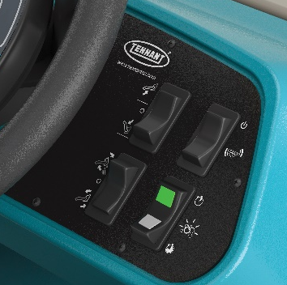
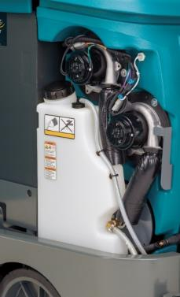
18
ec-H2O™ with Severe Environment™ (SE) Switch
SE is a detergent metering device that is optional on ec-H2O machines
Automatically increases water flow and down pressure to maximum level
Easily switches to conventional scrubbing to clean soils ec-H2O was not designed to clean
Cleaning detergents sent directly to scrub head, protecting the ec-H2O module
Two settings: 30 sec for spot cleaning and continuous flow
Adjustable mixing ratio
SE button
SE button
Pro-Panel™
Standard Controls
Detergent Tank

Slide 19

ES® Extended Scrubbing
®
Recycles cleaning detergents
Increase uptime and improve productivity by scrubbing floors using 66% less detergent than traditional cleaning methods

Slide 20
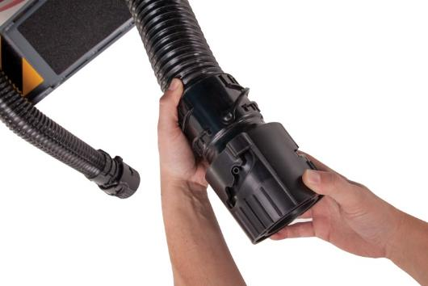
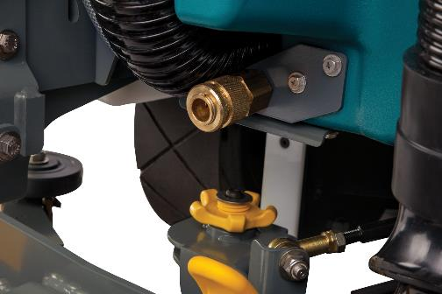
Autofill and Drain Cuffs
20
Adjustable drain cuff controls water flow
  Avoids messy clean-ups and overflows with ease
  Match the flow rate to the available drainage conditions (i.e. janitor sink, floor drain, etc.)
  Installed on both the solution and recovery tanks
Autofill allows for easy solution tank filling
  Fills solution tank and turns off water flow when tank is full
  Allows operator to do something else while filling the solution tank

Slide 21
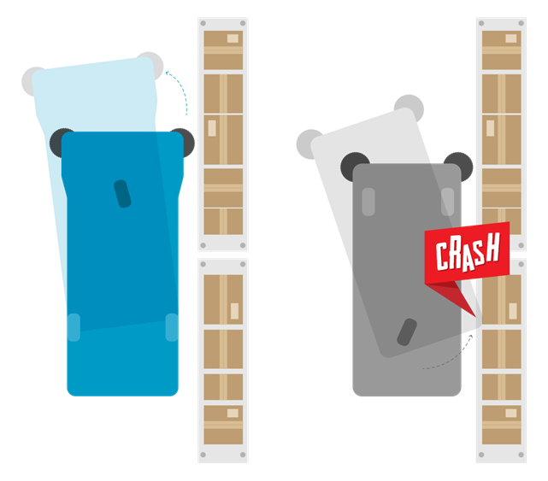
Front Drive and Steering
The front steering design pulls the machine away from the wall
Front drive wheel of the machine operates on dry floors versus wet floor
Gives operators confidence in congested spaces and along walls, racking and equipment
Able to move the side sweeping brush along pallets with confidence
Front drive wheel
Rear drive wheel

Slide 22
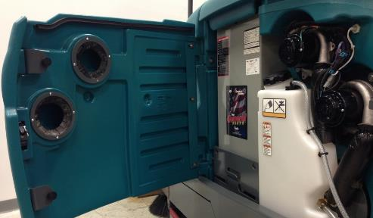
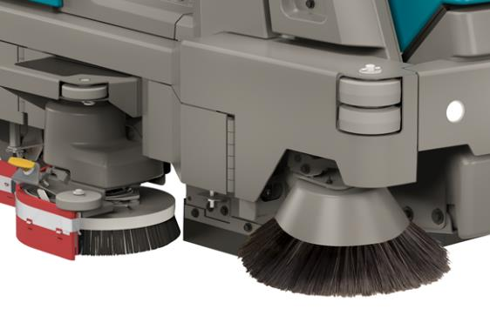
Quiet Operation, Steel Bumper and Rollers
Quiet 75 dBA Operation:
Quiet operation enables anytime cleaning
Leverage day staff and reduce the need for late night cleaning
Fans located behind the operator
Fans positioned behind side panel door acts as a manifold for cooling and sound deadening
Economy Mode:
Conserve energy and resources
Runs quieter than the M17’s normal cleaning modes
  Lowers recovery vacuum fans and scrub sound levels
Wrap Around Steel Bumper
Frame is 4-6 mm thick (depending on part of the frame) and surrounds the entire machine
Cushioned Stacked Rollers
Provides a layer of protection while maneuvering

Slide 23
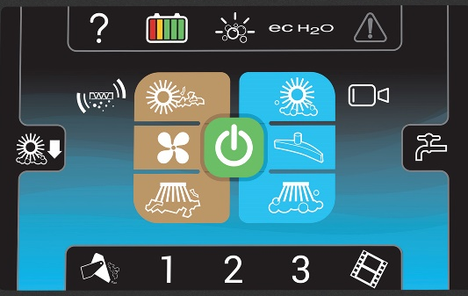
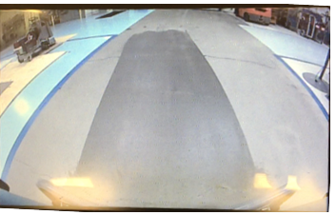
Optional Pro-Panel™
Pro-ID™
Allows the supervisor to tailor machines controls to a specific operator
Prevents unauthorized use and allows speed to be set for each operator
Pro-Check™
Provide a means for supervisors to ensure that a check list is completed
before machine is operational
On-Board/On-Demand videos
Enables operator to easily learn how to operate the machine and perform
routine maintenance
Rear View Camera with PerformanceView™
  View cleaning performance during operation
  See behind the machine in reverse to avoid equipment and facility damage
Language Settings
  User interface available in 28 languages
Zone Settings™
  Allows supervisor to program machine’s settings for specific zones of the building
Clogged Filter Indicator
  Alerts operator when the sweeper filter needs to be shaken maintaining indoor air quality
Screen Lockout
  Prevents accidentally touching the screen and unintentionally changing machine configurations
  Rear View camera remains active
  Unlock screen quickly with one touch of unlock button

Slide 24
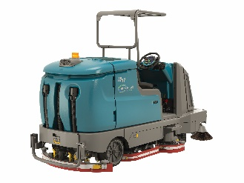

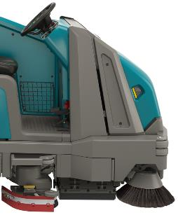
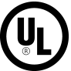
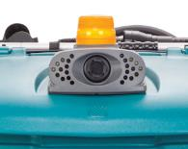
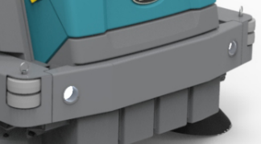
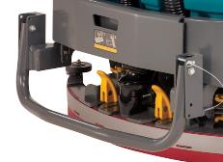
Operator and Machine Protection
Overhead Guard
  FOPS certified
  no wall side forward leg that could obstruct visibility
Front Protection
  Full Operator Protection from the front
CE Certification
  Safe operation
Reverse Chime
  Audible chime indicating the machine is in the reverse setting
Head lights
  Increases visibility
Heavy Duty Squeegee Protection
  Protects squeegee damage

Slide 25
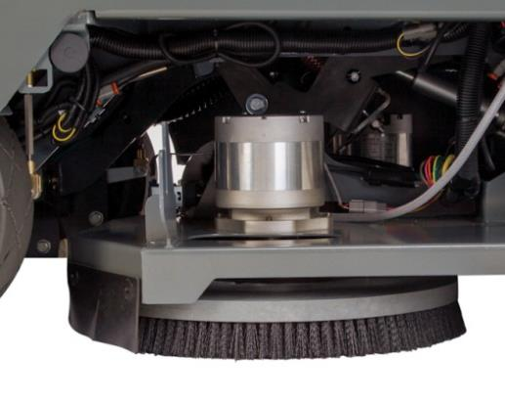
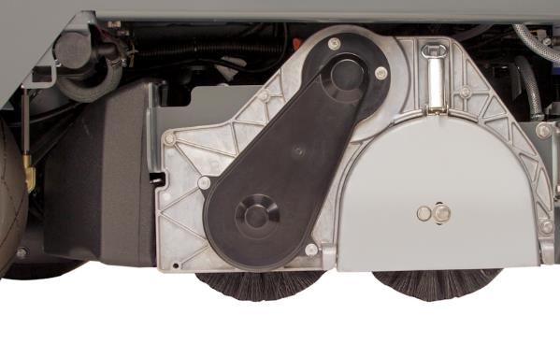
Cleaning Performance
Amazing Scrubbing Down Force
  Two 1.5 HP, 1.125 kW motors allow for down pressures up to 250 kg

Slide 26
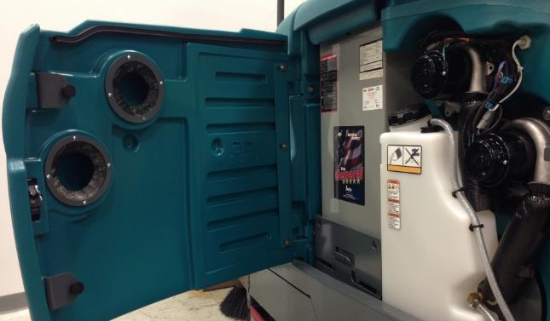
Cooling Manifold
Integrated Vacuum Fan Cooling Manifold
Pulls cooling air from outside the compartment
Ensure that COOL/DRY air and NOT hot moist vacuum exhaust is used to cool the vacuum fans.

Slide 27
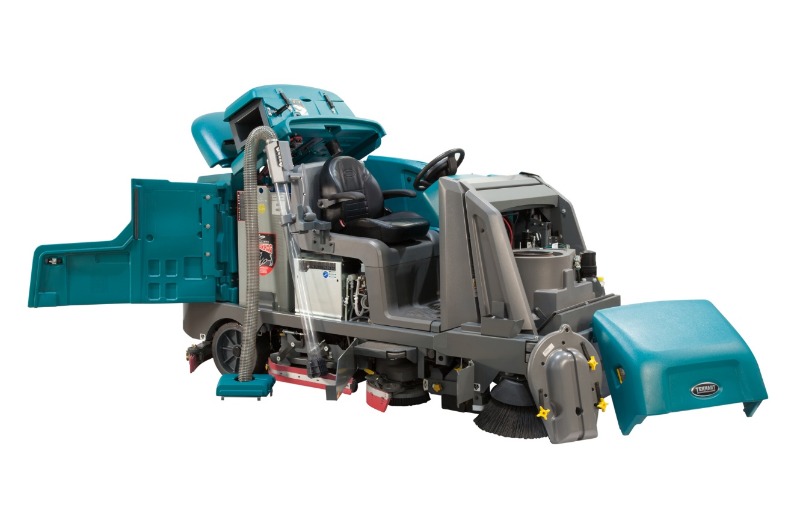
Easy Operation and Maintenance
Machine opens up completely for easy Access to Components
The quicker a technician can get to a component the sooner the machine is repaired and back on the floor cleaning.

Slide 28
Notes and Exclusions
Dual Force Sweeping is not available for machines equipped with Direct Throw sweeping
Direct Throw Sweeping is not available for machines equipped with Dual Force sweeping
The following items are not available on pressure washer equipped machines:
  ES
  Spray Wand
  Live Wand
  Battery rollout
  Wet Vacuum
The following items are not available on battery quick disconnect equipped machines
  Battery rollout
The following items are not available on live wand equipped machines
  Battery rollout
  Wet Vacuum
  Pressure washer

Slide 29


Summary
Reduce Costs to Clean
  Reduce the need for multiple machines
  Large battery capacity options available
Maintain Health and Safety
  Exceptional dust control
  Forward operator position, eyes-forward controls and engineered sightlines
Enhance Facility Image
  Excellent water recovery
  Capture large and small debris in one pass
Ease of Use
  Intuitive operator controls
  Tool-free access to main parts

Slide 30
M17BATTERY SCRUBBER-SWEEPER

