Slide 1
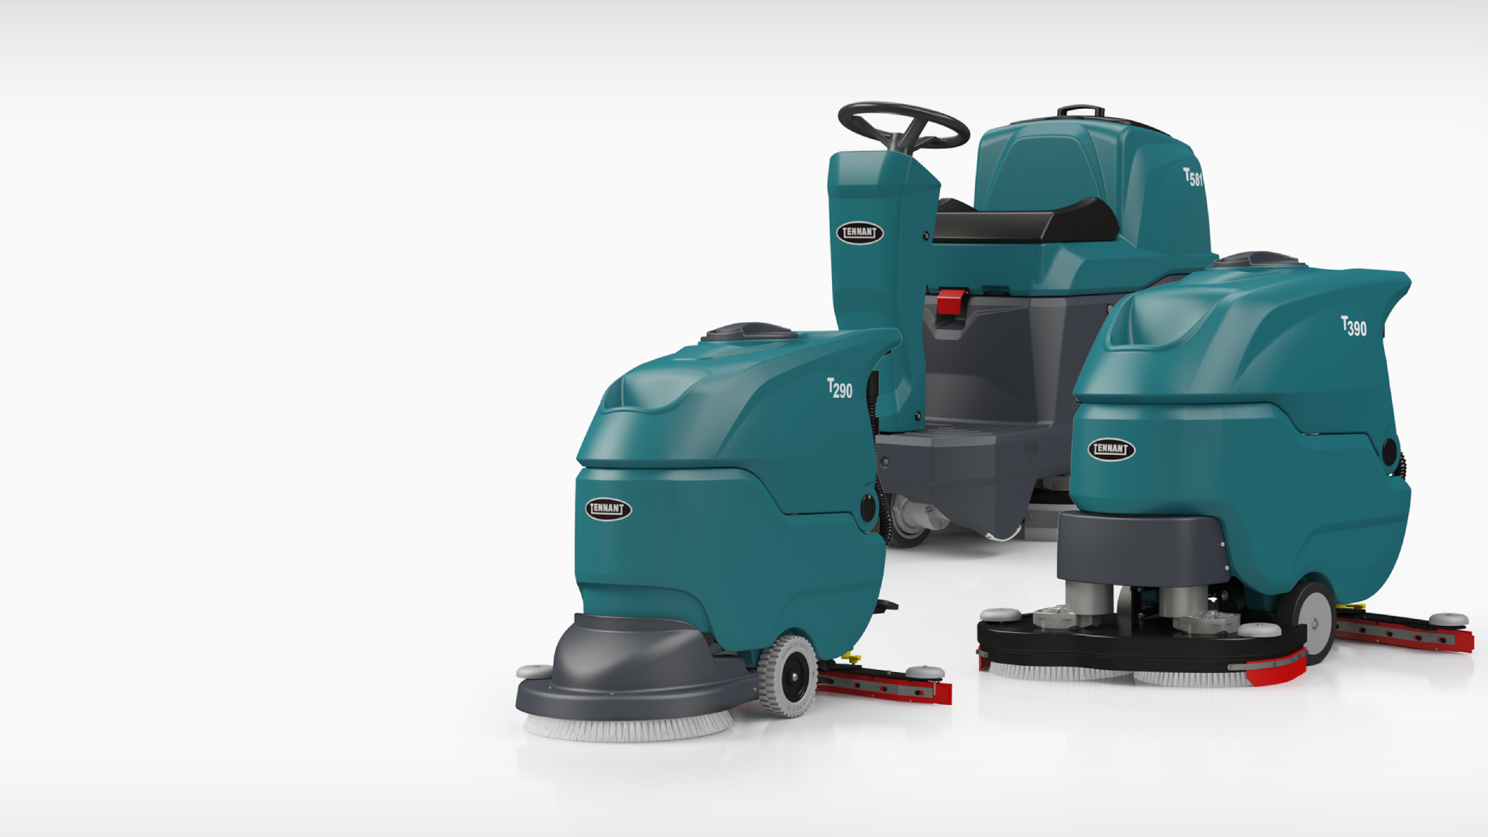

T290 & T390 Walk-Behind & T581 Micro-Rider
Scrubbers
VERSION: April.21

Slide 2
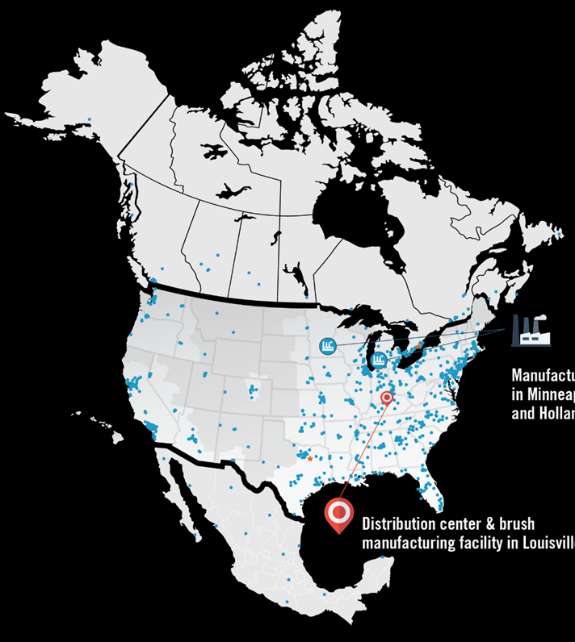


Trusted Advisor
150 Years Experience
Global Leader in the Cleaning Industry
Top of Class Quality & Reliability
Commitment to Sustainable Cleaning Solutions
Dedicated Technical Assistance Center
500+ Factory Direct Service Reps
Strategic Account Team
240+ Field Reps
Manufacturing Facility in Minneapolis, MN & Holland, MI
Distribution & Brush Manufacturing Facility in Louisville, KY

Slide 3
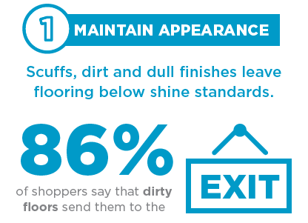

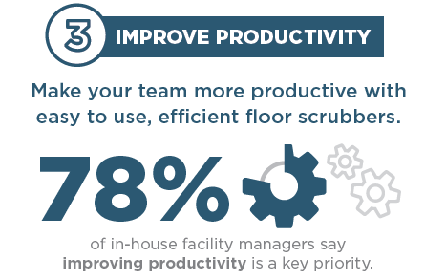
Why Does Cleaning Matter So Much?
0
SOURCES:
https://cstoredecisions.com/2011/01/21/study-dirty-store-repels-shoppers/
https://www.mckinsey.com/business-functions/marketing-and-sales/our-insights/survey-us-consumer-sentiment-during-the-coronavirus-crisis
https://www.cmmonline.com/articles/survey-says
https://www.arbill.com/roller/Blog/entry/painful-costs-of-slips-trips
Notes:
Survey Form inspiration
High-level conversation guide
Mechanize cleaning for your application

Slide 4
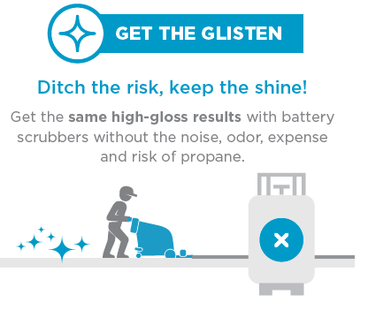

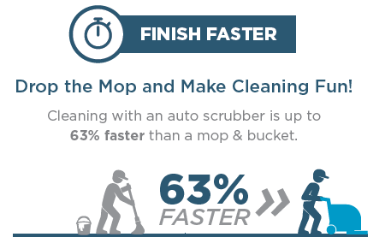
Benefits of Mechanized Floor Scrubbers
*based on a floor area of 38,000 sq. ft with a 23,000 sq. ft. cleaning area, scrubbed 7 days a week. Results are estimated and may vary.
SOURCES:
https://cstoredecisions.com/2011/01/21/study-dirty-store-repels-shoppers/
https://www.mckinsey.com/business-functions/marketing-and-sales/our-insights/survey-us-consumer-sentiment-during-the-coronavirus-crisis
https://www.cmmonline.com/articles/survey-says
https://www.arbill.com/roller/Blog/entry/painful-costs-of-slips-trips
Notes:
Survey Form inspiration
High-level conversation guide
Mechanize cleaning for your application

Slide 5
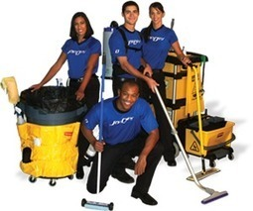
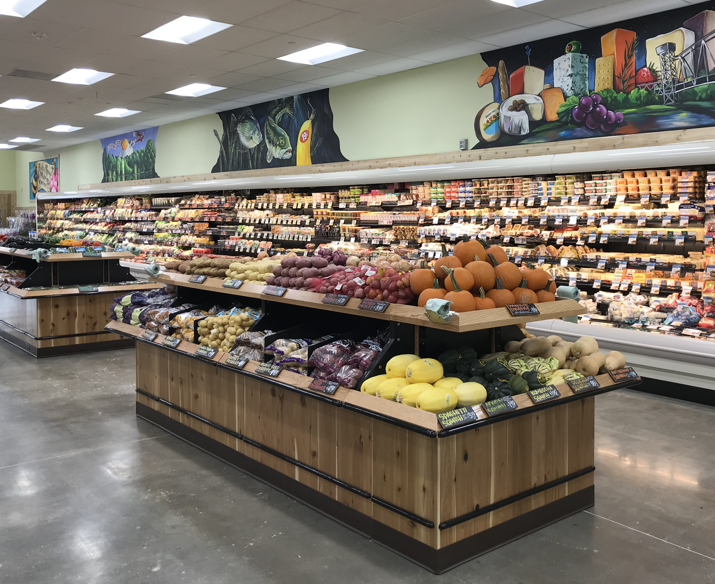
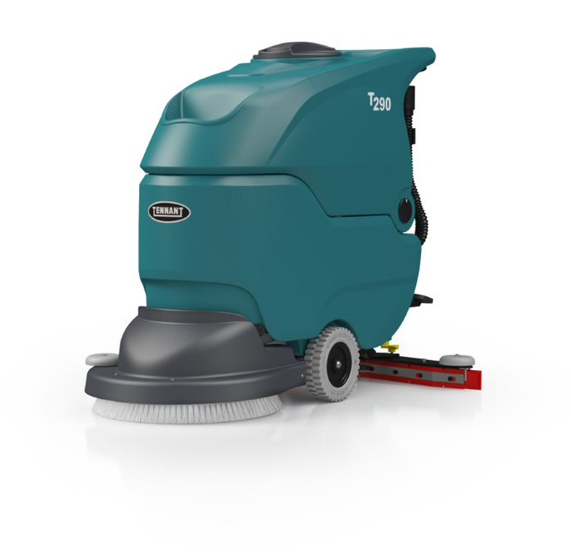
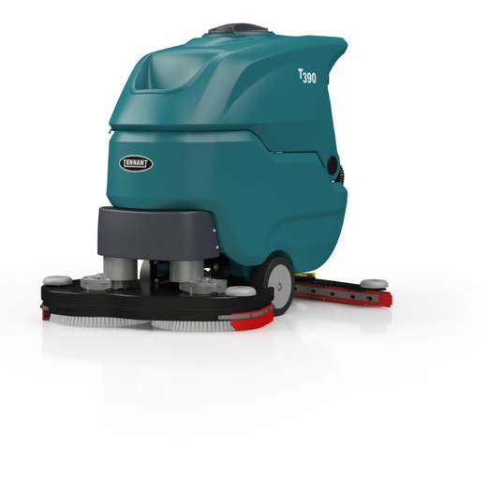



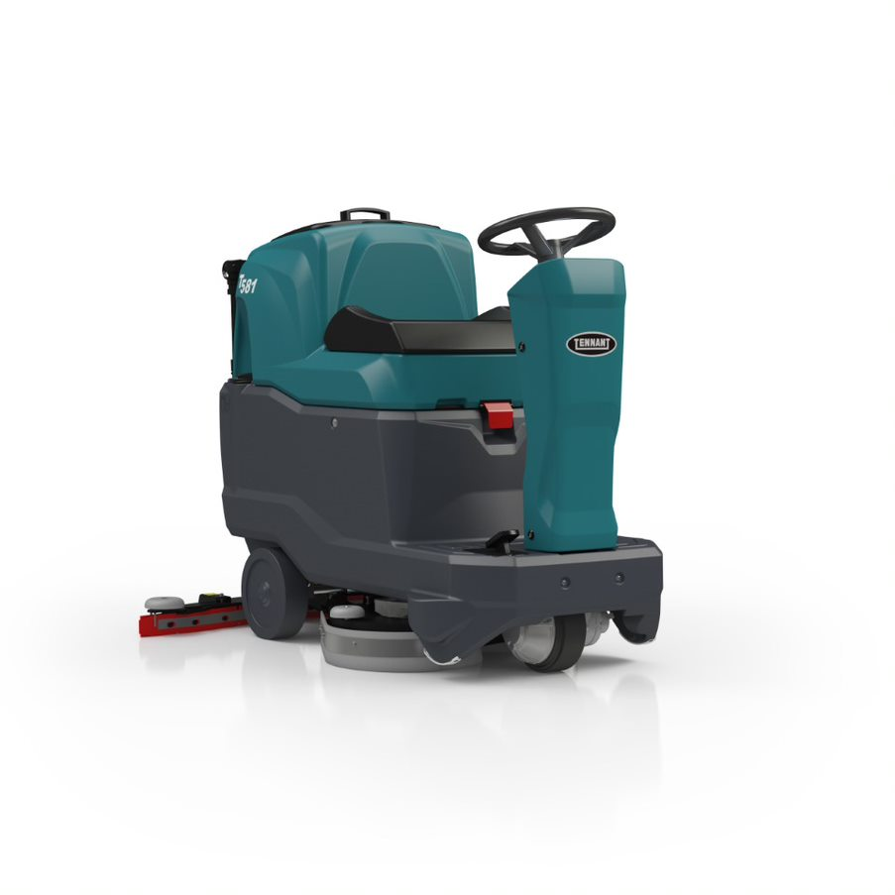
Scrubbers Designed for Commercial Markets
T290 – 20in Disk
Smaller, tight and contested spaces
BSCs
RETAIL
T390 – 28in Disk
Mid-size areas where productivity is key
HEALTHCARE
EDUCATION
T581 – 20in Disk
Congested areas where productivity, compact size and maneuverability in a rider are needed
GOVERNMENT

Slide 6
Right Product for Your Application
Facility Size & Usage
  Every other day cleaning during the day and/or night shift
  Small-to-large size areas
  Less than 2 hours cleaning per day
Application Challenges
  Typical commercial settings and floor types
  Few obstacles or objects to navigate (forklifts, pallets, carts, corner protectors, etc.)
Cleaning Environment
  Low to medium traffic areas
  Low to medium soils (few spills or aggressive soils)

Slide 7




Tennant Commercial Scrubber Advantages
Reduce Costs to Clean
Simple, intuitive controls that require minimal buttons to be pressed to help make start-up consistent and fast.
Maintain Health and Safety
Consistent water pick-up with durable “V” shaped squeegee design and standard Linatex® squeegee blades.
Enhance Facility Image
Reliable scrubbing performance from straight-forward, quality scrubbers that provide consistent up-time to keep your facility looking great.
Easy Operation & Maintenance
Easy daily maintenance from yellow touch points that help reduce breakdowns by simplifying preventative maintenance.

Slide 8
T290 Features
Intuitive control panel with an indicator light when solution tank level is low.
Easy-to-maneuver design, intuitive controls and robust components provide for simple operation and maintenance.
Robust construction in a compact scrubber with easy-to-use pad assist or self-propel operation
Consistent water pick-up with durable “V” shaped squeegee design and standard Linatex® squeegee blades.
Avoid kneeling to put the brush on, with hands-free brush replacement with spin-on, spin-off feature.

Slide 9

T390 Features
Intuitive control panel with an indicator light when solution tank level is low.
Ease of use and maneuverability allow for quick cleaning in medium sized spaces
Scrub deck made of tough steel material, with roller guide wheels to protect the facility.
Consistent water pick-up with durable “V” shaped squeegee design and standard Linatex® squeegee blades.
Increase productivity with the dual disk cleaning path while still having the maneuverability of a mid-size scrubber.

Slide 10
T581 Features
Maneuverable, productive and compact, easily fitting into most congested spaces, and quickly reaching many areas of a facility to get more cleaning done.
Easily change water flow rate and other cleaning functions from intuitive control panel.
Extended run times nearly 20% with ECO mode that decreases battery consumption during operation.
Ease of start-up and quick training with one-button cleaning operation that lowers the scrub head and squeegee at the same time.
Simple no-tools, no-touch brush change system.

Slide 11
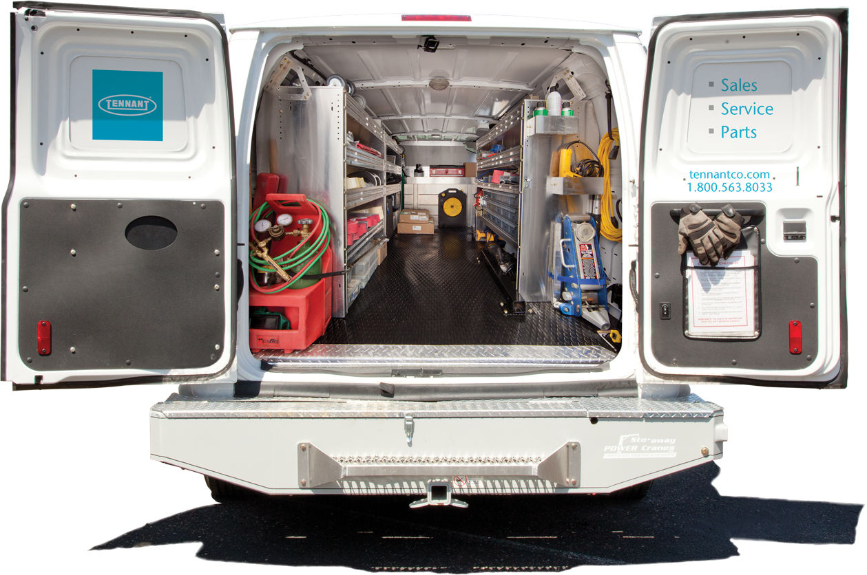







Tennant Service
TRUSTED. RESPONSIVE. LOCAL.
TRUST US
296,058
8 YEARS
TOTAL RESOLVED
SERVICE CALLS IN 2019
AVERAGE TENURE OF SERVICE REPS
26% INCREASE
IN WARRANTY USAGE WHEN LEVERAGING TENNANT SERVICE
85%
FIRST TIME OPERATIONAL
WE’RE RESPONSIVE
WE ARE WHERE YOU ARE
1.7
DAYS
RESPONSE TIME
500+ SERVICE TECHS
SERVING NORTH AMERICA
LICENSED • BONDED • INSURED
Updated 8.7.20​
Notes:
Service brochure - https://www.tennantco.com/content/dam/tennant/tennantco/services/service%20plans/service-brochure-en-noam.pdf

Slide 12
T290 & T390 Walk-Behind & T581 Micro-Rider
Scrubbers

