Slide 1
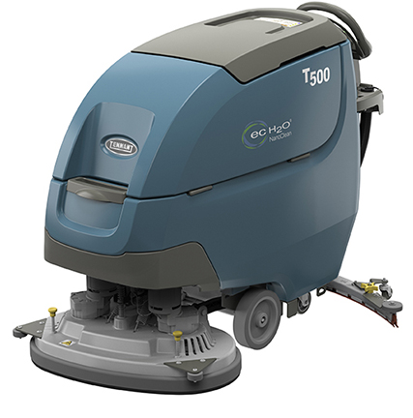
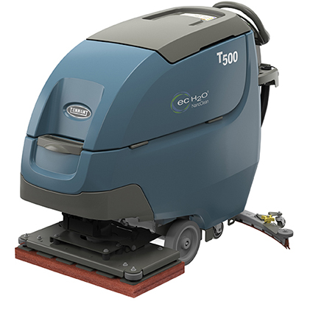
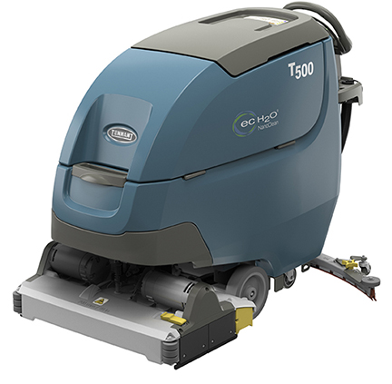
T500 WALK-BEHIND SCRUBBER
PRESENTER NAME MONTH.DATE.YEAR

Slide 2




T500
ADVANTAGES
Reduce costs to clean
  Maximize investment with a wide range of cleaning options
  Save time and money on battery maintenance and help increase battery performance
Maintain health and safety
  Virtually eliminate the need for caustic floor finish removal chemicals with orbital scrub head
  Reduce risk of slips and falls with redesigned squeegee and improved water pick-up
Enhance facility image
  Reduce noise levels to as low as 62 dBA with optional Quiet-Mode™ low dBA setting
  Easily standardize cleaning operations with customizable Zone Settings™ with labels on the Pro-Panel™ LCD touch screen
Minimize environmental impact
  Reduce environmental impact with detergent-free cleaning options
  Reduce the amount of water required to clean

Slide 3

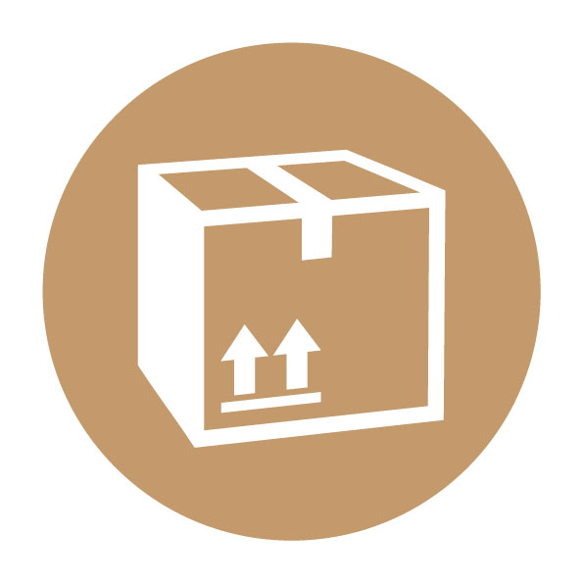
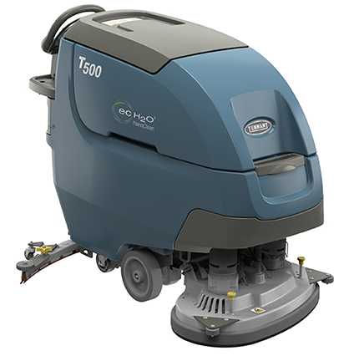



T500
KEY MARKETS
Retail
Healthcare
Education
Hospitality
BSC/Office
Logistics/Manufacturing

Slide 4
T500
KEY DIFFERENTIATORS
SENTINEL RIDER SWEEPR
BUILT-IN RESULS
PRODUCT FEATURES FOCUSED ON REDUCING COST & MAINTAINING HEALTH & SAFETY
Reduce costs to clean
Clean virtually any hard surface condition and maximize your return on investment with a wide range of cleaning options, including a 28 in/ 700 mm orbital head option.
Reduce costs to clean and maximize battery productivity with the exclusive patent-pending Smart-Fill™ technology, an on-board, virtually worry-free battery watering system.
Save time and money on battery maintenance and help increase battery performance with the patent-pending on-board Smart-Fill™ automatic battery watering system paired with IRIS® Asset Manager, which provides reporting on battery charging behaviors.
Reduce costs to clean, increase productivity and simplify operator training with the T500's suite of innovative technologies, such as ec-H2O NanoClean® technology, IRIS® Asset Manager, and Pro-Panel™ LCD touch screen with customizable Zone Settings™.
Effectively remove floor finish without expensive stripping chemicals with the 28 in/ 700 mm orbital cleaning head option.
Maintain health & safety
Reduce handling of daily cleaning chemicals with use of optional ec-H2O NanoClean® technology.
Virtually eliminate the need for caustic floor stripping chemicals with the use of the orbital scrub head and surface prep pad, which allows for chemical-free floor finish removal.
Eliminate secondary cleaning operations that could increase slips and falls with optional ec-H2O NanoClean® technology and Severe Environment™ switch, which allows you to attack trouble areas on-demand.

Slide 5
T500
KEY DIFFERENTIATORS
SENTINEL RIDER SWEEPER
BUILT-IN RESULTS
SENTINEL RIDER WEEPER
BUILT TO YO NEEDS
PRODUCT FEATURES FOCUSED ON ENHANCING IMAGE & EASY OPERATION & MAINTENANCE
Enhance facility image
Evenly and effectively remove floor finish with one of the highest standard orbital down pressure settings at 170 lb / 77 kg.
Validate cleaning, differentiate your operations and develop optimal cleaning program protocols with IRIS® Asset Manager's data driven reporting technology.
Trust in the orbital cleaning head's quality and durability with a 2,000 hour/3 year isolator warranty.
Reduce noise levels to as low as 62 dBA and allow for easy daytime cleaning without disruption with the Quiet-Mode™ low dBA setting.
Easily standardize cleaning operations with customizable Zone Settings™ on the Pro-Panel™ LCD touch screen.
Minimize environmental impact
Reduce the use of daily floor cleaning chemicals with optional detergent-free ec-H2O NanoClean® technology.
Ensure and validate compliance with sustainability initiatives and help realize projected chemical, packaging and water savings through IRIS® Asset Manager ec-H2O NanoClean® usage reporting.
Reduce water usage and time spent trying to accurately fill the solution tank with auto-fill and water level monitor, which ensures the tank fills to capacity and shuts-off automatically.
Reduce the amount of water required to clean due to optimal down pressure, high RPMs and ec-H2O NanoClean® technology.

Slide 6
T500
KEY FEATURES
KEY
ENHANCEMENTS
Increase productivity
  Innovative suite of optional technologies: Smart-Fill™ automatic battery watering, ec-H2O NanoClean® technology, IRIS® Asset Manager, and Pro-Panel™ LCD touch screen with customizable Zone Settings™
  Auto-fill and water level monitor ensure the tank fills to capacity and shuts-off automatically
  Optimal down pressure and high RPMs help quickly and effectively clean dirty floors
Lower costs to clean
  Smart-Fill™ on-board automatic battery watering saves time and money on battery maintenance
  On-board machine instructions, supervisor lock-out and yellow touch points help prevent breakdowns and simplify machine maintenance
  Smart charger reduces risk of battery damage while charging
  Durable orbital cleaning head with a 2,000 hour/3 year isolator warranty
Maintain health & safety
  Redesigned squeegee and integrated p-trap improve water pick-up and prevent water from dripping on the floor after cleaning
  Actuated scrub head controls provide simple and ergonomic machine operation
  Optional recovery Flow Control Valve reduces risk of contact with dirty recovery water
Minimize environmental impact
  Zone Settings™ allow operators to easily and quickly switch between cleaning settings to help reduce water and chemical consumption
  On-board tank rinse out spray nozzle and hose reduces additional water usage by utilizing remaining solution to easily clean recovery tank

Slide 7
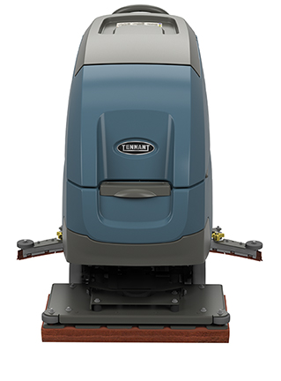
T500
OPTIONAL FEATURES
Productivity and ease of operation:
  Smart-Fill™ automatic battery watering
  Pro-Panel™ LCD touch screen technology with customizable Zone Settings™ with labels
  Tank rinse-out: spray nozzle with 53 psi and 10 ft / 3 m hose
  Solution tank auto-fill
Solution technologies:
  ec-H2O NanoClean® technology with Severe Environment™ Switch
Operator & machine protection:
  Chemical-free floor finish removal with orbital cleaning head
  Gray, oil resistant polyurethane recovery tank drain hose with
  flow control valve
Asset management:
  IRIS® Asset Manager

Slide 8
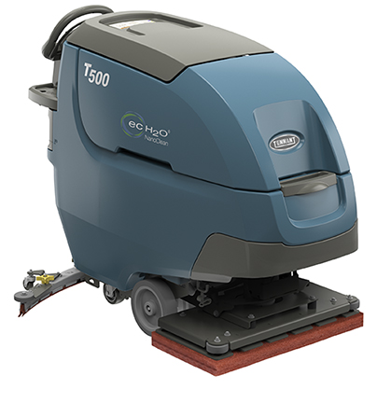
THANK YOU

