Slide 1
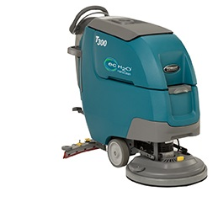
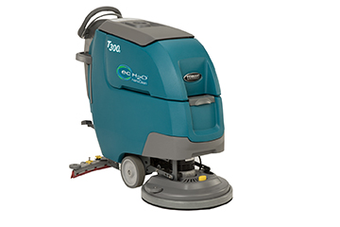
Product Application and Solution Guide
T300 / T300e Walk-Behind Scrubbers
T300
T300e

Slide 2
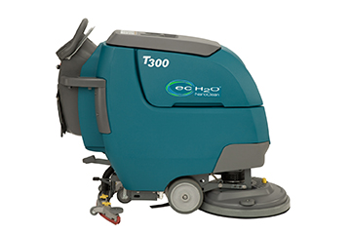
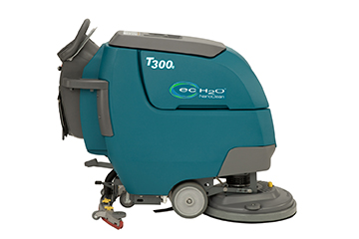
Overview
Expand Market Presence with 2-Tiered Product Strategy
T300 – New technologies to grow new business and revenue per unit
T300e – Simple, Rugged and more affordable than ever before
T300
T300e

Slide 3
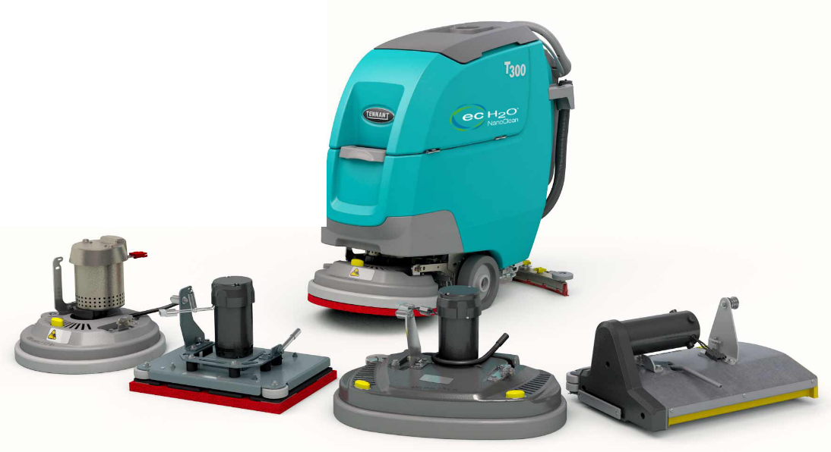
Positioning
T300 family provides the right product solution for your specific application
Uncompromising versatility
Tackles virtually any hard surface condition
Improving operating costs
Single Disk
17 in / 430 mm
20 in / 500 mm
Pad Assist &
Self Propel
Orbital
20 in / 500 mm
Self Propel
Dual Cylindrical
20 in / 500 mm
Self Propel
Dual Disk
24 in / 600 mm
Self Propel
New

Slide 4
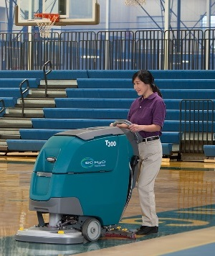
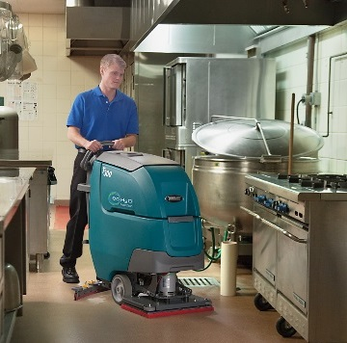
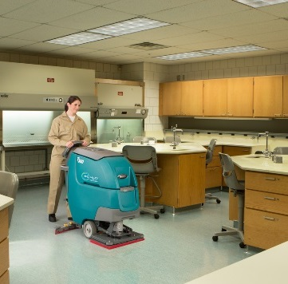
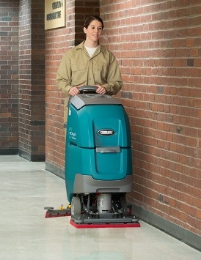
Markets and Applications
MARKET | APPLICATION | FLOOR TYPES
Schools and Universities | Hallways, entryways, kitchens, classrooms, cafeterias | VCT, polished stone, terrazzo, grouted ceramic and porcelain tile
Healthcare | Hallways, entryways, patient rooms, surgical suites, cafeterias, labs, handicapped ramps | VCT, polished stone, terrazzo, resilient flooring, grouted ceramic and porcelain tile
Child and Long-Term Care Facilities | Corridors, entryways, handicapped ramps, patient rooms, cafeterias, playrooms | VCT, polished stone, terrazzo, resilient flooring, grouted ceramic and porcelain tile
Hospitality | Lobbies, hallways, elevator areas | VCT, polished stone, terrazzo, grouted ceramic and porcelain tile
Retail | Aisle ways, check out counters, deli/cafeteria areas | VCT, polished stone, terrazzo, grouted ceramic and porcelain tile, polished concrete

Slide 5
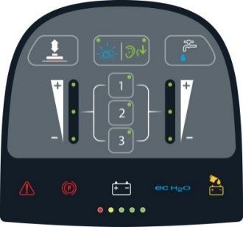
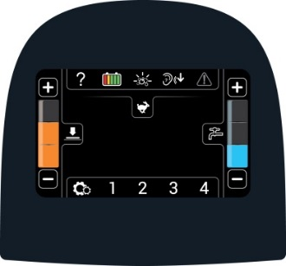
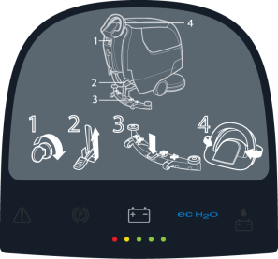
T300 and T300e Differences
 | T300 |  | T300e
Control Panels | Electronic Controls Membrane™ Panel (Std) | Electronic Controls Pro-Panel™ (Option) | Relay Controls Switches/Levers
Standard Features | Insta-Click™ Head 230 RPM’s (Single Disk) Multiple Machine settings Supervisor lockout Zone Settings™ Select warning lights As low as 65 dBA 3-second vac fan delay | Insta-Click™ Head 230 RPM’s (Single Disk) Multiple Machine settings Supervisor lockout Zone Settings™ Select warning lights As low as 65 dBA 3-second vac fan delay Operator log-in Maintenance video On-screen charger profile change | 3-lug head 230 RPM’s (single Disk) 23 kg (50 lbs) down pressure As low as 67 dBA
Key Options | ec-H2O NanoClean™ Severe Environment™ Quiet-Mode™ | ec-H2O NanoClean™ Severe Environment™ Quiet-Mode™ | ec-H2O NanoClean™ Insta-Click™ Head Dual down force

Slide 6
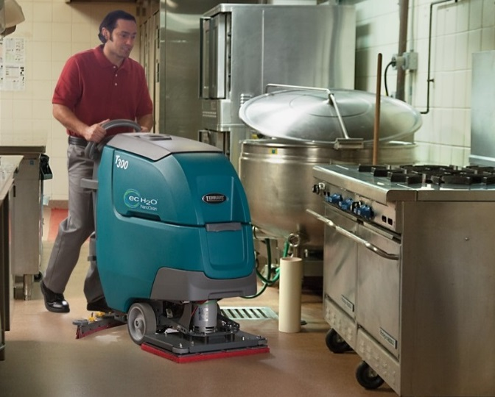
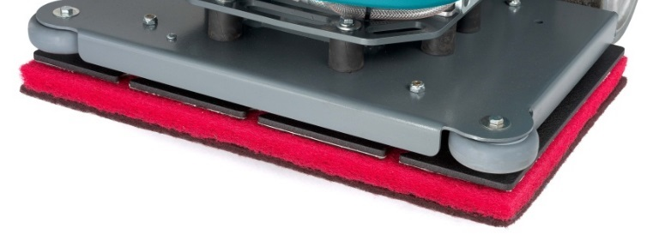
Orbital – T300 / T300e
Scrubbing and chemical-free floor finish stripping
Operate along edges and in corners
Aggressive scrubbing
  RPM: 2,200
  Down Pressure: 63 to 109 lbs (29 to 50 kg)
Consistent solution distribution
Consistent floor finish removal

Slide 7
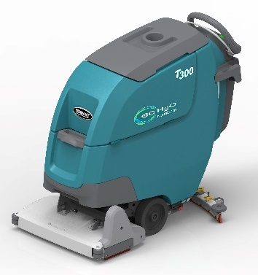
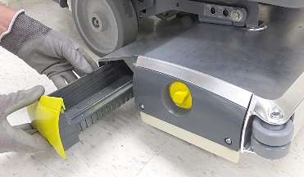
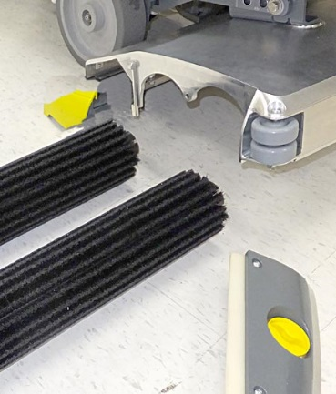
Dual Cylindrical – T300 / T300e
Dual brushes allows pre-sweeping maximizing productivity
One side brush removal
Integrated 1-piece debris tray
  One side brush removal
  Drawer style
  Easy to remove
Excellent cleaning performance
  RPM’s: 1,065
  Down Pressure: 53 to 64 lbs (24 to 29 kg)
2 brush types available
  Nylon – general purpose
  Poly – more aggressive
Integrated side squeegee
  Contains water, especially in turns

Slide 8
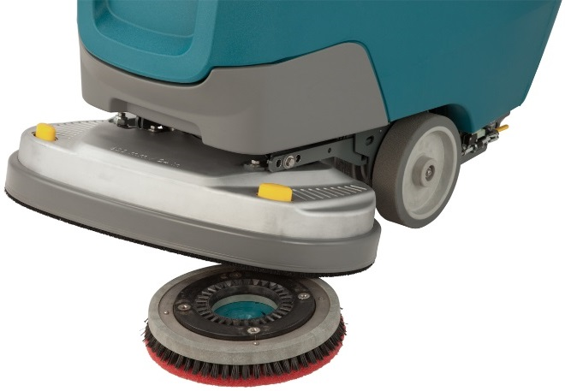
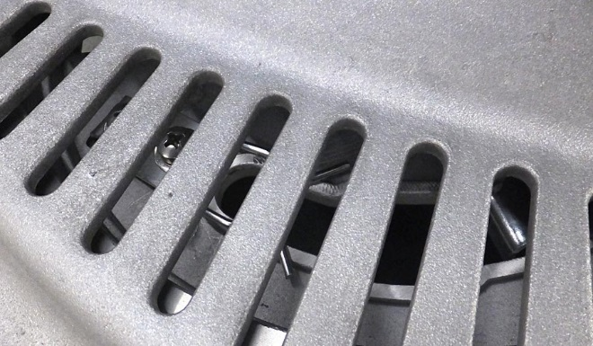
Disk Cleaning Tool Attachment
Insta-Click™
  Powerful magnets for easy, low-touch cleaning tool attachment and removal
  Easy by hand or drop head over pad drivers or brushes
  Quick removal of clean tools
  Standard on T300
  Optional on T300e
Improved 3-Lug System
  Bigger drive plate holes repositioned
  Larger view ports
  Standard on T300e
Insta-Click
3-Lug

Slide 9
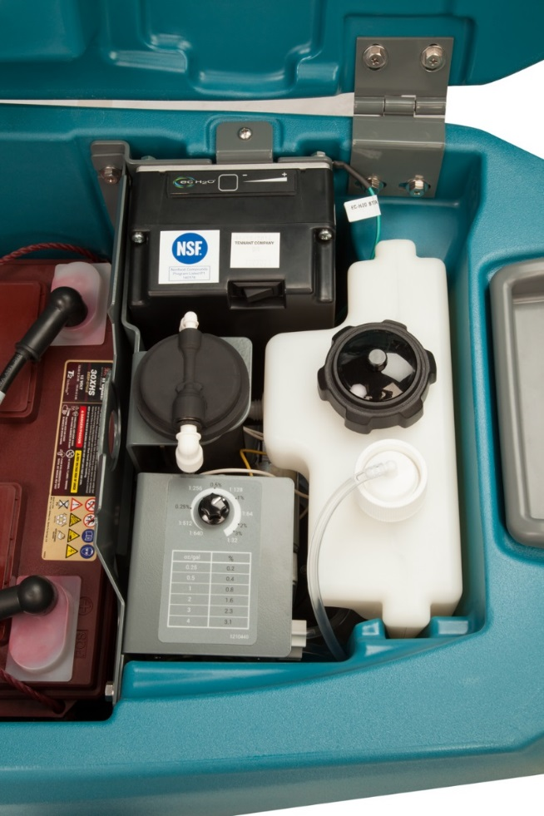
Severe Environment™ Switch – T300 only
Optional on T300 machines with ec-H2O NanoClean™ machines
To clean the rare soil that ec-H2O™ is not designed to clean
30-second spot cleaning
Always on for larger spaces

Slide 10
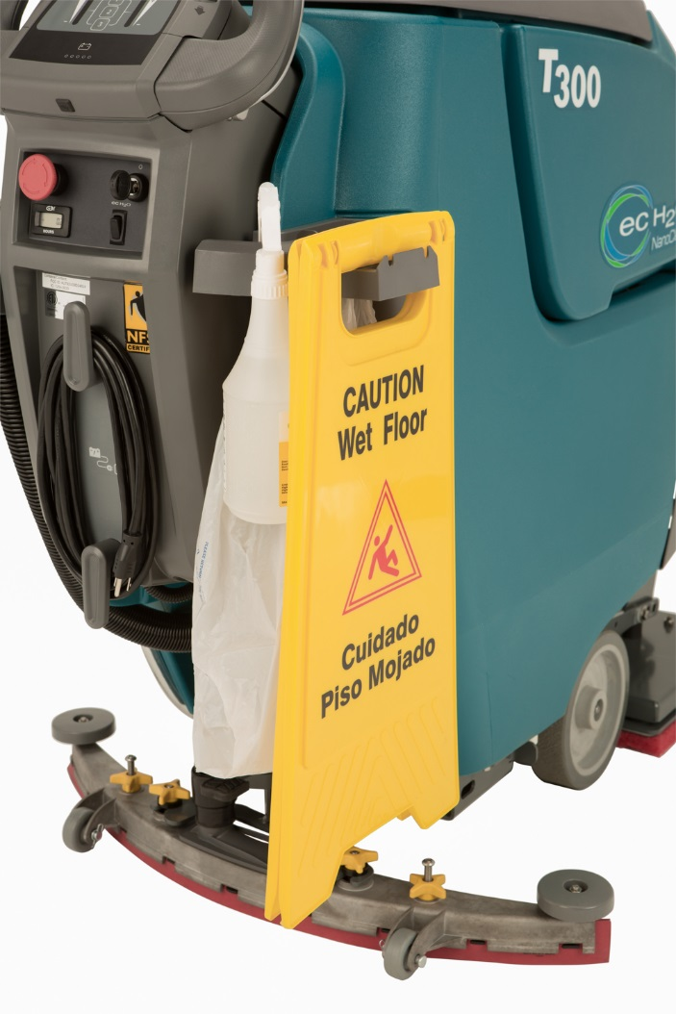
Superior On Board Storage
Integrated Squeegee Hang
Debris Bag Holder
Optional Accessory Clip
Wet Sign Holder
Spray Bottle

Slide 11
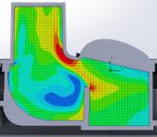
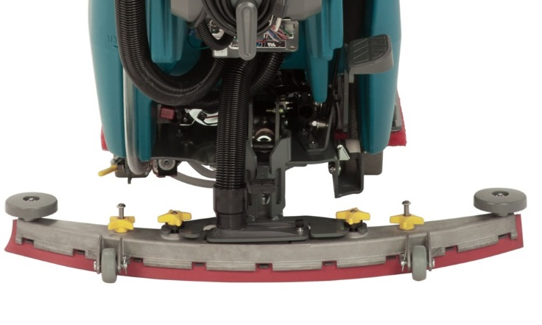
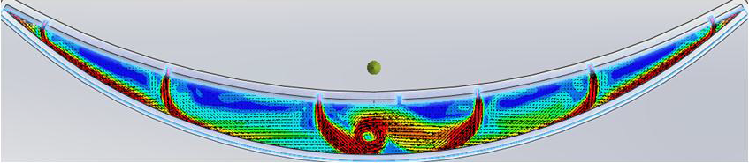
New Squeegee Design – T300 / T300e
Easy to use
3-second delay in vacuum fan shut off on T300 machines
Great water pick up
Fluid Dynamic Analysis
No P-Trap loop
(Less water in hose)
P-Trap
(Minimizes left over water in the assembly)
Tighter end seal
(More airtight)
Releases blades
(Easy to replace blades)
Foot peddle raises and lowers the squeegee
(No bending to raise and lower squeegee)
Fast moving air minimizes dead spots
Dead spots causes “splashes” as it moves over floor voids
Fluid Dynamic Analysis

Slide 12
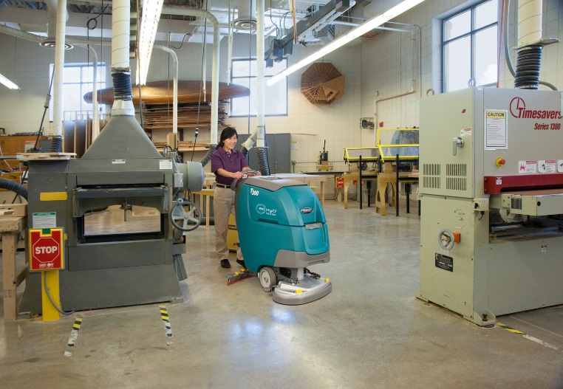
Polished Daily Stone Care
No tripping circuit breakers
  Added four amps, now 40 amps total
  Enhanced wiring
Tools tested
  3M™ Purple pad
  3M™ Sienna pad
  3M™ Trizact™ blue disc
Gloss of the floor maintained
  Delays the time and cost of mild restoration

Slide 13
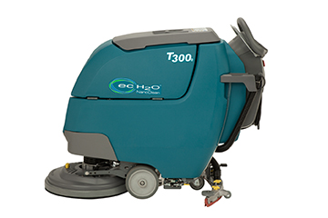
T300e Features
Standard Features
  Manual controls
  ~50 lbs of down pressure (varies by head type)
  3-lug head
  As low as ~67 dBA
Upgrade Features
  Dual down pressure
  Single disk – 47 & 86 lbs (21 & 39 kg)
  Dual disk – 57 & 97 lbs (26 & 29 kg)
  Dual cylindrical – 53 & 64 (24 & 29 kg)
  Orbital – 63 & 109 lbs (29 & 50 kg)
  Insta-Click™ head
Key Options
  ec-H2O NanoClean™ Technology
  Oil resistant recovery and vac hoses
  HydroLink® battery watering system

Slide 14
Product Specs – T300 / T300e

Slide 15
Addressing Key Customer Needs
Environmental Health and Safety
Cost to Clean
Enhancing Facility Image
Environmental Health & Safety
  Slip & Falls
  Chemical Handling & Storage
  Improper equipment operation
  Ergonomics
Enhance Facility Image
  Cleaning equipment performance
  Proper use of equipment
  Following proper cleaning processes
Cost to Clean
Chemical & Water Costs
Labor & Training Costs
Safety Costs
Service Costs

Slide 16
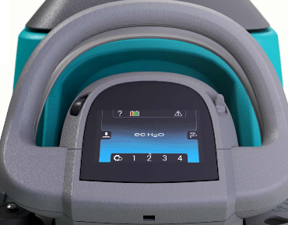
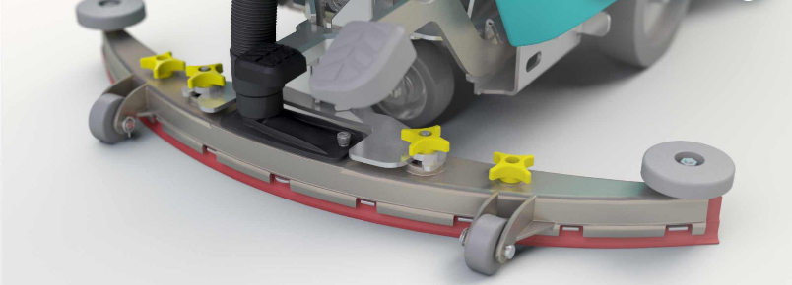
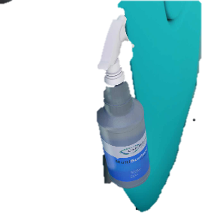

Cost to Clean
ec-H2O NanoClean™ eliminates neutral cleaners and saves water
Pro-Panel™ touchscreen minimizes training
Zone Settings™ simplifies cleaning processes
Yellow touch points simplifies routine maintenance
Accessory clips expedites secondary cleaning tasks
T300e simple and rugged

Slide 17
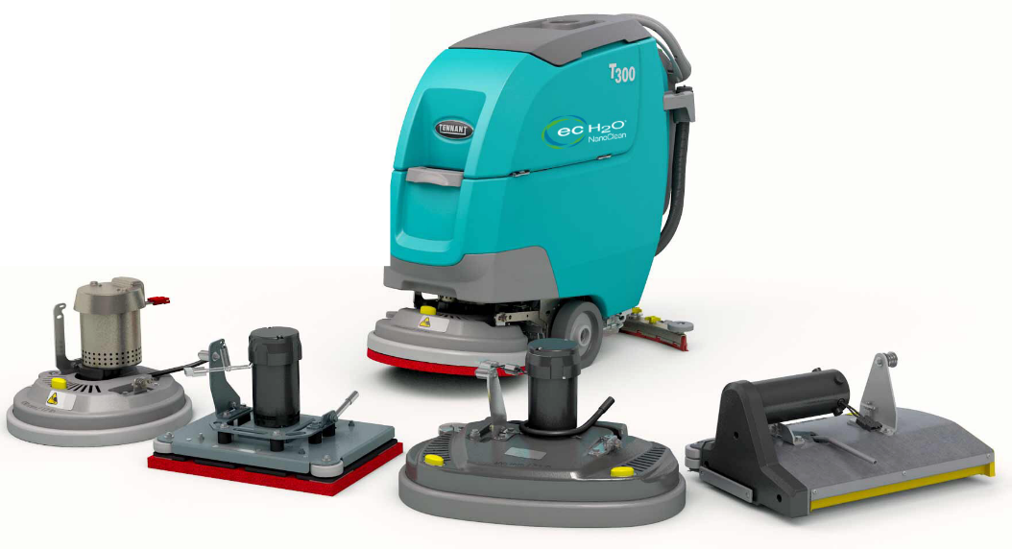
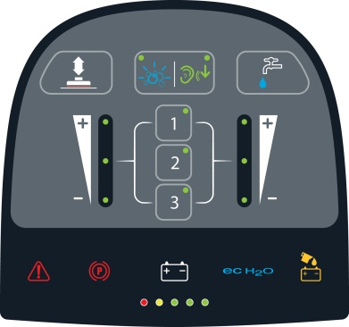

Enhancing Facility Image
More applications
More water & down pressure settings
Daily stone care maintenance
Zone Settings™ eliminate guesswork and rework
Membrane™ Panel
Pro-Panel™

Slide 18
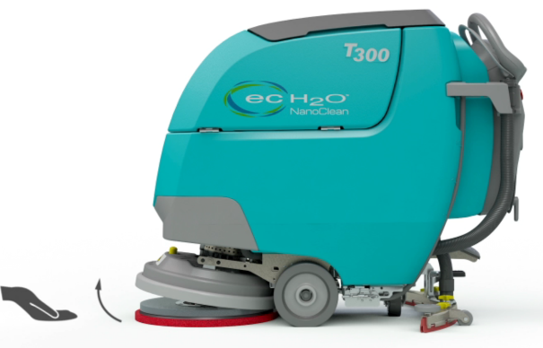
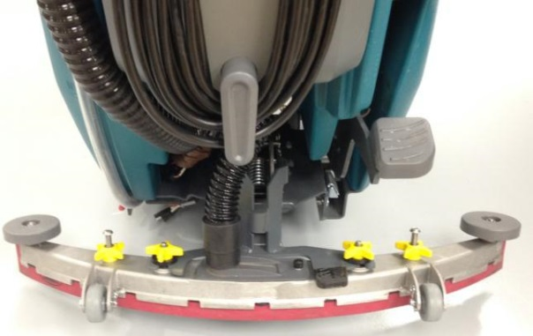

Environmental Health and Safety
Improved water pickup
ec-H2O NanoClean™ technology is NFSI certified
Tutorial videos may help reduce slip & falls or other worker compensation claims
Ergonomic Design
  Insta-Click™ head reduces bending
  Foot activated squeegee minimizes bending
  Wider handle improves machine operation

Slide 19
Addressing Customer Needs

Slide 20

Competitive Advantages
 | DESIGNED FOR PRODUCTIVITY Zone Settings™ / Supervisor lockout Insta-QuickTM Magnetic Head Pro-PanelTM screen & On-board diagnostics Recovery Tank Debris Tray 65 & 58 dBA Tennant Service | BENEFITS Standardization of cleaning Less time for machine start up/shut down Daytime cleaning Less downtime
 | ENVIRONMENT New squeegee and improved vac fan 65 & 58 dBA Smarter charger Actuated controls & ergonomic design | BENEFITS Less water on the floor Quieter environment for operators & others Safe charging of batteries Better ergonomics
 | CLEAN FLOORS Severe EnvironmentTM (SE) Switch New squeegee and improved vac fan On-board instructions High RPM’s and down pressure | BENEFITS Cleaner floors in fewer passes or secondary operations Soils removed from the floor Proper instruction for better results
 | OPERATOR On-board training & trouble shooting Zone Settings™ LCD screen Insta-Click™ head Ergonomic design Tool-less daily maintenance | BENEFITS No guesswork cleaning Consistent results Improved working environment Easy maneuverability Simple to maintain
COST TO REDUCE CLEAN
HEALTH & SAFETY
ENHANCE FACILITY IMAGE
EASY OPERATION & MAINTENANCE

Slide 21
T300 / T300e Summary
Taking cleaning to the next level
  Innovation in machine controls
  Enhanced detergent-free cleaning
Additional revenue per unit opportunities
  Tennant technologies
Expanding into new markets
  T300e – simple, reliable and more affordable
Improved cleaning cost for our customers
  Process improvements
  Lower acquisition costs

Slide 22
Things to Remember
T300 family:
A versatile set of cleaning solutions
Tackles virtually any hard floor condition
Improves operating costs

Slide 23
Thank You!

