Slide 1
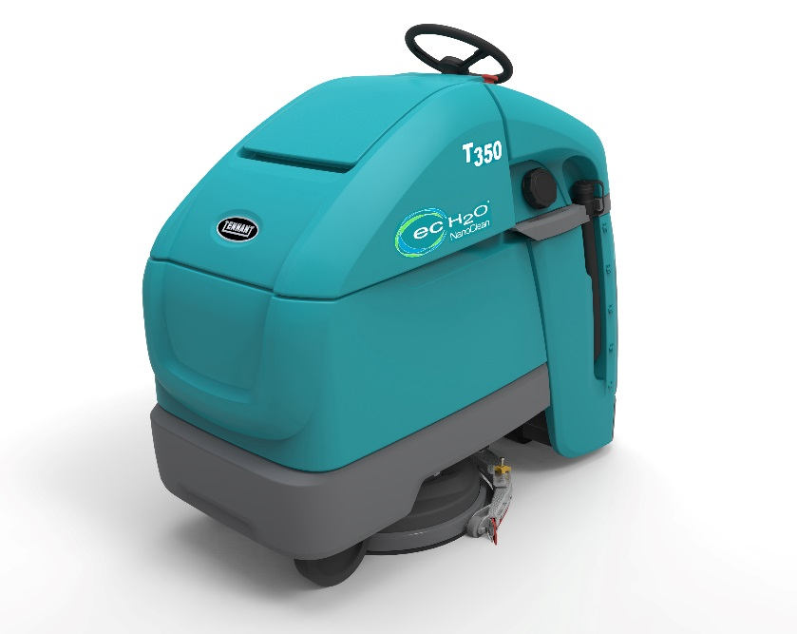
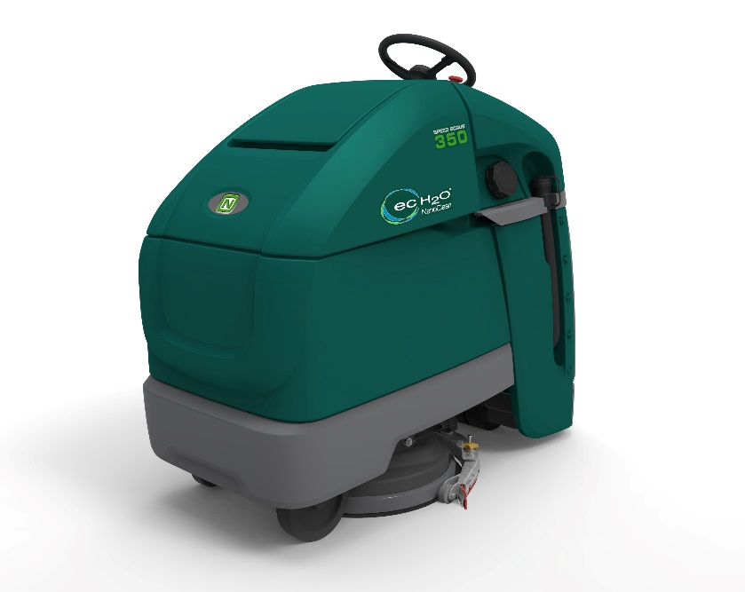
T350 / SS350
Stand-on Scrubber
Hands on Training session

Slide 2
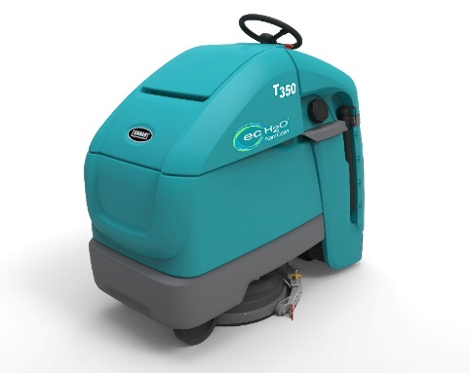
Objectives
Able to operate the machine and demonstrate machine to others
Able to summarize all service activities needed on a PM job
Able to explain the function of the following systems:
Akerman steering – drive wheel/caster wheel
Scrub head lift control - lifting, down pressure, pad release function
Automatic Battery Watering
Able to perform the following exercises:
Replace the steering cables incl adjustment (IB needed)
Replace the main circuit board (IB needed)
Enter manual mode for machine testing
Connect Service Diagnostics to machine and explore options

Slide 3
Program today
Overview on today’s T350 Training: | Est time (min) | Time
Short online quiz to test knowledge | 30 | 8.00-8.30
Component locator exercise | 30 | 8.30-9.00
Hands-on Session – Operation | 60 | 9.00-10.00
Break | 15 | 10.00-10.15
Hands-on Session – Service activities and PM | 30 | 10.15-11.00
Hands-on Session – Several System | 30 | 11.00-11.30
Hands-on Session – Service Diag, Manual mode, etc | 30 | 11.30-12.00
Break | 30 | 12.00-12.30
Hands-on Session – Service repair | 120 | 12.30-14.30

Slide 4
Kahoot - Quiz
Test your knowledge on the T350 at the start of this training:
Connect to WIFI or 3/4G network
Navigate to Kahoot.it
Fill in the participants code
Play the game!

Slide 5
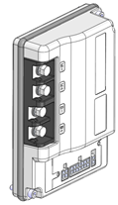
Component Locator
?

Slide 6
Hands-on exercises
Use operator manual as reference for:
Operation of machine
Service activities needed during PM
Steering chain, tension, damage, lubricate
Steering cables, tension and damage
Vacuum motor, propel motor, brush motor, replace carbon brushes
Check drive wheel, caster wheel, rear wheel
Check solution and pick up system, hoses, leakages, etc
Check state on all electrical wiring and connectors
Fill caps ABW system check on sticking floats.

Slide 7
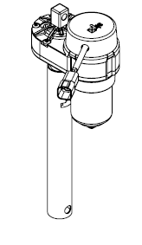
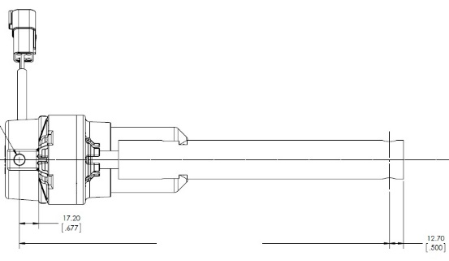
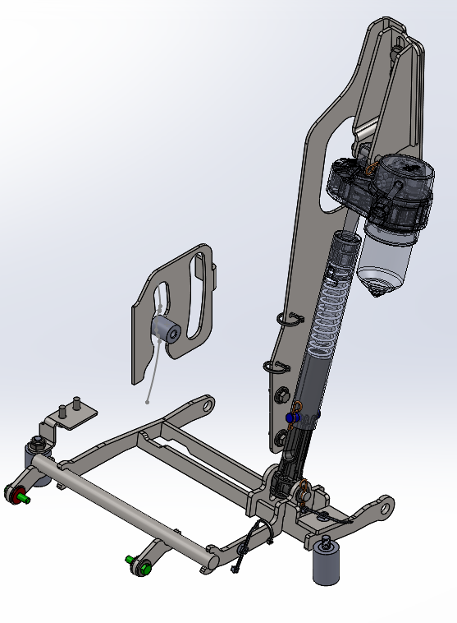
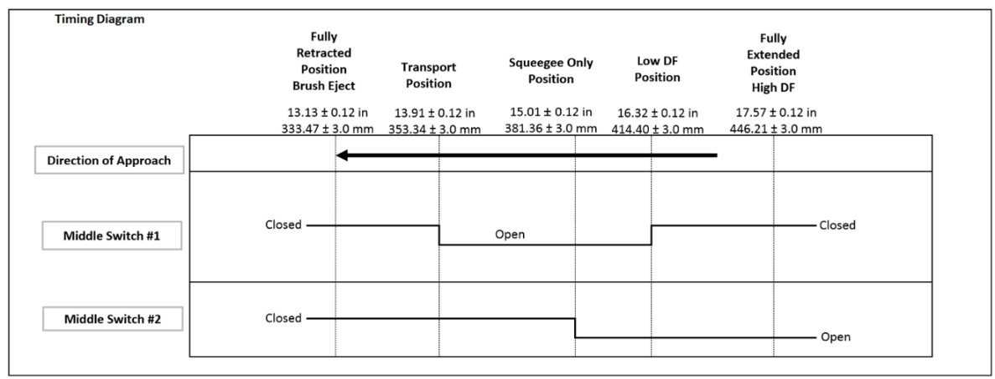
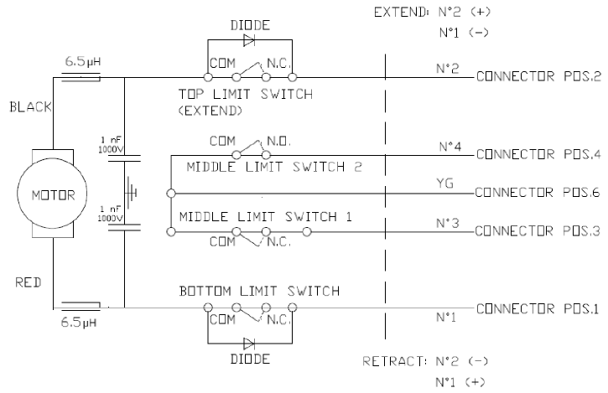
Hands-on exercises (explain at machine)
Scrub head lift - Operation and control logic
Down Pressure Logic
A down pressure change shall apply immediately when actively scrubbing.
The head shall move to the Ready/Vac-Only Position when scrubbing is enabled and operator present switch is engaged.
The head shall return to the Transport position when propelling in reverse.
Down pressure obtained through 2 fixed control positions.
The controller shall automatically reduce the high down pressure to low if either of the following conditions occur:
Scrub motor current exceeds 40A for 30 seconds, or
Scrub motor current exceeds 50A for 5 seconds.
If scrubbing is stopped when the scrubber automatically modified the down pressure, the machine shall return to the user set down pressure when scrubbing is resumed.
The actuator contains two internal switches for position detection and two limit switches for the fully extended and retracted position.
The actuator is driven by a bi-directional PWM-controlled output - nominal current of 2 amps operation with a maximum of 20 amps.
5 discrete positions defined as:
Pad Eject Position
Transport Position
Ready/Vac-Only Position
Low Down Force Position
High Down Force Position
The internal switch states shall behave according to the following logic:
Retracted length
333,5
+/-3mm

Slide 8
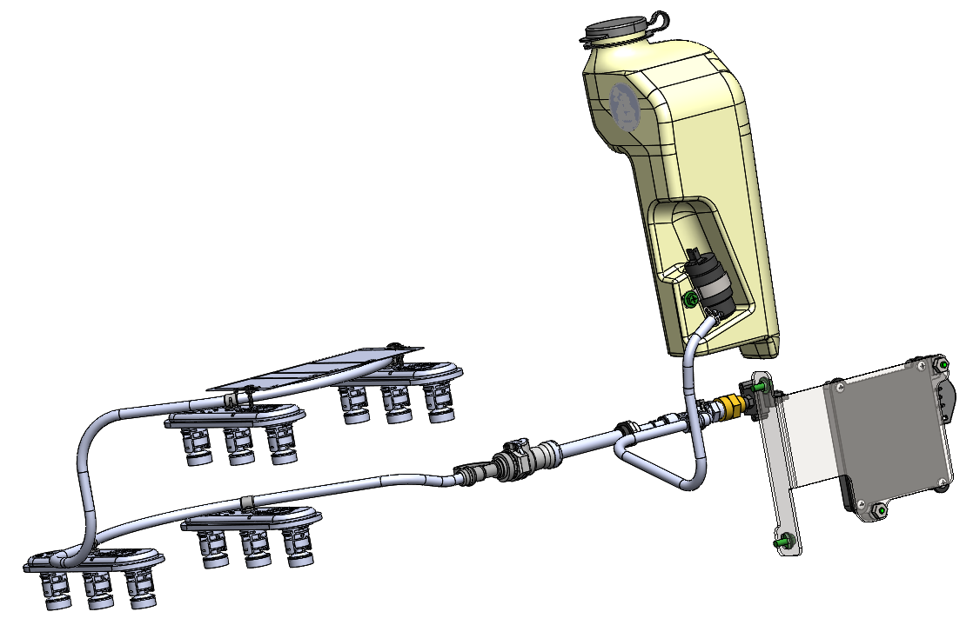
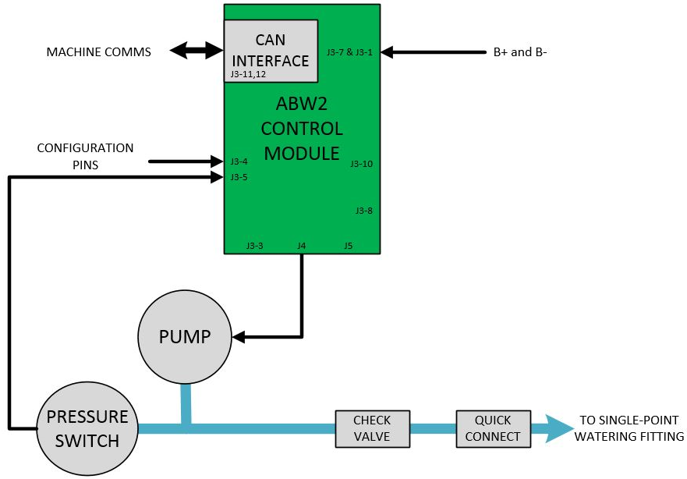
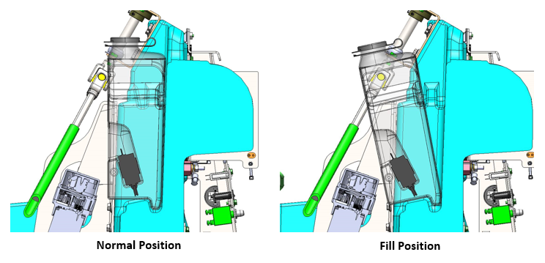
Hands-on exercises
ABW Smart fill system
Automatically waters batteries based on charge cycles and machine hours
Monitors water level by sensing in-tank pump motor current
When the ABW tank is empty, the indicator on the User Interface panel will light up and flash.
If the ABW tank remains empty after 10 power cycles the battery watering icon will flash at four times the normal flash rate.
The fault will also be lit and the battery discharge indicator will not display battery charge status.
The scrub functions will be disabled until the ABW tank is filled with distilled water.

Slide 9
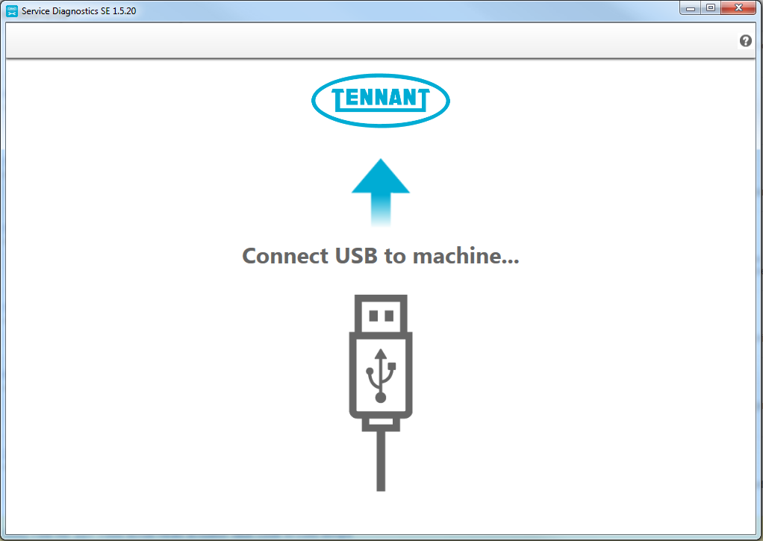
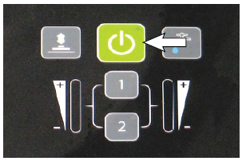
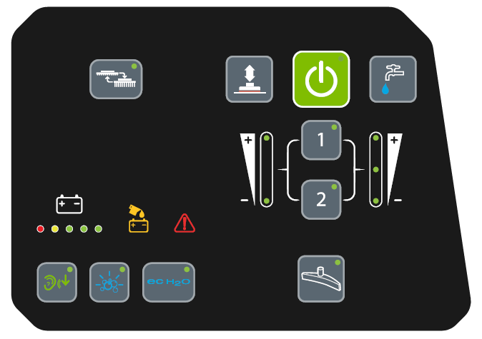
Hands-on exercises
Connect Service Diagnostics
Automatic firmware update (yellow highlight rim)
Fault code reading
Re-configure the machine or reprogram new installed components
Explanation of the manual mode function. Two versions: membrane panel and Pro-panel. Use service manual if needed.
Get familiar by exercise with changing zone settings and Lockout Mode. Use operator manual for instructions.

Slide 10
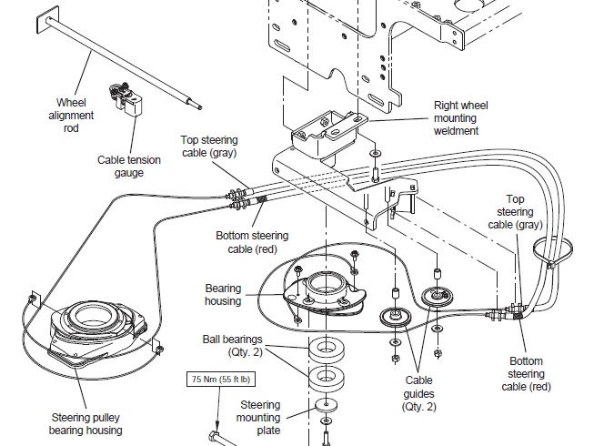
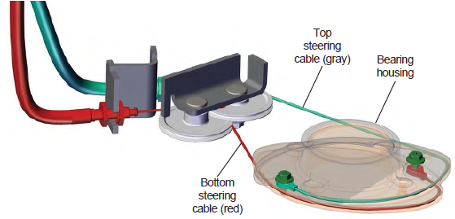
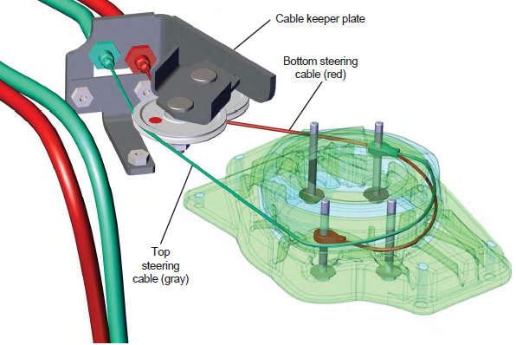
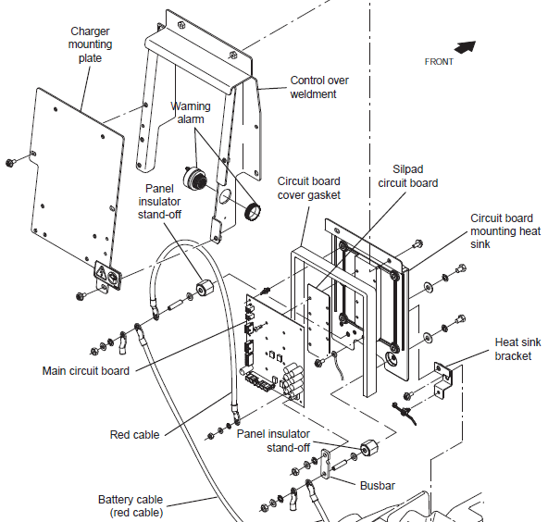
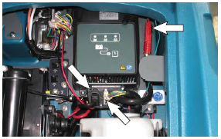
Hands-on exercises
Replace and adjust steering cables
Perform a replacement of the cables on the machine
Remove batteries and put machine on side
Replacement of circuit board
Remove components to gain access to circuit board

Slide 11
T350 / SS350 Stand-on Scrubber
Notes:
Thank you for your interest in the 350 Series Stand-On Scrubber machines.

