Slide 1
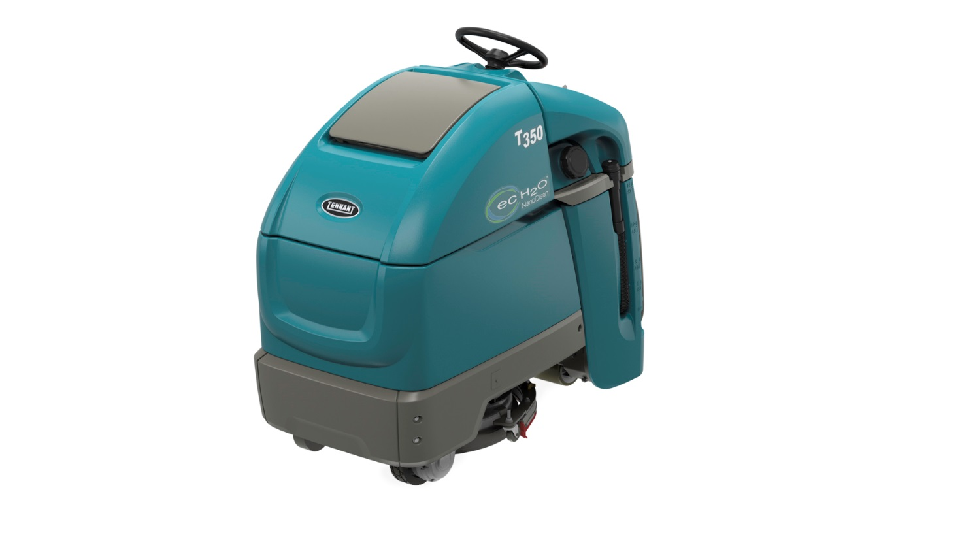
Product Application and Solution Guide
T350 Stand-on Scrubber
Updated – Dec. 2018

Slide 2




Markets and Applications For Stand-on Scrubbers
Markets
  Education
  Healthcare
  Retail
  Logistics
  Transportation
Applications
  Aisle ways
  Checkout aisles
  Entryways
  Cafeterias
  Tight spaces
  Hallways
Flooring
  VCT
  Polished stone
  Terrazzo
  Grouted ceramic & porcelain tile
  Polished concrete
  Marmoleum®
  Teknoflor®
Stand-On Scrubber Advantages
  More productive than a walk-behind
  Highly maneuverable

Slide 3
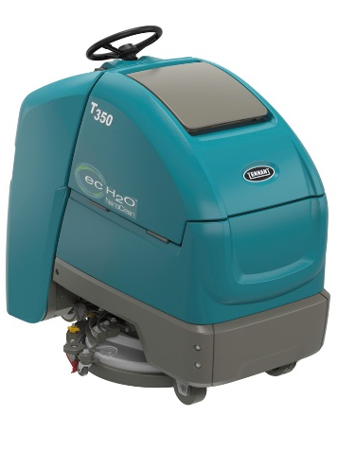
T350 Overview
Now a Different and Better Stand-on Scrubber you can use with confidence
REDUCED COST TO CLEAN
Lower costs with category leading productivity and Tennant technologies
Maximize up time with a durable design and an expansive service network
ENHANCE FACILITY IMAGE
High performance scrubbing with best in category cleaning features
High maneuverability to clean the tight spots
HEALTH & SAFETY
Operator comfort achieved through ergonomic design
Safely use and maintain the machine by leveraging Tennant exclusive features
Tennant’s T350 reduces costs of cleaning while providing great performance on the floor

Slide 4
T350 Product Overview
Product Offering
  Single disc – 20” (50 cm)
  Dual disc – 24” (60 cm)
Head Type*
  Insta-Click™ magnetic head
Tank Capacity
  14.1 gal (53L)
Down Pressure
  62 & 90 lbs / 28 & 41 kg (20” / 50 cm head)
  64 & 91 lbs / 29 & 41 kg (24” / 60 cm head)
Cleaning Head Speed
  215 RPMs (20” / 50 cm head)
  275 RPMs (24” / 60 cm head)
Sound Level
  Standard - As low as 63.7 dBA
Controls
  Pro-Membrane™
  LCD Pro-Panel®
Productivity
  3.6 mph (5.8 km/h) scrub speed
  24,588 ft² (2,286 m²) cleaned/hr - 20” (50 cm) head
  30,052 ft² (2,795 m²) cleaned/hr - (24” (60 cm) head
  60” (152 cm) aisle-turn
Batteries & Charging
  Wet: 210 AH & 240 AH
  Sealed: 210 AH AGM
  On-board and off-board chargers
Key Options
  ec-H2O NanoClean® Technology
  Severe Environment™ Switch
  Smart-Fill™ Automatic Battery Watering
  Single Point Battery Watering
  Quiet-Mode™ - As low as 59.7 dBA
  IRIS® Asset Manager
*Update on Jan. 1st, 2019
  3-Lug no longer offered after this date
  Insta-Click magnetic gauss ratings info on Sales Tools Hub and My Account

Slide 5
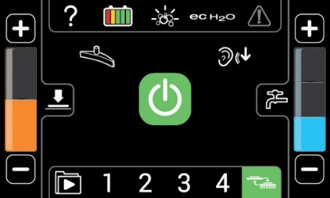
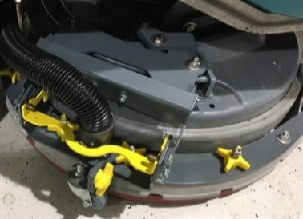
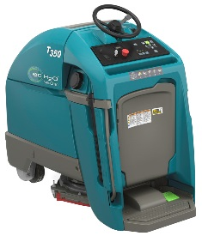

Cost to Clean
Reduce detergent, labor and water costs with ec-H2O NanoClean®
Minimize secondary cleaning operations with Severe Environment™ Switch
Simplify cleaning processes with LCD Pro-Panel® and Zone Settings™
Reduce maintenance costs with Smart-Fill™ automatic battery watering
Simplify routine maintenance with yellow touch points
Streamline squeegee maintenance with the quick release design
Expanding cleaning time with 14.1 gallon (53L) solution tank
Easy access to all components

Slide 6


Enhancing Facility Image
High performance floor cleaning delivered through high brush/pad RPMs & down pressure
Keep the machine running properly with on-board, on-demand maintenance videos
Standardize cleaning performance with Zone Settings™ and supervisor lockout capabilities
Enhance cleaning operations provided by exclusive Tennant technologies
20” (50 cm) Single Disk
24” (60 cm) Dual Disk
Pro-Membrane™ Panel
LCD Pro-Panel™

Slide 7

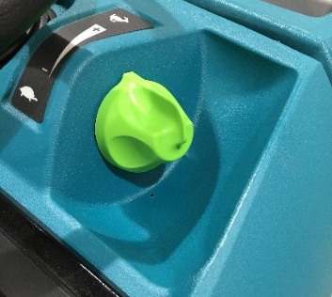
Environmental Health and Safety
Quick drying floors with optimized squeegee design and recovery system
Minimize slip and falls with NFSI certified ec-H2O NanoClean® technology
Safely perform routine maintenance with on-board tutorial videos
Safe battery maintenance provided by Smart-Fill™ automatic battery watering
Reduced body fatigue by managing machine speed via speed dial on console

Slide 8
Addressing Customer Needs

Slide 9
T350 Control Panel Offering
T350 control panels provide enhanced cleaning functionality
  Zone Settings™
  Vac only
  Warning lights
  1-Step activation of machine
LCD Pro-Panel provides additional functionality:
  Additional Zone Settings
  Operator Log-in ID
  Operator permissions
  Training and maintenance videos
  On-screen charger profile

Slide 10

Starting The Machine
❻
❸
❹
Key on machine
Step on Operator Presence Switch (OPS)
Select the travel direction
Press 1-Step button
Step on Green Go pedal
Control speed with green knob on control panel
❶
❺
❷

Slide 11
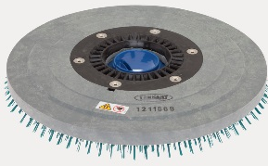
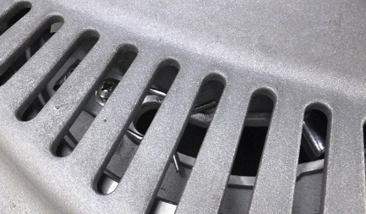
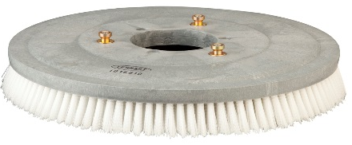
Disk Cleaning Tool Attachment Options
Insta-Click™ Option
  Powerful magnets for easy, low-touch pad driver and brush attachment and removal
  Push-button brush and pad release
3-Lug System – Standard*
  Conventional tool attachment
Pro-Membrane™
Pro-Panel®
Insta-Click Cleaning Tool
Release button
Release button
Insta-Click Pad Driver
3-Lug Cleaning Tool*
*Update on Jan. 1st, 2019
  3-Lug no longer offered on products from the factory after this date.
  Insta-Click magnetic gauss ratings info on Sales Tools Hub and My Account

Slide 12
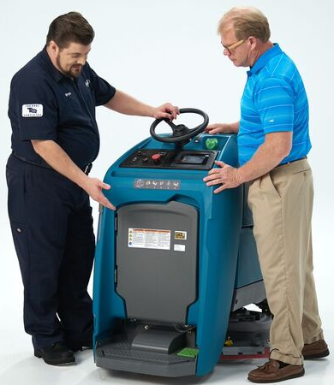
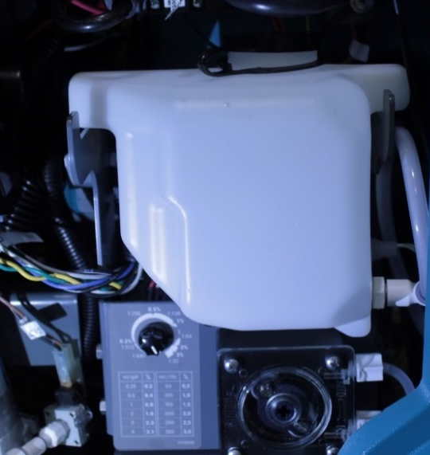
ec-H2O NanoClean® with Severe Environment™ Switch
On-demand detergent dispensing system cleans tougher soils like heavy oils
  Saves time and money by reducing secondary cleaning processes
  30-second detergent flow for spot cleaning
  Continuous detergent flow for larger spaces
  Located behind the access door
Detergent tank
Access Door
Dilution Control Dial

Slide 13
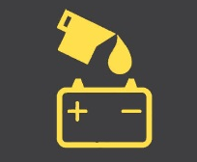
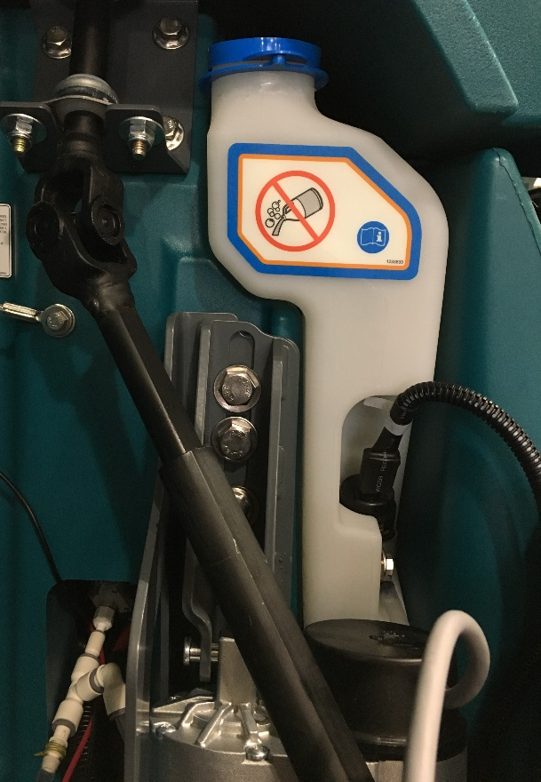
NEW Smart-Fill™ Automatic Battery Watering
Address Major Pain Point – Wet Battery Maintenance and Costs
Virtually maintenance-free battery watering system
  Smart – Automatically fills batteries to proper level with distilled water
  Safe – Effectively eliminates potential for battery acid contact
  Automatic operator notification when
  Smart-Fill tank is empty
Improved cost of ownership
  Optimizes battery life
  Improves battery run time
  Reduces maintenance costs
Easy to use
  Just fill the Smart-Fill water tank with distilled water
  Tank located in battery compartment
Warning Light
Distilled Water Tank
Notes:
Julie – make this a big deal, it’s a big deal
John – when showing the numbers, walk them through more methodically
Keith – three words come to mind…performance, price and safety – reduce the
John/Julie – they’ll want to know how it works, be prepared
John – thinks the selling scenarios should be done during the small group
Julie – confused about the $445/$290 – adjusted to use “save” and labeled appropriately
From Mike: Explain more of what the benefits are of safety and confidence to the customer.
Fin
Simple – On-board system means virtually worry-free battery maintenance
Smart – Automatically fills batteries at the best time in the charging cycle
Safe – Remove operator’s manual task of checking, opening and filling

Slide 14
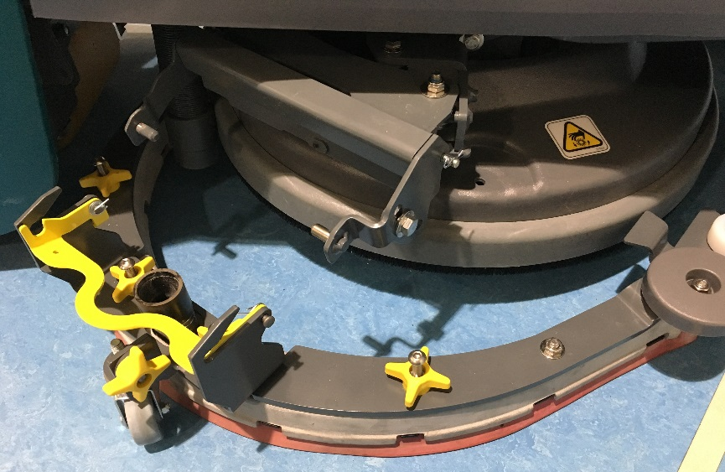
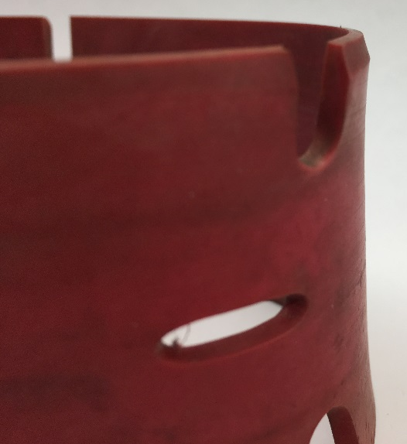
Quick Release Squeegee and Blade Replacement
Quick Release Squeegee
Quickly and easily release squeegee with a simple grab of the yellow bar
Enables easy rotation or replacement of squeegee blades
Squeegee Blade Replacement
Leverage all four sides of squeegee blades or replace them when the blade is warn half way through its thickness.

Slide 15
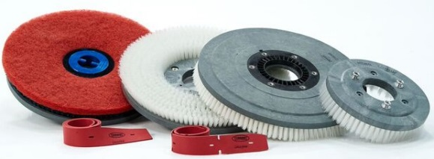
TennantTrue® Cleaning Tools
Complete the system with the right cleaning tools
A variety of pads and brushes to tackle almost any cleaning situation
All pads and brushes are the same as the T300e

Slide 16

TennantTrue® Service Plan
Lower Total Cost of Ownership
Budget control with predictable service fees
Increase productivity and reduce risk of costly breakdowns with regularly scheduled maintenance
Get Answers Fast
Get solutions on-site from Tennant‘s local service technicians
Get answers by phone from the Tennant Tech Assistance Center
Optimize Equipment Life
Deliver a higher level of clean with TennantTrue
parts designed and built specifically for Tennant machines
Optimize machine life with service by factory-certified
Tennant service technicians

Slide 17
Tennant Lineup
T300 Walk-behind
  Small spaces
T350 Stand-on
  Higher productivity for spaces with obstacles
  Higher run time
T500 Walk-behind
  Larger spaces needing more performance features
T7 Sit-on
  Productivity needed for large open spaces

Slide 18
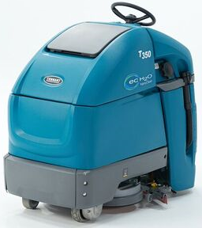
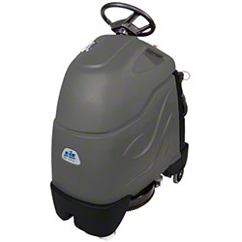
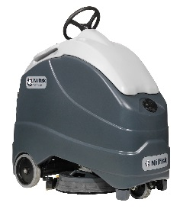

Competitive Comparison - Productivity
Tennant is 40% to 70% more productive
Productivity is a combination of:
Machine scrub speed
Solution Tank size
Cleaning path width
Water flow
Dump/fill time
TENNANT T350 | CHARIOT 2 | NILFISK SC1500
20”/50 cm 24,558 ft²/hr 2,286 m²/hr 24”/60 cm 30,052 ft²/hr 2,795 m²/hr Practical Productivity | 20”/50 cm 14,304 ft²/hr 1,330 m²/hr 24”/60 cm NA NA Practical Productivity | 20”/50 cm 17,160 ft²/hr 1,600 m²/hr 24”/60 cm NA NA Practical Productivity
3.6 mph / 5.8 km/h Scrub Speed | 2.7 mph / 4.3 km/h Scrub Speed | 2.6 mph / 4.2 km/h Scrub Speed
14.1 Gal / 53 L Tank Size | 10.0 Gal / 38 L Tank Size | 12.0 Gal / 45 L Tank Size
0.15 gpm / 0.57 lpm Water Flow | 0.33 gpm / 1.25 lpm Water Flow | 0.16 gpm / 0.61 lpm Water Flow
94 min Solution Tank Drain Time | 30 min Solution Tank Drain Time | 75 min Solution Tank Drain Time

Slide 19
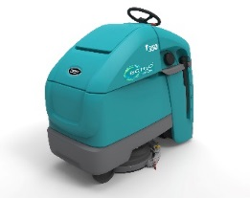
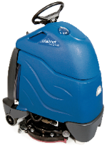
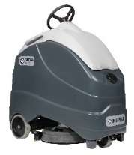
Competitive comparison – Performance & Innovation
Tennant optimizes cleaning performance and leverages time-saving innovation
Proper weight distribution and heavy duty frame make the machine very stable
TENNANT T350 | CHARIOT ISCRUB 20 | NILFISK SC1500
215 RPM Brush Speed | 180 RPM Brush Speed | 140 RPM Brush Speed
62 & 90 lbs / 28 & 41 kg Down Pressure | 50 lbs / 23 kg Down Pressure | 51 & 75 lbs / 23 & 34 kg Down Pressure
ec-H2O NanoClean® Detergent-free Cleaning IRIS® Asset Management Smart-Fill™ Automatic Battery Watering System Pro-Panel® LCD touch screen Machine Controls | Water Detergent-free Cleaning None Asset Management None Automatic Battery Watering System Dial Machine Controls | Water Detergent-free Cleaning None Asset Management None Automatic Battery Watering System Std. Membrane Machine Controls
490 lbs / 222 kg Machine Weight | 209 lbs / 95 kg Machine Weight | 355 lbs / 161 kg Machine Weight
CLEANING PERFORMANCE
TIME-SAVING TECHNOLOGY
Machine Stability

Slide 20
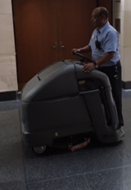
Extraordinary durability and reliability
Over 100 lab tests conducted prior to launch
  Endurance testing
  Belgian block impacts
  Collision and drop tests
  Tank dump and fills
  Tank vacuum cycles
  Etc.
25 customers in-field testing sites
    In-field customer tests
    Education, healthcare and retail
Confidence in the machine

Slide 21

T350 Overview
T350 provides you with the confidence you need
Lowering costs through improved productivity
Reduce cost of ownership with Tennant exclusive technology options
High maneuverability to clean tight spaces
Worry-free experience with a durable design backed by an expansive service network
High performance cleaning results from high down pressure and brush RPMs
Operator comfort through smart ergonomic design
T350… a stand-on scrubber that is truly different and better!

Slide 22
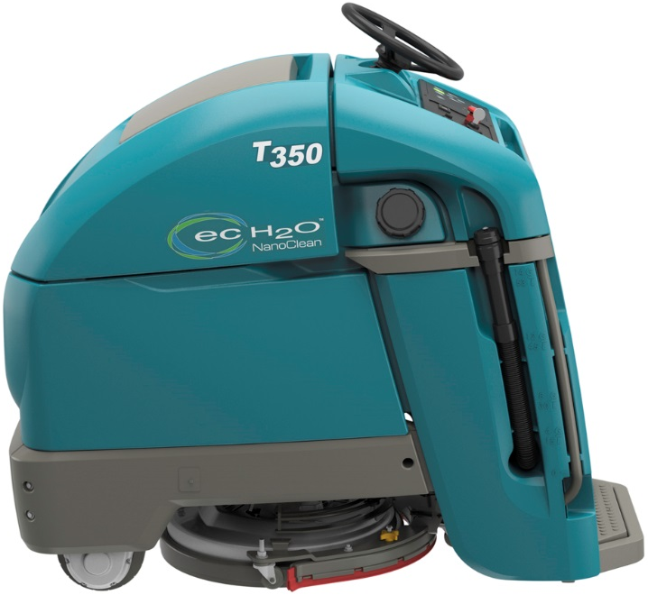
Thank You!
T350… Different and Better

