Slide 1
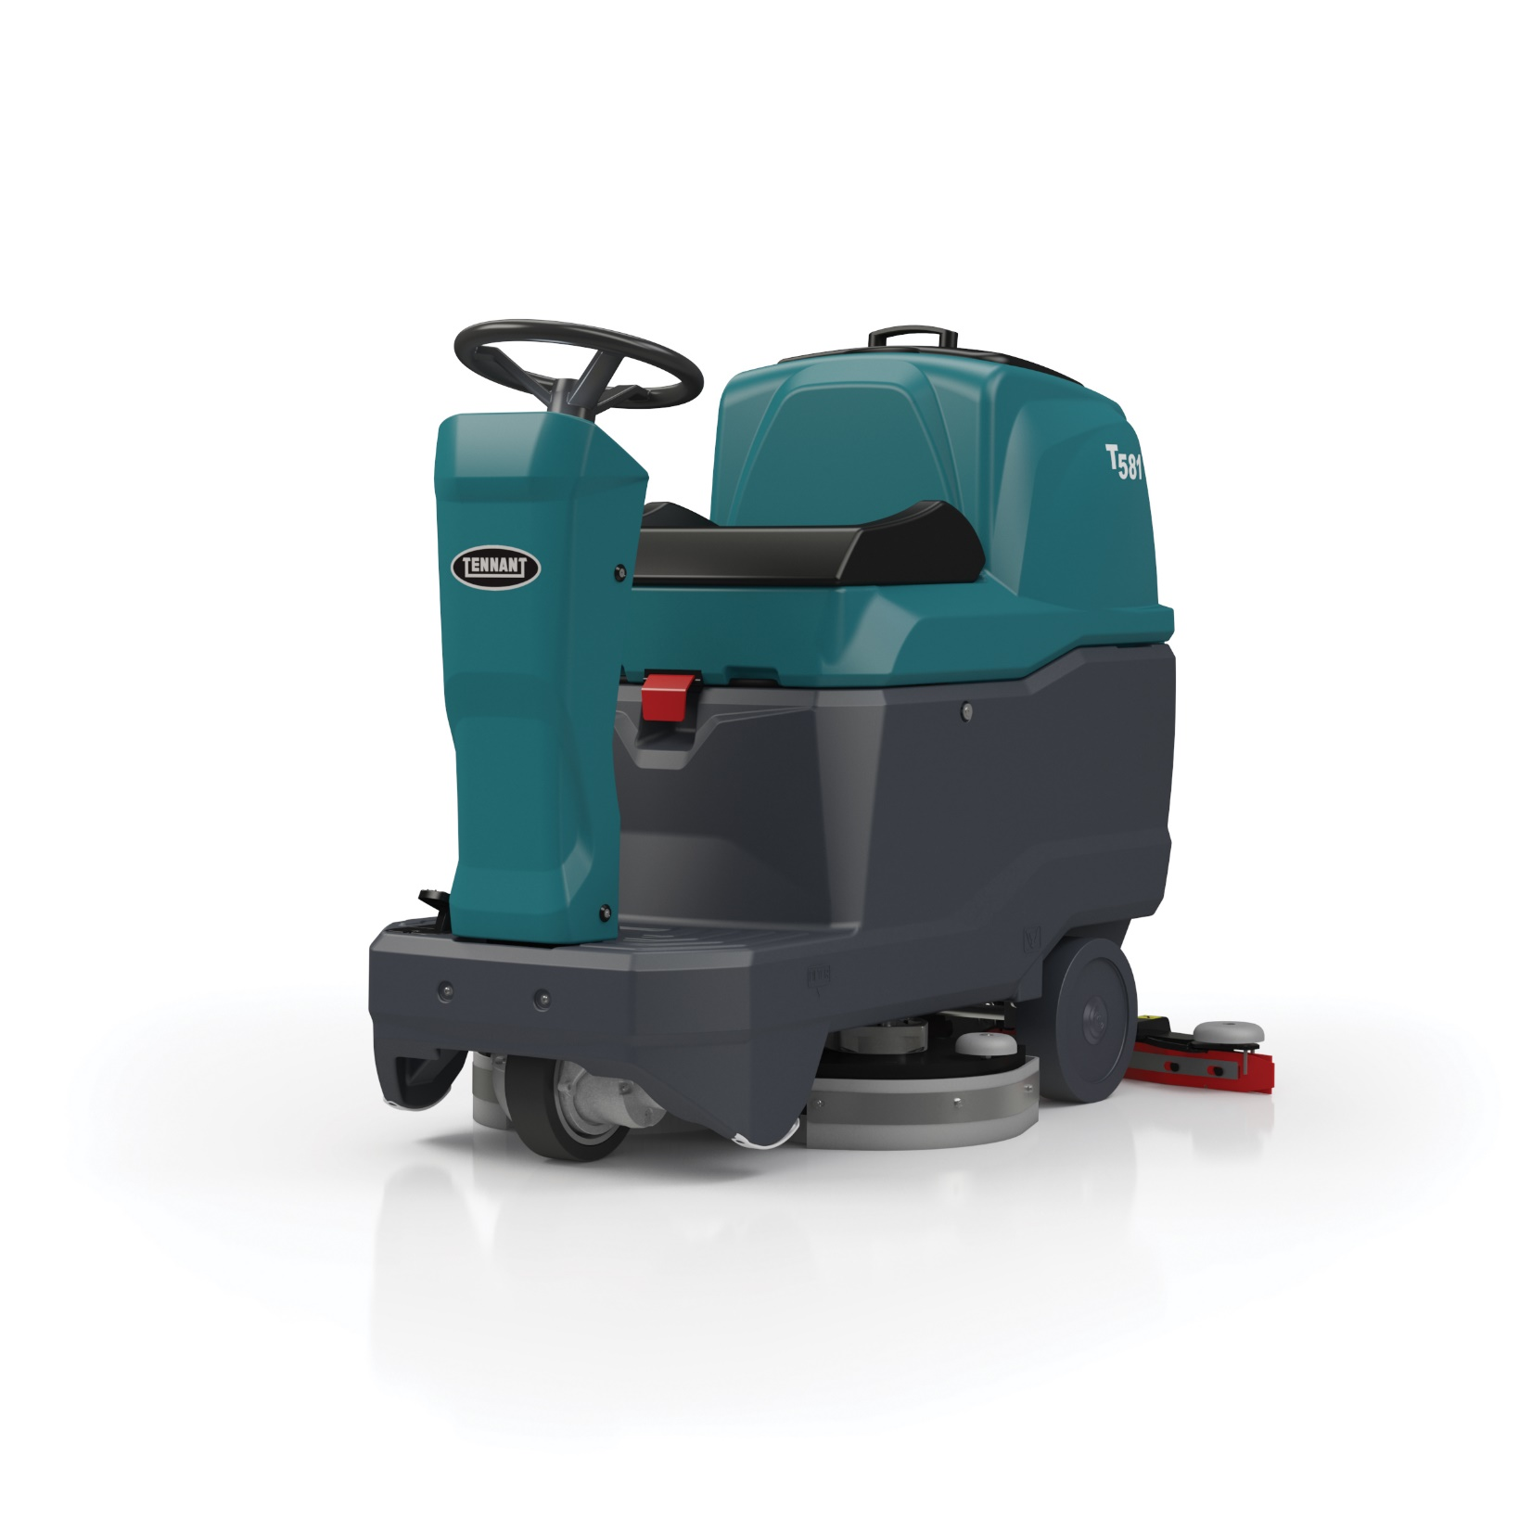
T581
Micro-Rider
Scrubber-Dryer

Slide 2
Trusted Advisor
150 Years Experience
Global Leader in the Cleaning Industry
Top of Class Quality & Reliability
Commitment to Sustainable Cleaning Solutions
Dedicated Technical Assistance Center
360+ Service Technicians across Europe
Strategic Account Team

Slide 3
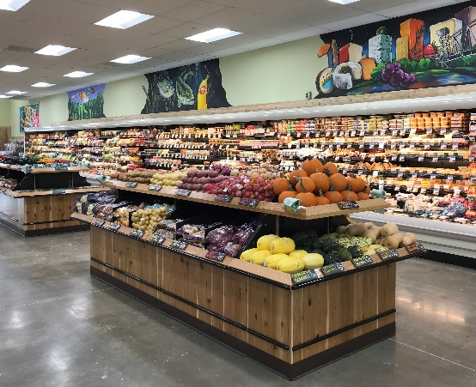
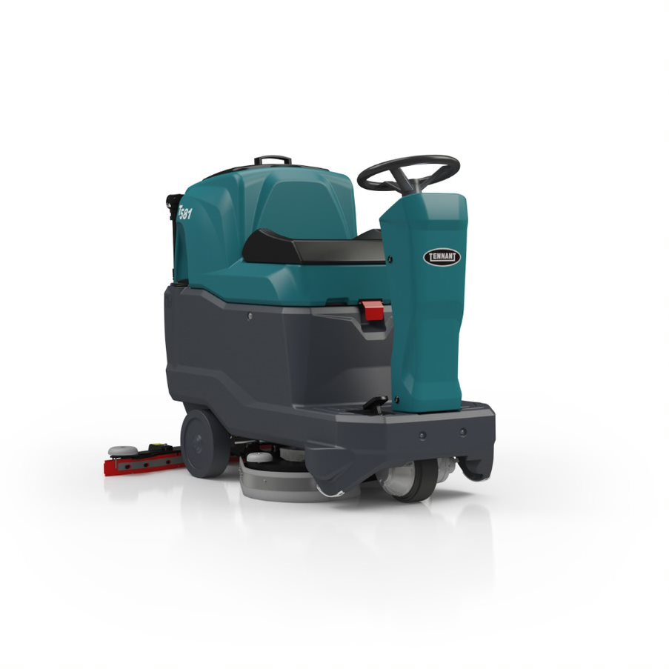
Designed for Commercial Markets
T581
550 mm single disk
700 mm dual disk
BSCs
RETAIL
Great for small areas where productivity, compact size and maneuverability in a rider are needed
Integrated Chem-Dose System standard
Includes poly bristle brush(es)
HEALTHCARE
EDUCATION

Slide 4
Right Product for Your Application
Facility Size & Usage
Every other day cleaning during the day and/or night shift
Small-to-large size areas
Less than 2 hours cleaning per day
Application Challenges
Typical commercial settings and floor types
Few obstacles or objects to navigate (forklifts, pallets, carts, corner protectors, etc.)
Cleaning Environment
Low to medium traffic areas
Low to medium soils (few spills or aggressive soils)

Slide 5
Tennant Commercial Scrubber Advantages
Reduce Costs to Clean
Simple, intuitive controls that require minimal buttons to be pressed to help make start-up consistent and fast.
Maintain Health and Safety
Consistent water pick-up with durable “V” shaped squeegee design and standard Linatex® squeegee blades.
Enhance Facility Image
Reliable scrubbing performance from straight-forward, quality scrubbers that provide consistent up-time to keep your facility looking great.
Easy Operation & Maintenance
Easy daily maintenance from yellow touch points that help reduce breakdowns by simplifying preventative maintenance.

Slide 6
T581 Features
Maneuverable, productive and compact, easily fitting into most congested spaces, and quickly reaching many areas of a facility to get more cleaning done.
Easily change water flow rate and other cleaning functions from intuitive control panel.
Increase consistent cleaning performance and reduce cost to clean with integrated chemical dosing system
Ease of start-up and quick training with one-button cleaning operation that lowers the scrub head and squeegee at the same time.
Extended run times nearly 20% with ECO mode that decreases battery consumption during operation.
Simple no-tools, no-touch brush change system.

Slide 7
T581 Specifications
Feature | Self-Propel | Self-Propel
Cleaning Path | 550 mm | 700 mm
Productivity (per hour) theoretical max | 3,300 m²/hr | 4,270 m²/hr
Estimated coverage (per hour) | 2,038 m²/hr | 2,645 m²/hr
Scrubbing speed | 6.0 kmh
Brush/pad speed | 150 rpm | 220 rpm
Brush/pad pressure | 22 kg | 10 up to 50 kg
Solution tank capacity | 78.5 L
Recovery tank capacity | 80 L
Battery run time - up-to hours | 2.3 | 4.5
Battery voltage | 24V (2 x 12) | 24V (4 x 6)
Dimensions (LxWxH) | 1,310 x 673 x 1,030 mm | 1,310 x 760 x 1,030 mm
Squeegee width | 710 mm | 924 mm
Sound level (operator's ear) | 65 dB
Chem-Dose tank capacity | 3 L

Slide 8
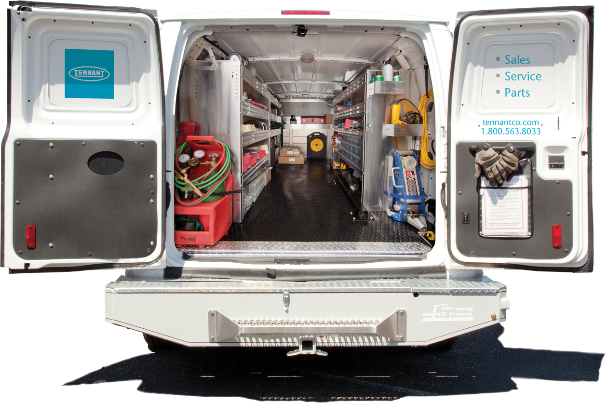
Tennant Service TRUSTED. RESPONSIVE. LOCAL.
TRUST US
140K
12 YEARS
TOTAL RESOLVED SERVICE CALLS IN 2020
AVERAGE TENURE OF SERVICE REPS
74% OF MACHINE
WORKING WITH RESPONSE TIME COMMITMENT
84%
FIRST TIME OPERATIONAL
WE’RE RESPONSIVE
WE ARE WHERE YOU ARE
1.3 DAYS
RESPONSE TIME
360+ SERVICE TECHS
SERVING EUROPE
LICENSED • BONDED • INSURED

Slide 9
T581
Micro-Rider
Scrubber-Dryer

