Slide 1
os3 OSG unit
First introduction!
February 12, 2014, Bottesford, UK

Slide 2
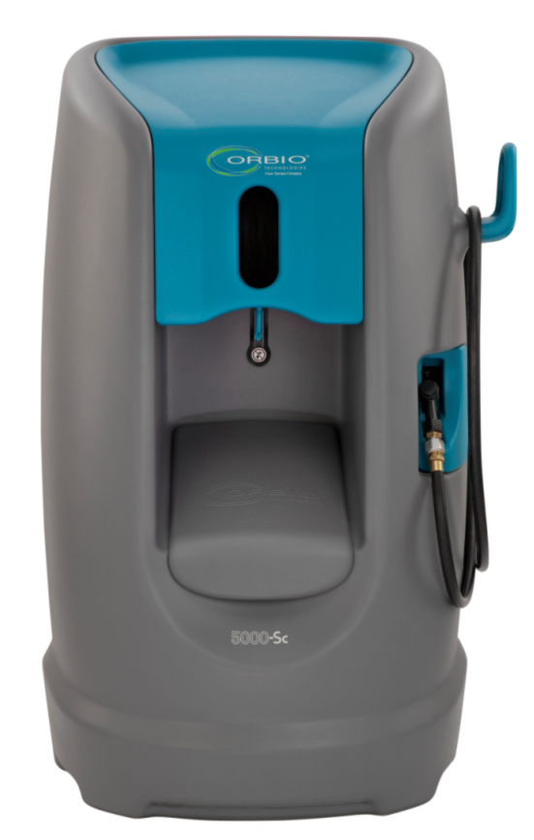
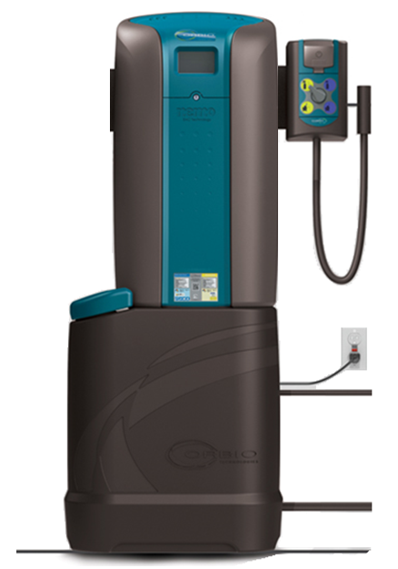
os3 Strategy - Product - More markets, more applications, more chemicals replaced
Central Filling
Large Spaces
Cleaning Only
Central & de-centralized filling
Small/Medium Spaces
Cleaning AND Antimicrobial
5000-Sc
os3

Slide 3
os3 Product Overview vs. 5000-Sc
Enhancements from 5000-Sc:
Smaller size (18” x 11” floor footprint)
Lower price
Easier to install & service (think toner cartridge)
Cleaning AND Antimicrobial output
No filters to change out
Floor OR Wall-mounting
No water softener set-up
Common with 5000-Sc:
Uses standard water softener salt
Simple user-interface
“just dispense and clean”
Notes:
INSTALLATION
Potential for DIY Install
Wall-mount or Floor-mount
One SKU/choose at install site
All hardware included
No water softener set-up (automatic). Uses standard softener pellets.
Remote dispenser or connected to Generator
Requirements:
- Water supply, Drain, Electrical Supply
OPERATION and SERVICE “GUI”
Operation
Same/similar icon-based as 5000-Sc
Ready to dispense
Generating
Add salt
Turn on water
Turn off hot water
Solution amounts generated (L & Gal)
Service
Planned Service Items
EASE OF SERVICE
Proactive “Service Soon” icons
E-cell (~36K gals RTU)
pH Probe (1 year)

Slide 4
os3 Core System Concept
Graphic User Interface
Generator
Dilution Control
50 Gal Multi-Surface Cleaner available at one time
25 Gal Antimicrobial available at one time
Power
Water Supply
Water Softener
Drain
4
Notes:
OUTPUTS
~50 gal RTU MSC &
~25 gal RTU Antimicrobial
…avail at one time
Regeneration from empty
MSC = ~5 hrs
Antimicrobial = ~2 hrs
Bottle and Machine-fill
Hydro dispenser
Shelf Life (Stability testing on-going)
MSC - Months as Pre-diluted Solution & RTU
Antimicrobial
30+ days as Pre-diluted Solution
7+ days as RTU

Slide 5
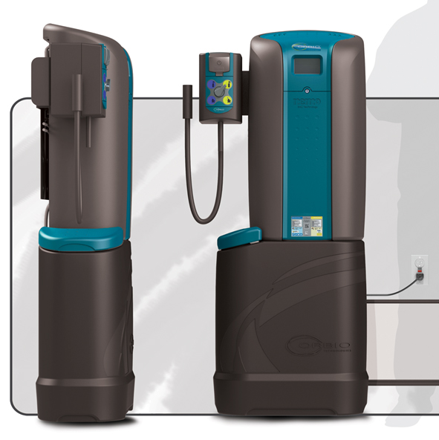
os3 Flexible Mounting Design
Wall-mount
Floor-mount
Confidential - Tennant/Orbio

Slide 6
os3 Outputs
MultiMicro (Disinfection)
Notes:
High Capacity - Concentrated solutions are held inside generator until needed to be dispensed via the dilution control, allowing for a small machine with a big output. 50 Gal/200L RTU Multi-Surface Cleaner and 25 Gal/100L RTU MultiMicro 200 available at one time. Regeneration at approx. 12 Gal/45 L RTU/hour each.
Concentrated solutions minimize generator size and weight, and allow high RTU capacity for not just bottle filling, but larger cleaning equipment, increasing productivity.

Slide 7
os3 Cleaning output
Specs
Formula:
Concentration:
MultiSurface Concentrate
NaOH(aq)
Concentrate
MultiSurface Cleaner
NaOH(aq)
Dilution:
pH:
Usability:
Smell:
10,5-11,5
Ready to use
50 ppm
30 days after dilution
None
30 days after production
None
12,2-12,5
2000 ppm
Notes:
Multi-Purpose - Replaces APC, glass, SS, floor scrubber and carpet chems with one simple solution.
Customers can simplify their cleaning processes and reduce the number of chemicals that need to be re-ordered, inventoried and distributed, saving time and money.
Operator training is simplified with reducing the number of solutions that need to be trained on as well as refilled, saving time and simplifying the cleaning process.
3rd Party Recognized – Extensive certifications and registrations of the Orbio MultiSurface Cleaner has been earned in the areas of cleaning performance, food safety as well as environmental impact.
Customers can feel confident that the decision to incorporate this Multi-surface cleaner is a sound one and backed by some of the most stringent and recognized organizations in the cleaning industry.
Carpet Performance – Extensive testing by third parties such as CRI, PTL and Woolsafe have led to approvals and evidence that show the Orbio MultiSurface Cleaner performs as well as or outperforms many conventional carpet cleaners.
Orbio Multi-Surface Cleaner has received approvals from both CRI and Woolsafe, as safe for use on wool and advanced generation carpets, providing our customer peace of mind that it is not only safe form use, but will not void their warranty.
Third party testing has also shown that due to its lack of sticky surfactants, the Orbio Multi-Surface Cleaner resoils less, compared to several conventional carpet cleaners. Less resoiling means our customers carpets stay cleaner longer improving facility image and increasing productivity and reducing labor costs by increasing the time between carpet cleaning.
Third party testing has also shown less residual moisture left in carpets after cleaning with the Orbio Multi-Surface Cleaner compared to conventional carpet cleaners. Less residual moisture means quicker dry times, providing greater flexibility in when carpets are cleaned and returning the areas to service quicker.
Long Shelf Life – Both in concentrate and RTU form, the Orbio MultiSurface solution is shelf stable for months.
Long shelf life provides customer with the confidence that the cleaning solutions remain effective well after they are dispensed, increasing productivity and reducing costs over other OSG solutions that only remain effective for one or seven days.
No Odor – no odor and no VOC’s reduce the potential for interaction with operators and the people in their care that have chemical sensitivities and reduces chemical odors during the cleaning process.
No odor increases productivity by allowing increased flexibility in cleaning times.
No odor reduces costs by eliminating the need to accommodate operators or the people in their care with unique cleaning chemicals or cleaning times.

Slide 8
os3 NEW(!) Disinfection output
Specs
Formula:
Concentration:
MultiMicro Concentrate
HOCl(aq)
Concentrate
MultiMicro 200
HOCl(aq)
Dilution:
pH:
Usability:
Smell:
6-8
Ready to use
200 ppm
7 days after dilution
Low level of chlorine
1500 ppm
30 days after production
Chlorine
5-6
Notes:
Deodorizer – Deodorizes garbage storage areas, garbage bins, toilet bowls, and other non-porous surfaces in odor-causing areas.
Long Shelf Life – Shelf life of 7 days in RTU form and 30 days in concentrate form.
Long shelf life provides customer with the confidence that the solutions remain effective well after they are dispensed, increasing productivity and reducing costs.
No PPE Required – Safe to use for operators. Although no PPE is required, almost all cleaning programs require or recommend the use of PPE as part of best practices protocol. > Check final regulatory description!

Slide 9
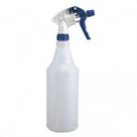
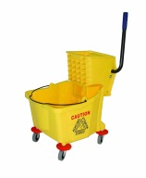
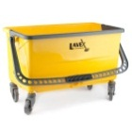
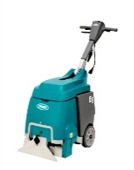
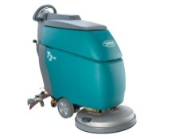
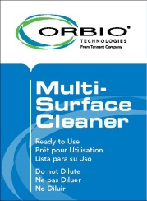
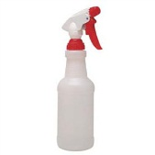
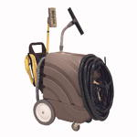
os3 Output Applications
Cleaner
Antimicrobial
Glass Cleaners
All-Purpose Cleaners
Floor Cleaners
Floor Cleaners
Carpet Cleaners
Floor Cleaners
mmm
Hard Surface Sanitizers
Hard Surface Disinfectants
Hard Surface Disinfectants
Hard Surface Disinfectants
Hard Surface Disinfectants

Slide 10
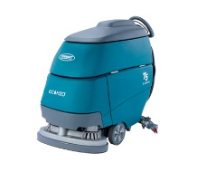
os3 Generator RTU Volume
Cleaner 50 G RTU (5 hours to refill - 250 G/day max.) | 1 Qt (200x) | 10 G (5x) | 25 G (2x) | 4 G (12x) | 1 G (50x)
Antimicrobial 25 G RTU (2 hours to refill – 300 G/day max.) | 1 Qt (100x) | N/A | N/A | 4 G (6x) | 1 G (25x)
mmm

Slide 11
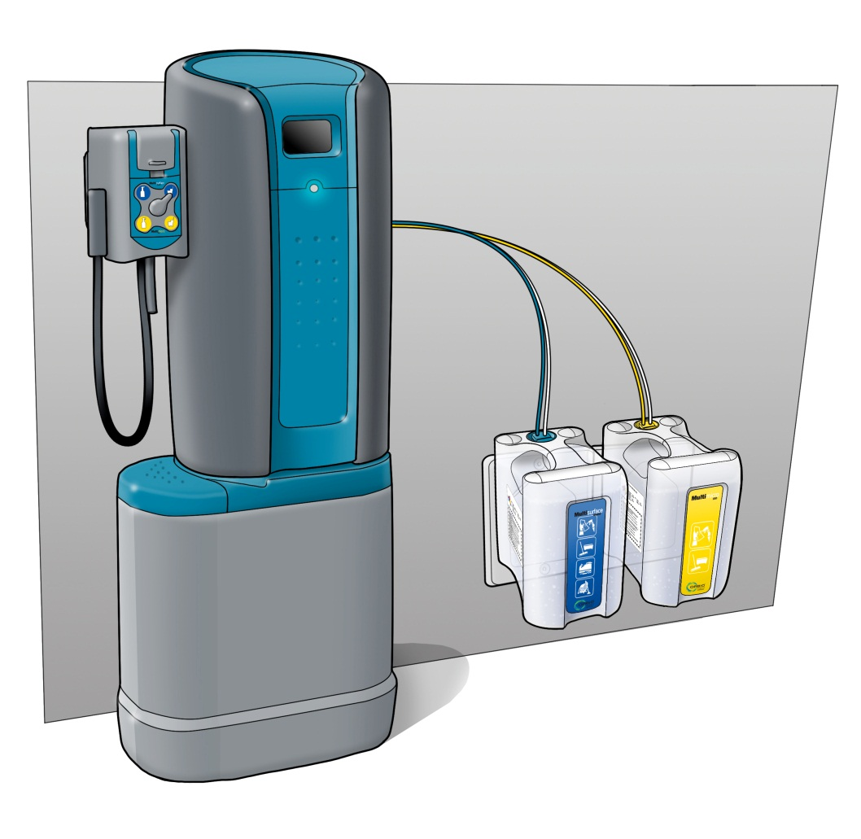
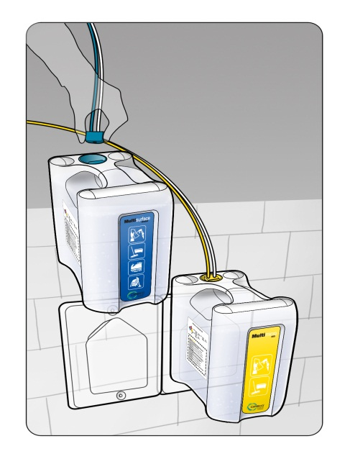
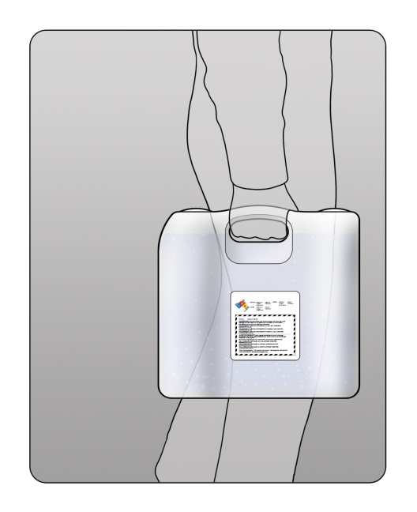
Optional Satellite Station
Filled by NEMO…
Disconnect Transport Containers
from Nemo
Transport Containers moved to remote
custodial closets
Confidential - Tennant/Orbio

Slide 12
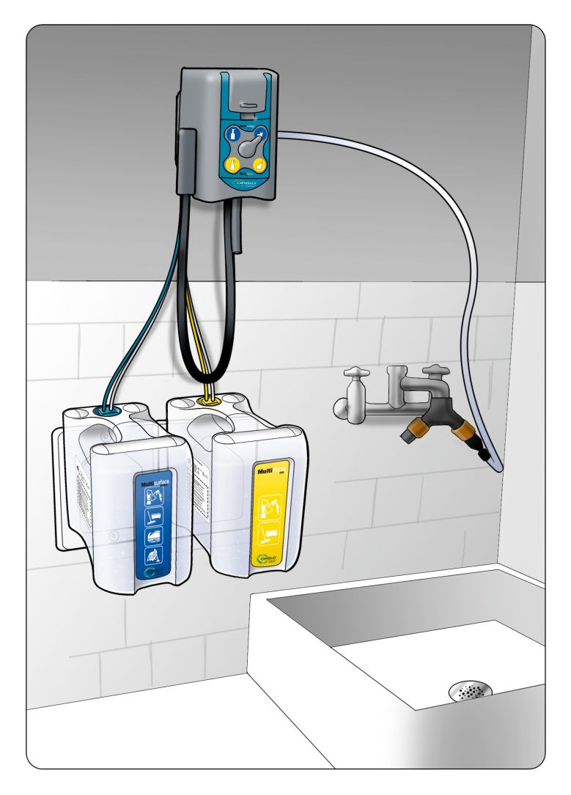
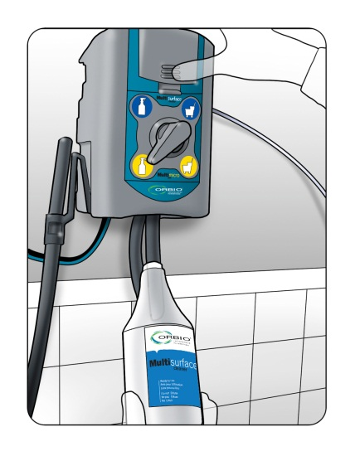
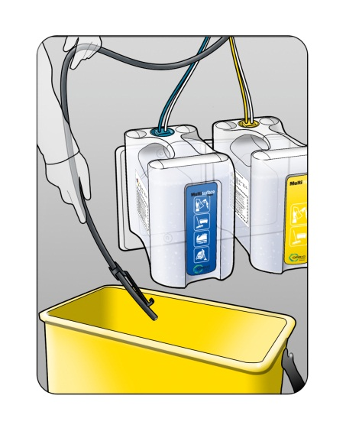
Optional Satellite Station
…diluted where needed.
Connect container
to dispenser…
Bottle fill…
Bucket or equipment
fill…
Satellite station in remote closet
Confidential - Tennant/Orbio

Slide 13
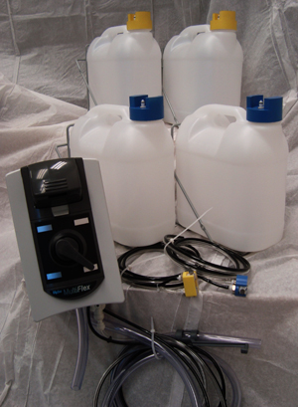
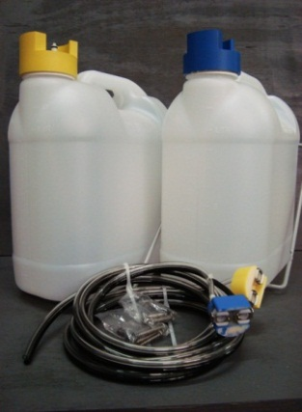
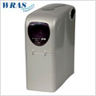
Satellite Products
 | Satellite System | Transport Container Expansion Kit | Water Softener
Purpose: | Remote dilution and dispensing of solution(s). | Allows Filling of multiple Transport Containers at Generator Site to support multiple Satellite Systems. | Conditioning of hard water at Satellite Station, only at locations with hard water issues.
Confidential - Tennant/Orbio

Slide 14
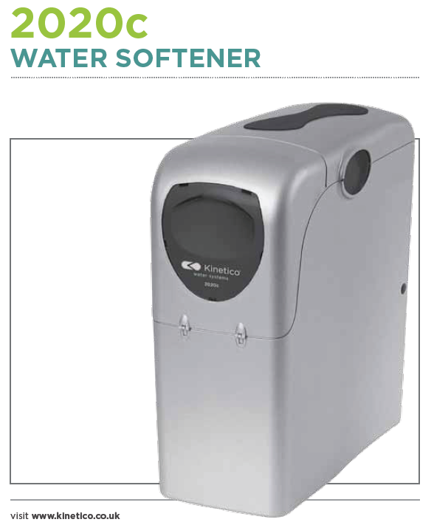
Satellite water softener
When to install a satellite water softener?
Measurement of conductivity of water is >= 400 ms.
This is equal compared to traditional chemicals.

Slide 15
os3 Satellite Tank RTU Volume
Cleaner 25 G/ container | 1 Qt (100x) | 10 G (2.5x) | 25 G (1x) | 4 G (6x) | 1 G (25x)
Antimicrobial 18 G/ container | 1 Qt (72x) | N/A | N/A | 4 G (4x) | 1 G (18x)
mmm

Slide 16
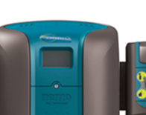
os3 Graphical User Interface

Slide 17
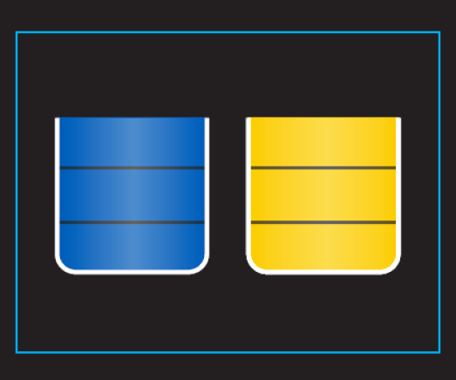
System indicators on GUI
Interface panel with touch screen
All information and diagnostics available through interface panel
No laptop/toughbook connection needed
Wait! Do not dispense
Ready to Dispense
(home screen)
Both tanks full
Ready to dispense
(filling screen)

Slide 18
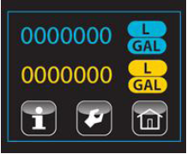
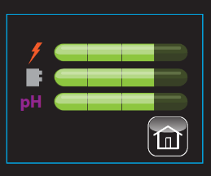
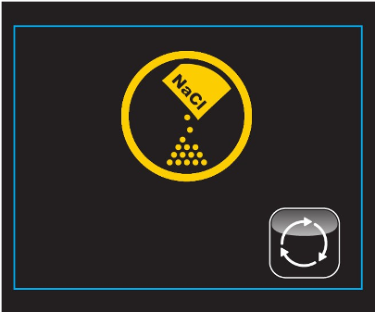
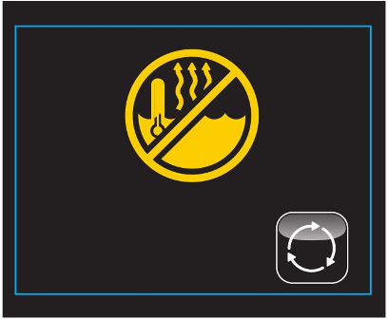
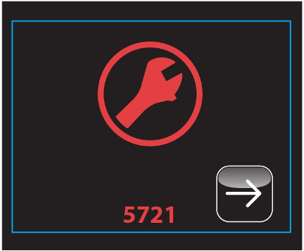
System indicators on GUI
Quantity Dispensed
Wear Components Status
Low Salt
Hot Water
Fault Condition

Slide 19
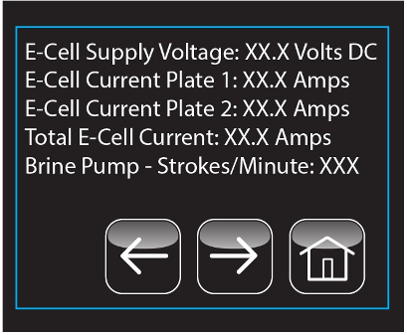
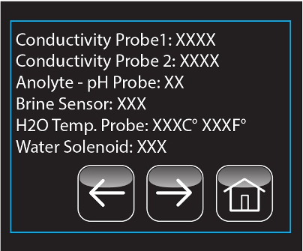
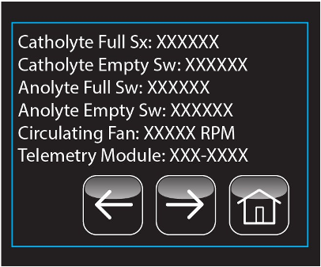
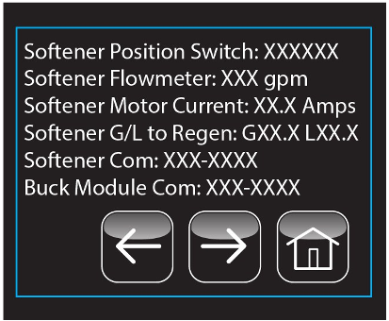
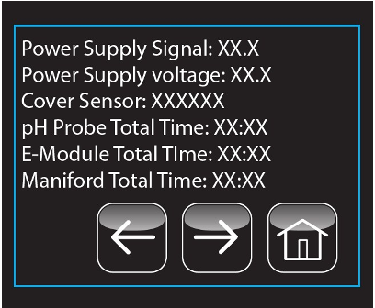
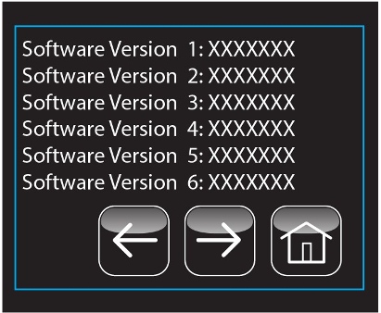
Service Diagnostics Screens

Slide 20
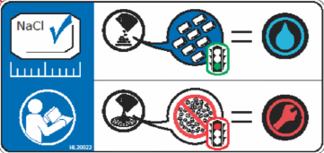
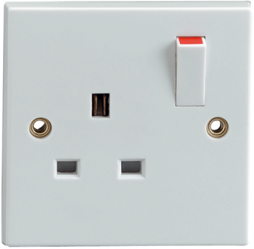
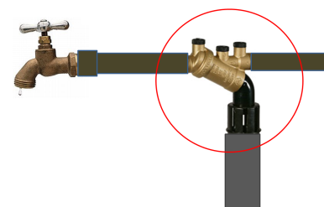
Consumables & Service
Pellet Salt
Electricity - 15A GFCI or Fuse Protected Circuit
Water - Tap (Cold) 30psi Minimum (with back flow prevention)
Allen Key Entry
Removable Front and Top Access Panel
Generator Component Access
Easy Component Replacement

Slide 21
os3 Maintenance
Notes:
Easy to maintain – The os3 has only three wear items and one consumable item. The three wear items are changed out very infrequently. These are:
pH Probe – Changed out annually, regardless of the amount of solution generated.
e-cell – Changed out every 36,000 Gal/136000 l of Multi-Surface Cleaner generated.
Manifold Module - Changed out every 120,000 Gal/450000l of Multi-Surface Cleaner generated.
Check P1 testing outcomes with Ronny for Service!

Slide 22
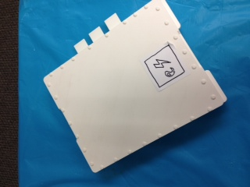
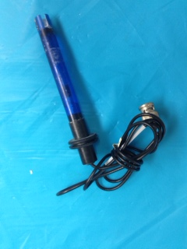
Aftermarket Wear Items
 | e-Cell Module | pH Probe
Purpose: | Electrolyzes inputs – salt, water | Senses pH
Change out frequency: | 4k hours/36K gallons of Orbio Multi-Surface Cleaner | Annually
Long Life Items
Brine Pump
Display Module
Control Board
Water Softener
Confidential - Tennant/Orbio

Slide 23
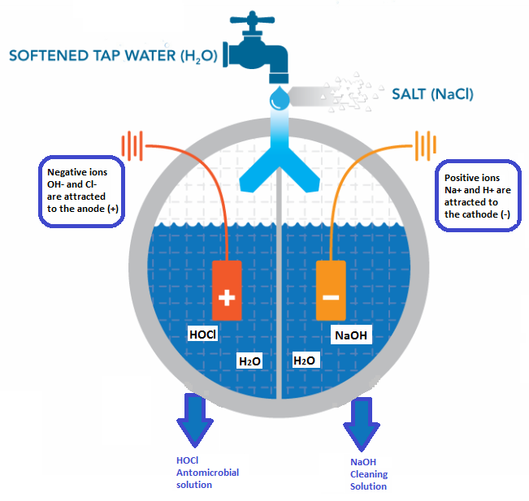
How does it work?
HOCl
Desinfection
Solution

Slide 24
Lead User VOC
+’s
“I like the pool smell”
“Blue and Yellow. It’s simple”
“My mops don’t stink”
“My mops are whiter”
“Grout stays cleaner”
“Wow, closet looks organized”
“Works great on carpet”
-’s
“Too much wiping on glass”
“My squeegee sticks”

Slide 25
os3 Strategy - Product - More markets, more applications, more chemicals replaced
Central Filling
Large Spaces
Cleaning Only
Central & de-centralized filling
Small/Medium Spaces
Cleaning AND Antimicrobial
5000-Sc
os3

